Slide 1
Workshop 13: Inclusive socialisation models for persons with disabilities
Vanessa Schembri
Sharing Lives Agency Sapport
#QualitySocialServices

Slide 2
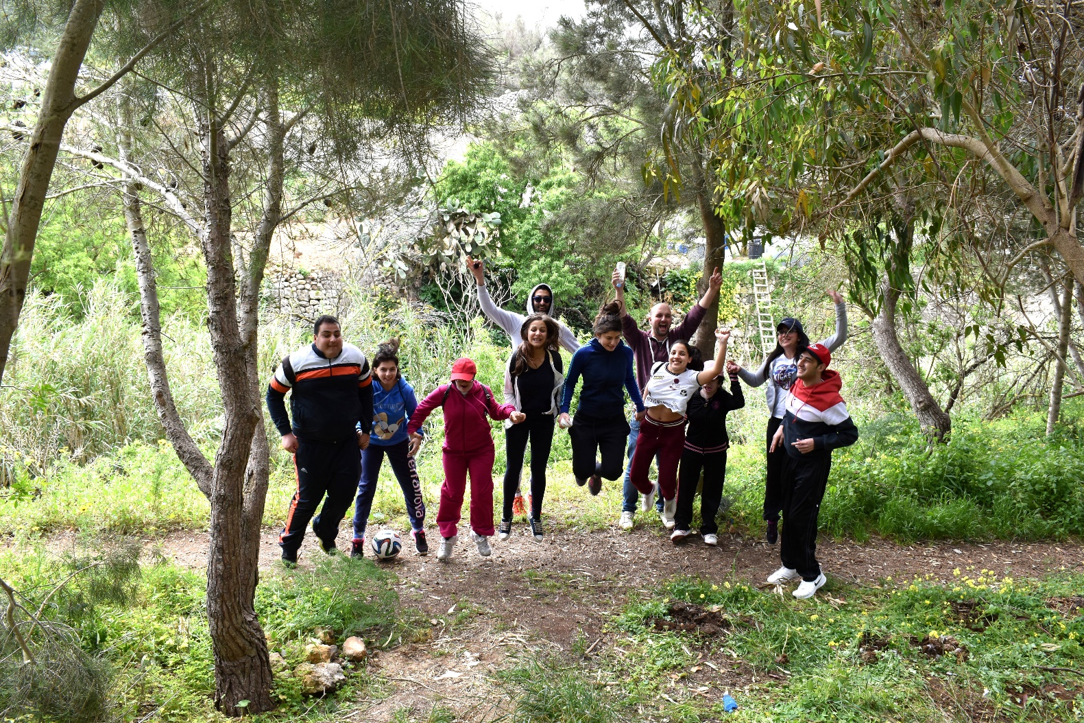
Sharing Lives Service
Sharing Lives is a service established in 2017.
It’s aims are:
To facilitate access to events / activities that persons with disability would not normally attend
To enhance the social support network of people with disability
To initiate dialogue and collaborations between people with disability and mainstream society
#QualitySocialServices

Slide 3
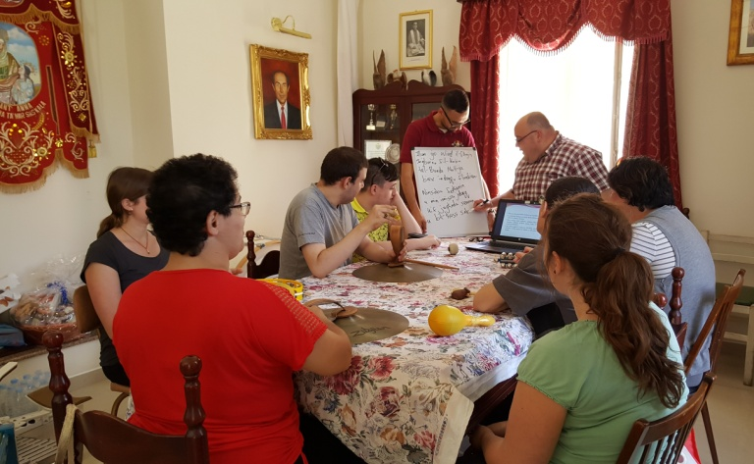
The Experiences We Offer
Leisure activities
Cultural activities
Sports activities
Arts, music and craft sessions
Youth groups
Social groups for Adults
Formative and self advocacy sessions
Voluntary work by the service users
#QualitySocialServices

Slide 4
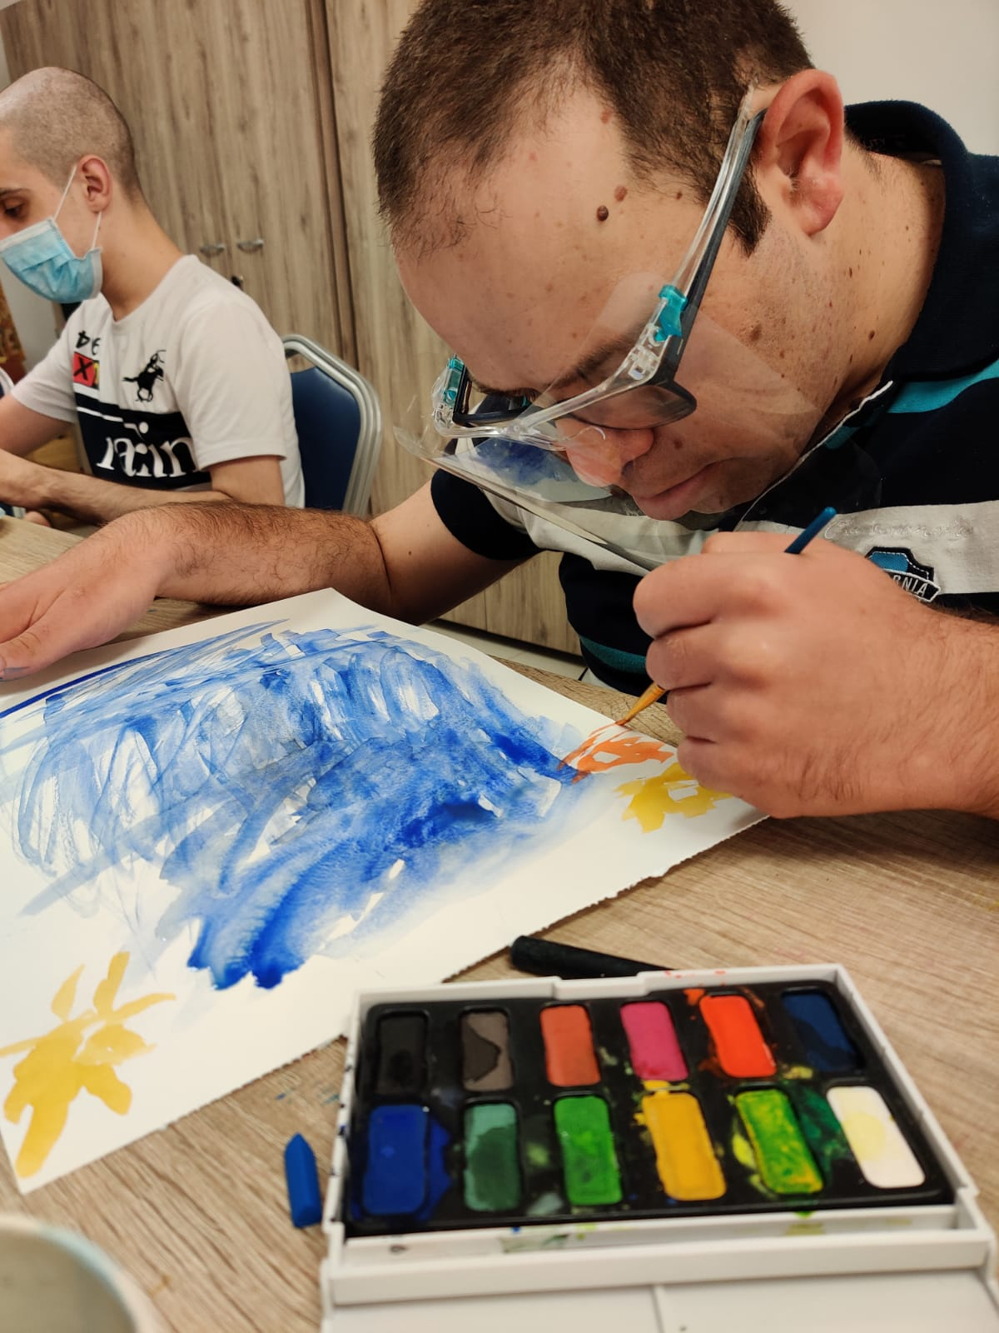
The Impact of the Service
Promote social inclusion, accessing activities in the community
Developing meaningful relationships and extending support networks
Act as a stepping stone for persons with disability to have access to more opportunities
#QualitySocialServices

Slide 5
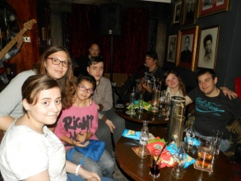
The Impact of the Service
Developing a relationship based on equality and collaboration
To facilitate the integration of persons with disability within the community
Creating awareness, challenging stereotypes and reduce stigma of persons with disability
#QualitySocialServices

Slide 6
The Structure of the Service
The service involves volunteers, service users and professionals coming together to work on unique programmes, projects and activities in a safe environment.
It taps on the resources in the community and the strengths, potential, passions of all involved.
This process creating spaces for creativity, collaboration, sharing and positive connections with other and the community.
#QualitySocialServices

Slide 7
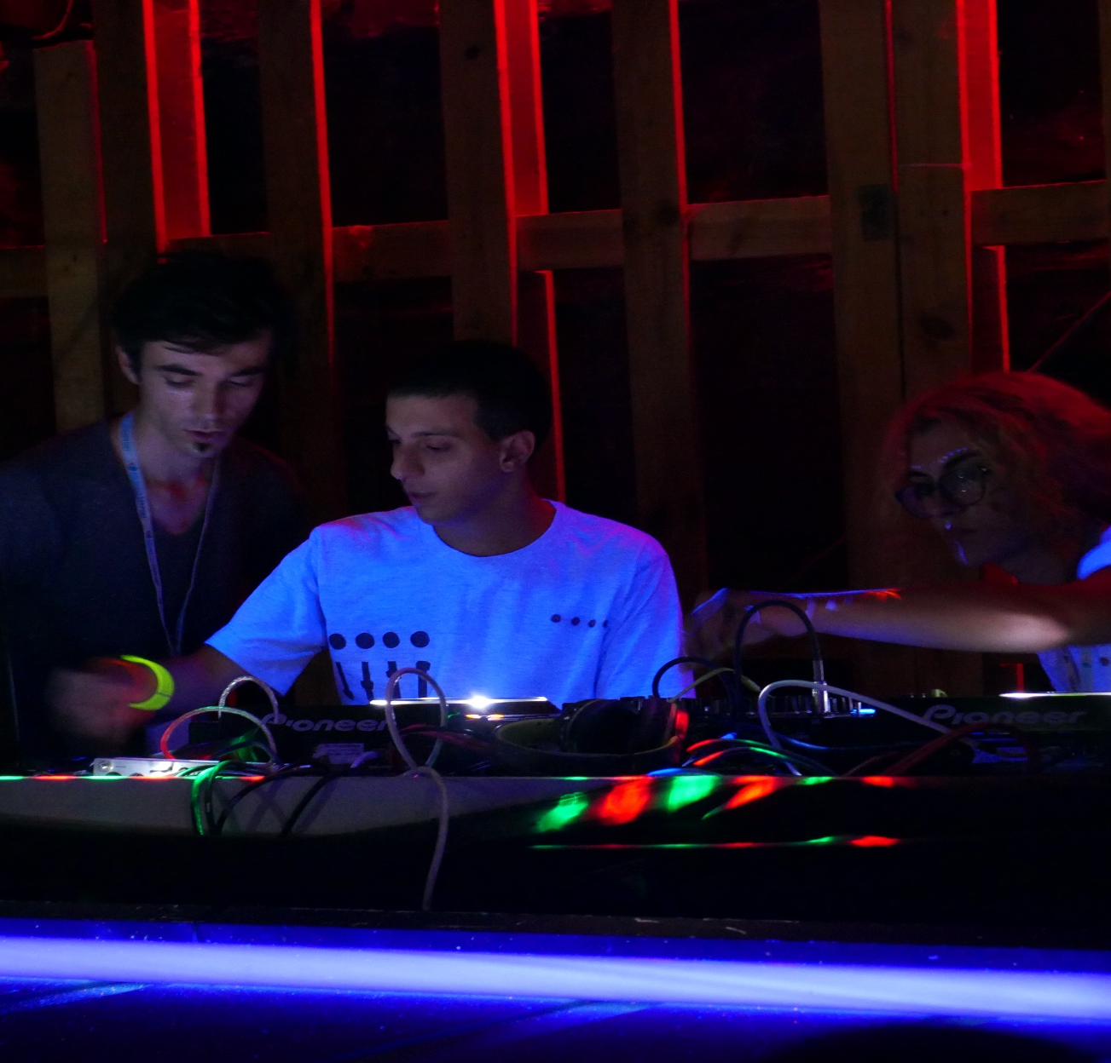
The Structure of the Service
Social Contact
A volunteer is matched with a service user providing regular and one-to-one support
Social Activities
A number of volunteers and service users participate together in an activity.
#QualitySocialServices

Slide 8
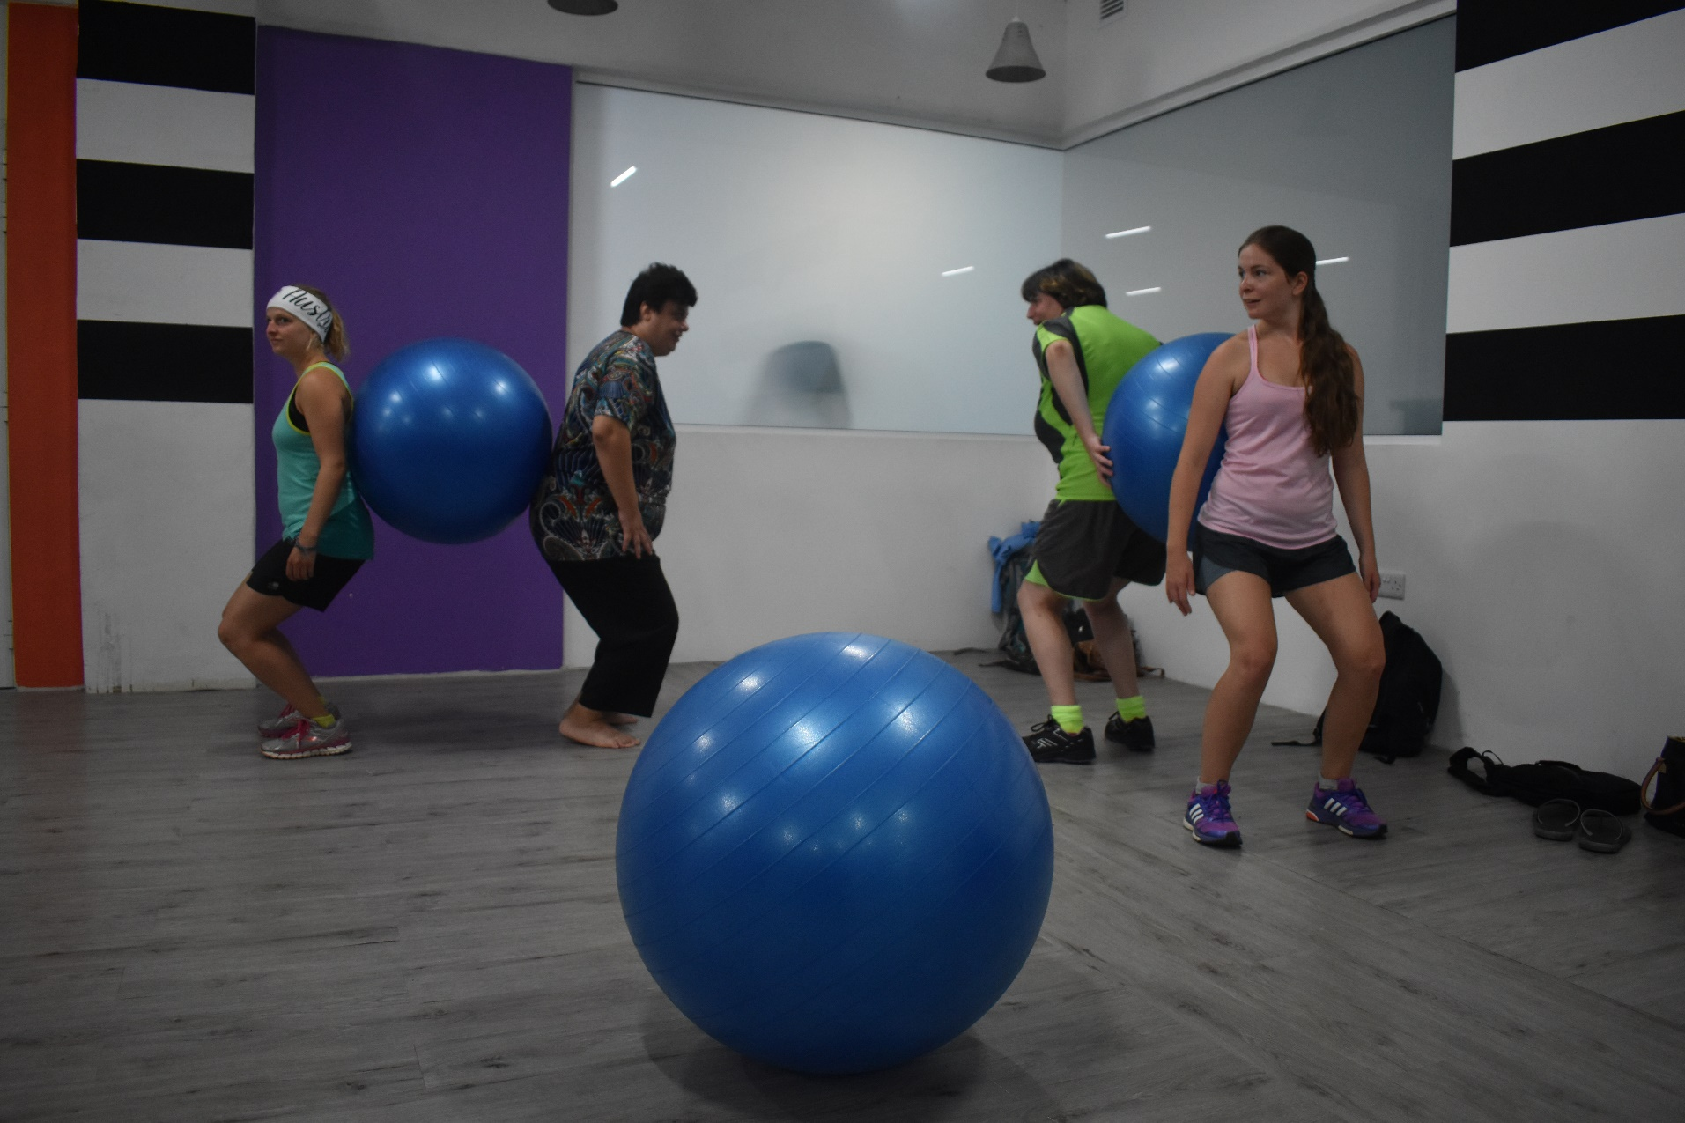
The Process
Referrals
Self referral or from other departments/organizations.
Waiting list
Assessment by professional
Consent forms
Access to activities
#QualitySocialServices

Slide 9
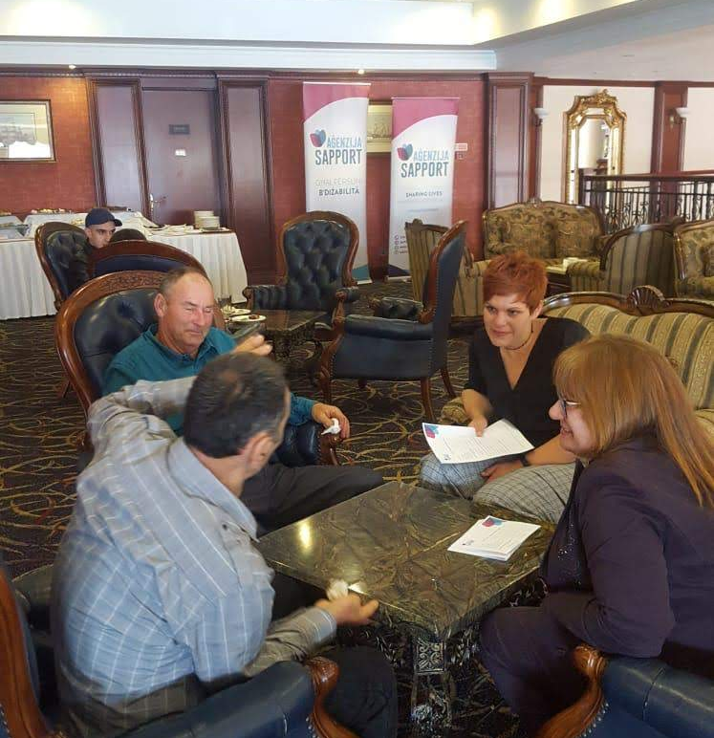
The Process
Recruitment of Volunteers
Submission of application & Police conduct
Interview
Continuous Training
Regular Supervision
#QualitySocialServices

Slide 10
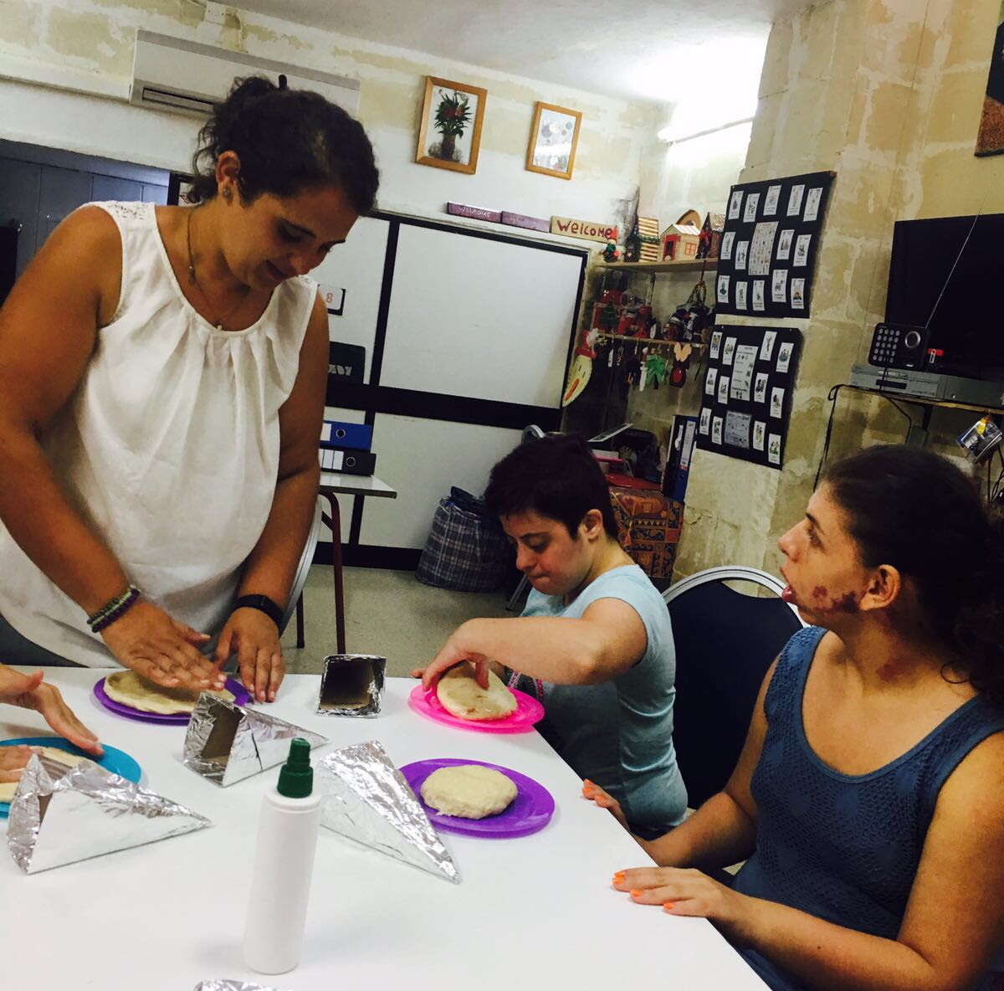
Testimonial
Keely Triganza,
35 years old, Chef, Malta
“ It’s not just the clients that gain from the experience, but everyone involved gets to share the joy just by sharing their time and experience.”
#QualitySocialServices

Slide 11
Thank you!
Agenzija Sapport
Patri Gwann Azzopardi str.,
Santa Venera,
Malta
T: +356 22568000
E: sapport@gov.mt
Url: www.sapport.gov.mt
#QualitySocialServices

