Slide 1
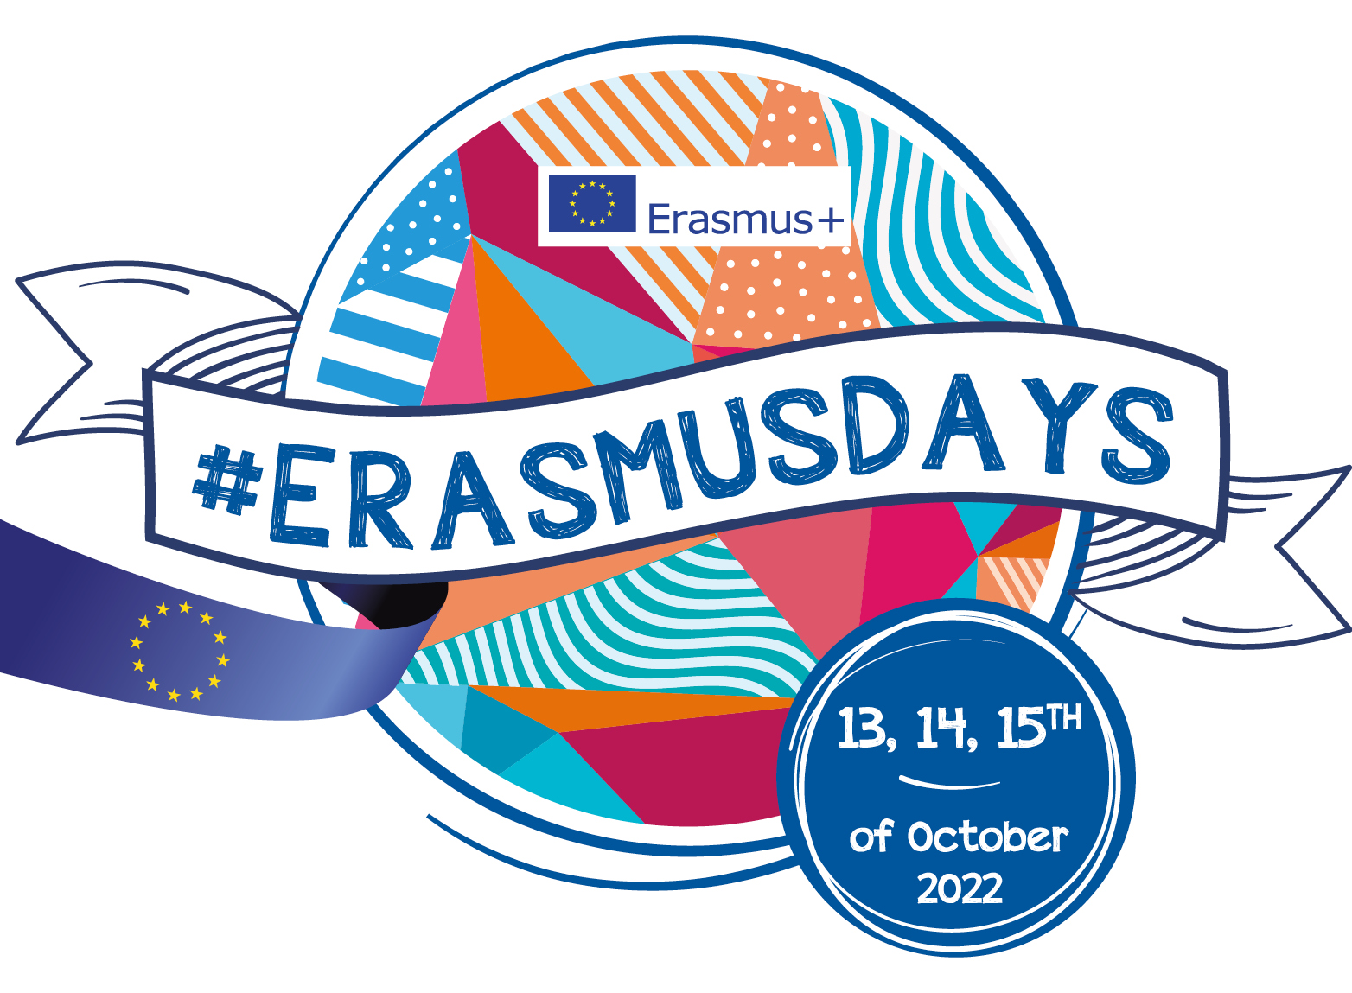
Workshop 13: Inclusive socialisation models for persons with disabilities
Enrica Chiara Cappadonna
#QualitySocialServices

Slide 2
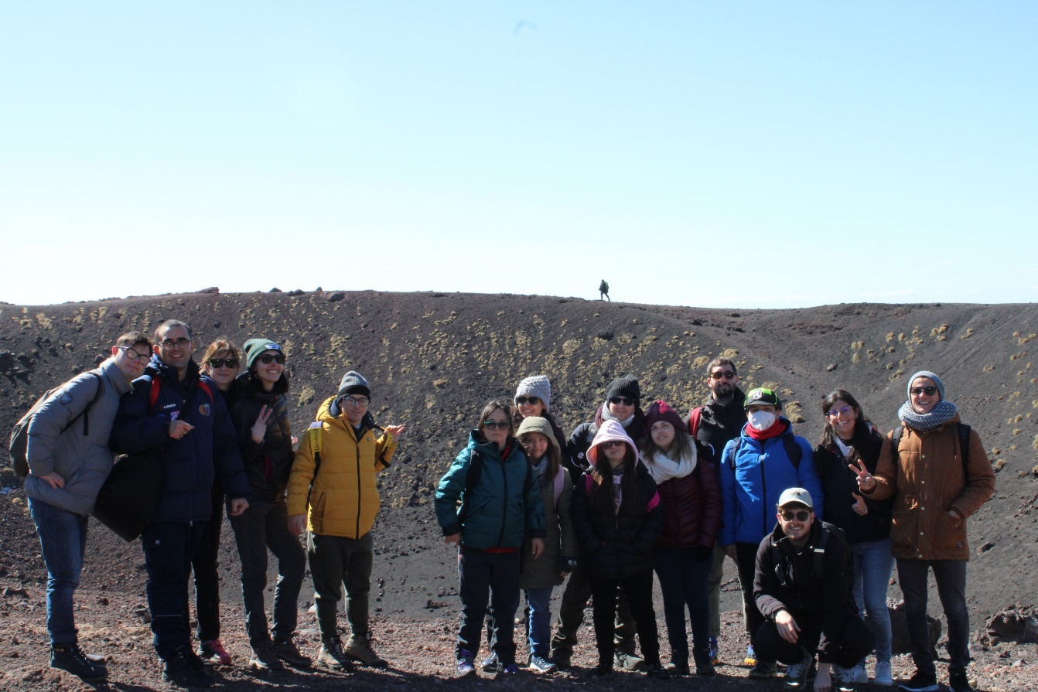
The Hi-Ability project
Hi-Ability wants to "open the doors to new spaces of education", promoting an education for autonomy, independent and inclusive life, in a context still not very accessible such as hiking and eco-tourism.
#QualitySocialServices

Slide 3
The Hi-Ability Specific Objectives
S01
Training the trainers
Development of educational materials and
Training courses for professionals working with people with disabilities to improve their skills in outdoor educational activities.
S02
Training people with ID as “assistants” to professional guides for outdoor tours
Development of personal and professional skills through a specific training course.
S03
A better accessibility through technological tools
Creation of an app to facilitate the participation of people with ID in outdoor activities .
S04
Definition of a European model
Development of policy recommendations and guidelines to facilitate the transferability of the model to all EU countries.
#QualitySocialServices

Slide 4
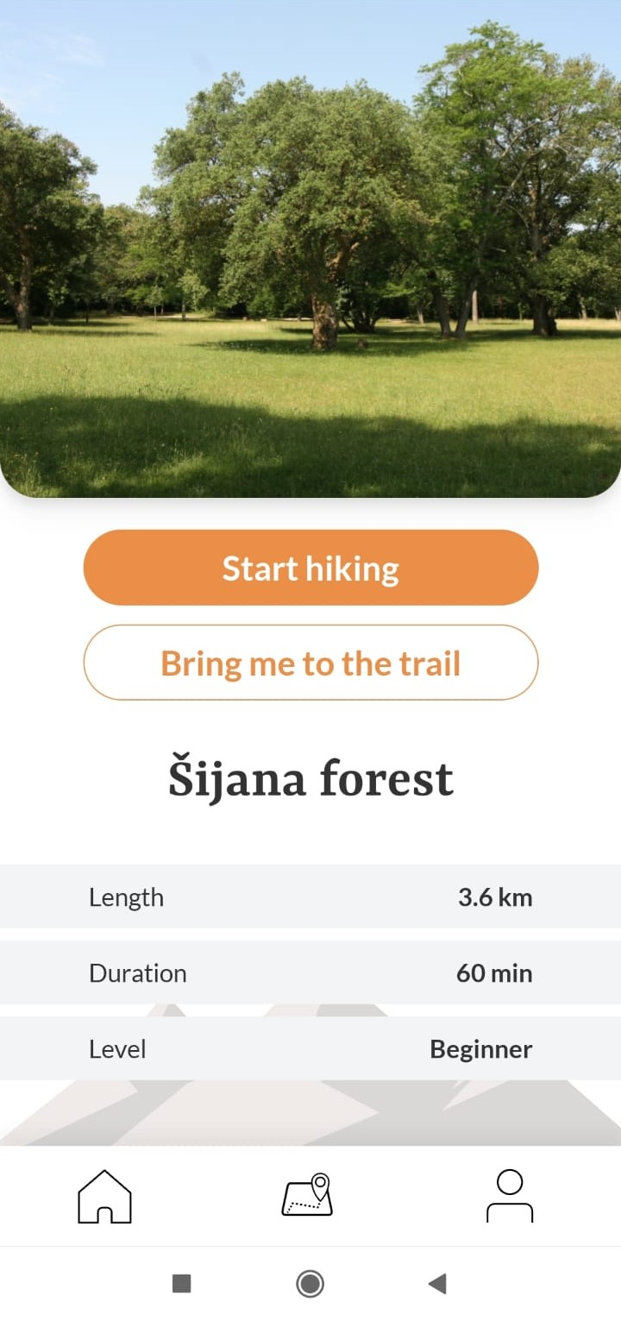
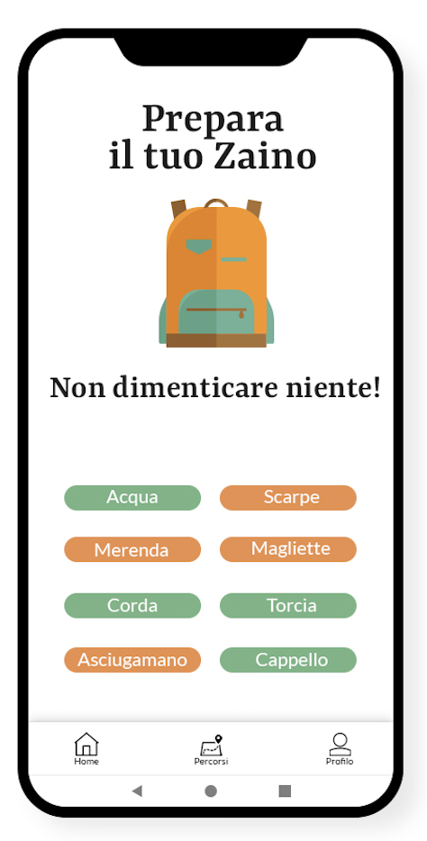
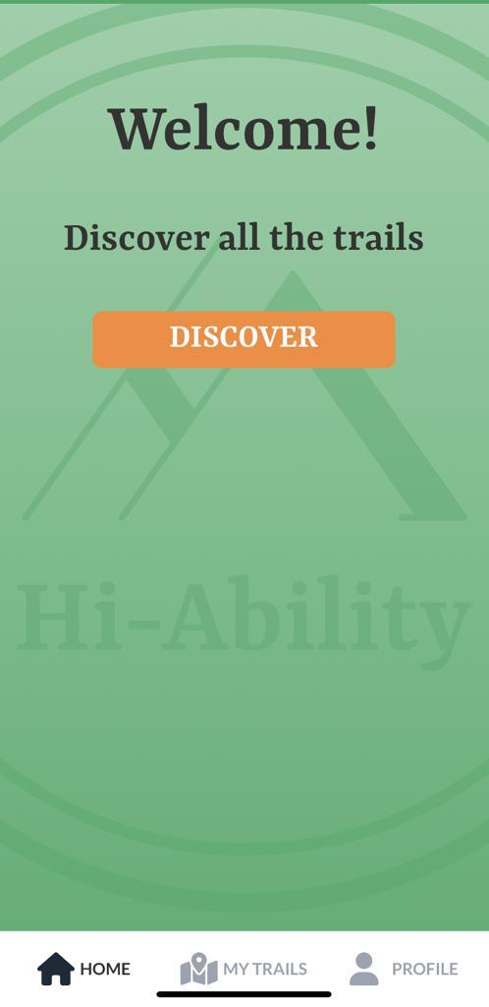
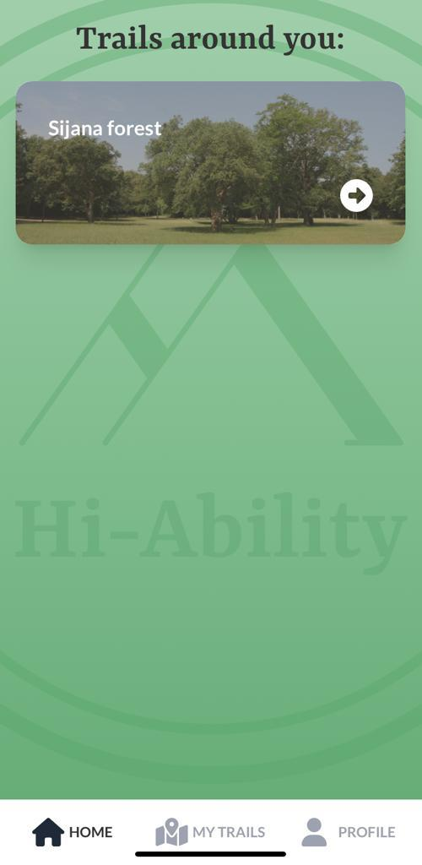
The Hi-Ability APP
#QualitySocialServices

Slide 5
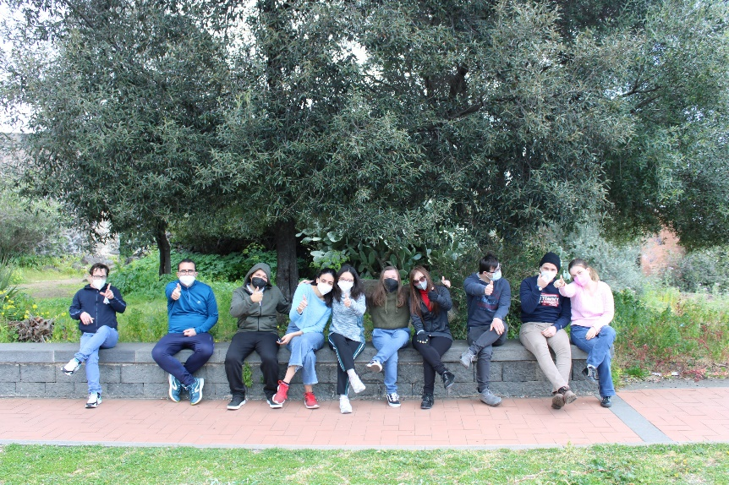
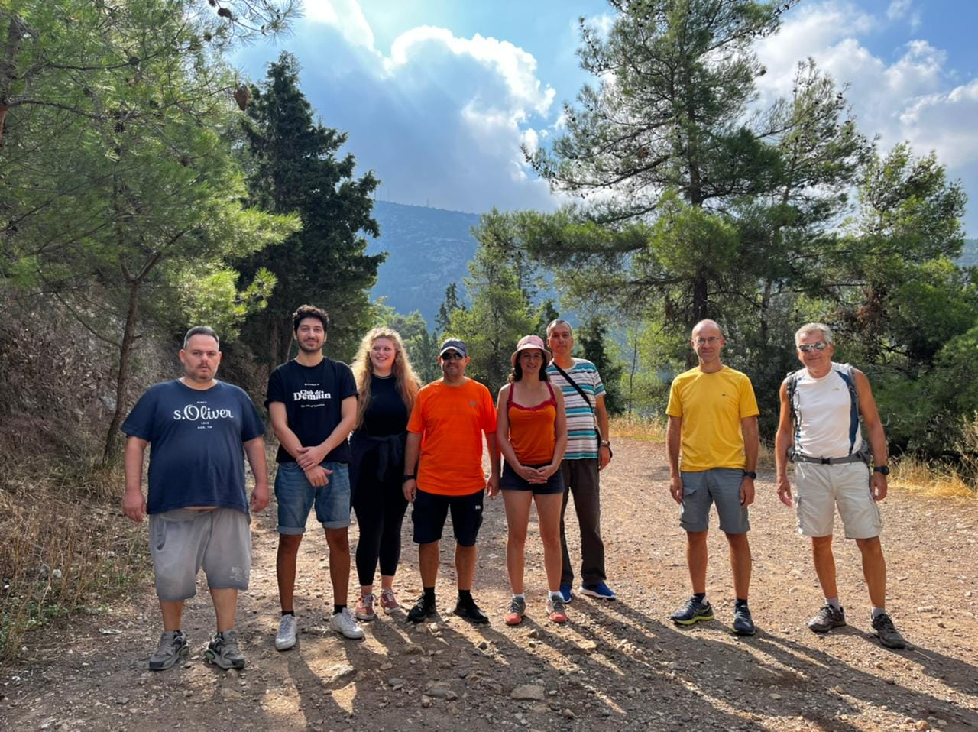
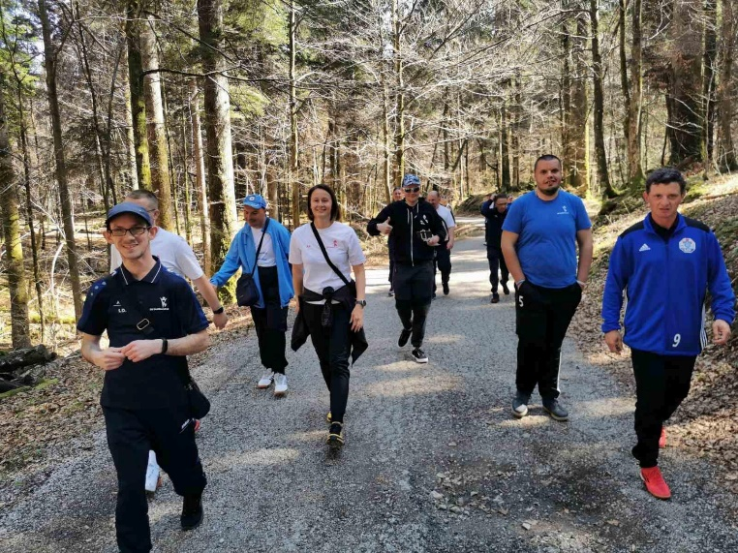
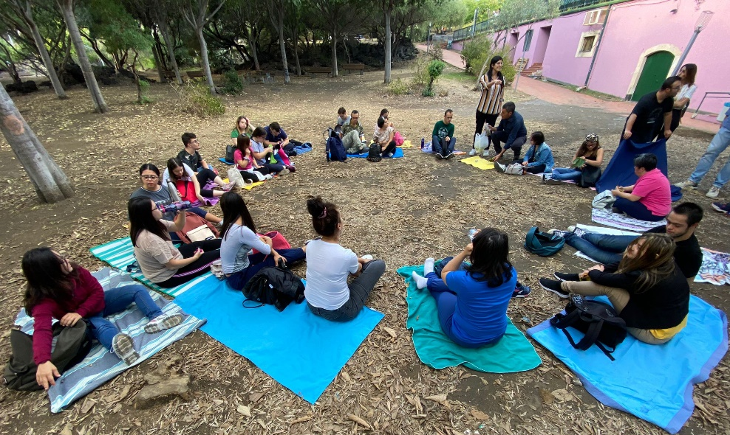
The Hi-Ability benefits for people with ID’s quality of life
Better sleep-wake rhythm
Motor skills
Physical fitness
Proactivity
Stabilization of emotions
New knowledge and skills Reduced oscillations in behaviour
Social skills and bonding
Communication skills
Sense of being part of a community
Teamwork
New employment opportunities
#QualitySocialServices

