Slide 1
Measuring quality in KVPS
Petra Rantamäki

Slide 2
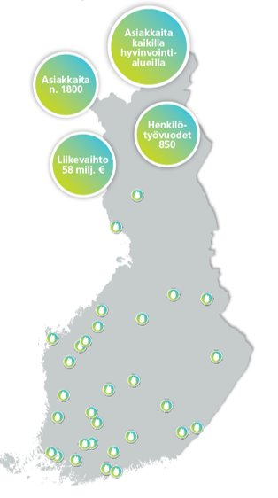
KVPS & KVPS Tukena Ltd - KVPS-group
Providing services, housing, support and activities all over Finland for persons with intellectual disabilities or similar support needs
KVPS was founded by Inclusion Finland in 1992
Promoting inclusion, equal opportunities and full citizenship
1800 service users
850 persons working/year
1300 homes in communities: individual apartments and apartments in group housing

Slide 3
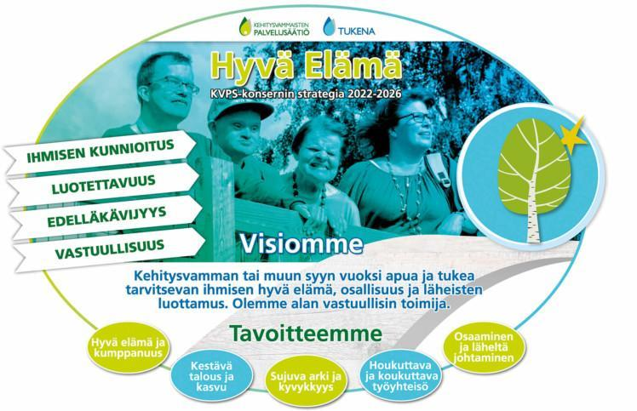
Quality & strategy
Quality is measured through our strategic goals
Strategic goals
Good life & partnerships
Sustainable economy & growth
Fluent everyday life, abilities & skills
Attractive work community

Slide 4
How do we measure quality in KVPS?
Tools
Customer surveys for the service users, family members & public authorities organising services
Internal and external auditing (ISO 9001 certification)
Tools for evaluating staff wellbeing
Impact evaluation tools
Individual service implementation plans
Everyday tools
Short surveys to service users about the everyday life important issues: making choices etc.
Direct feedback, documented to the web-based tool
Web-based tool for reporting customer and staff safety incidents
Collecting feedback every time we organise event etc.
Encounters, conversations, gestures, expressions, feelings..

Slide 5
Involving service users & beneficiaries
Individual service implementation plans
done & evaluated together with the service users
Customer surveys
done involving different customer groups
identified the factors that are relevant to the service user
survey questions were targeted at these factors
The results of the surveys are discussed in the services with the service users and family members
Development goals are selected based on the results of the surveys.

Slide 6
Continuous development
The quality processes are constantly developed based on the feedback
The data from the quality measurement processes is analysed in many levels
The goal is to improve the services and support, based on the results
Quality is done, measured and evaluated in everyday environments and as part of strategic evaluation.

