Slide 1
Workshop 12: Modernising human resources & organisational management
Mac MacLachlan & Cathal Morgan
#QualitySocialServices

Slide 2
Rights-Based Leadership and Governance
European Framework
Health System Building Blocks – Leadership & Governance
A Rights-based approach – the UNCRPD
A Tool to Measure this.
#QualitySocialServices

Slide 3
“The WHO European Framework for action to achieve the
highest attainable standard of health for persons with disabilities
2022–2030”
envisions that, by 2030, persons with disabilities will be fully included and considered in all health planning, delivery and leadership across the WHO European Region, leading to a disability-inclusive health sector and the promotion of the health and well-being of all persons, in order to achieve the highest attainable standard of health for persons with disabilities of all ages, ethnicities, and genders; and across the diverse contexts in the Region.
#QualitySocialServices

Slide 4
4 Framework Principles
1. Human rights: Persons with disabilities should enjoy the same rights to health, employment, education and all other areas of life on an equal basis with others.
2. Universal design: The built environment, health equipment and products, and all health services need to be accessible and usable by all people.
3. Life-course: The needs of persons with disabilities should be fully considered across the life course.
4. Health systems: Actions need to be developed to ensure that disability inclusivity is integrated in the six building blocks of health systems: (a) service delivery, (b) health workforce, (c) health information systems, (d) access to essential medicines (and for people with disability especially assistive technology products), (e) financing, and (g) leadership and governance
#QualitySocialServices

Slide 5
Our literature review and argument focuses on four themes.
1. Persons with disabilities must have accessible information about and access to the services they need.
2. People with disabilities must be central to and involved in the leadership and governance of health services.
3. Persons with disabilities have the right to have their health services provided through the most effective mechanisms of service delivery, and especially the most effective ways of teamworking across multi- and inter-disciplinary teams.
4. People providing services have a right to work in psychologically safe environments, where they feel valued, have opportunities to share leadership of teams, have secure and fulfilling employment, feel empowered to question each other and to advocate for the rights of service users.
Fortunately, all four of these aims can not only be achieved, but each will reinforce the other, when services are designed from a rights-based perspective.

Slide 6
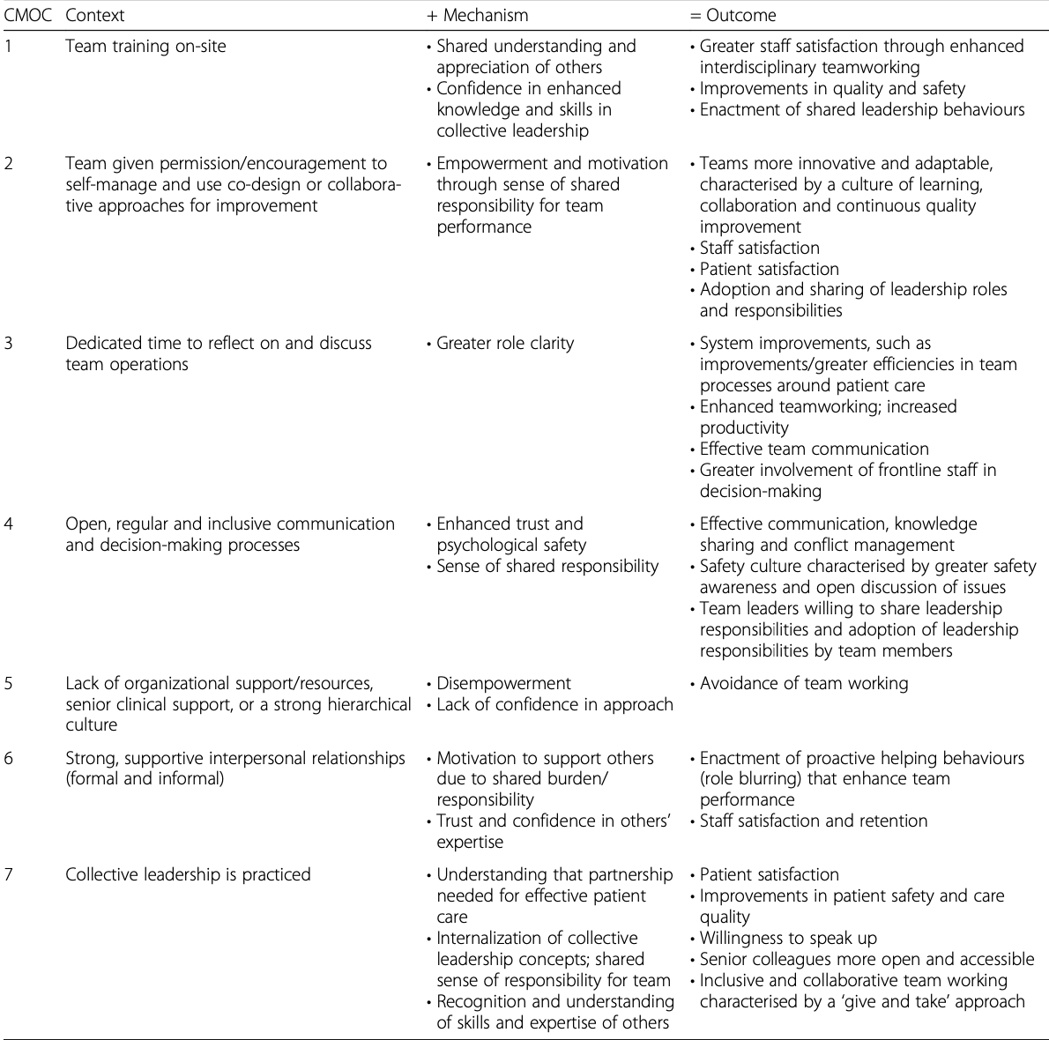
Point 3: De Brún, A., & McAuliffe, E. (2020). Identifying the context, mechanisms and outcomes underlying collective
leadership in teams: building a realist programme theory. BMC Health Services Research, 20(1), 1-13.
#QualitySocialServices

Slide 7
Exercise Instructions
You have been given a double-sided page which identifies a rights-based services issue, indicates a problem statement and suggests an outcome that could be associated with successfully addressing it.
This is an anonymous exercise, unless you want to identify yourself by giving contact details.
You only have 15 minutes
4. First individually read the handout, then form groups with those sitting close to you and identity 3 questions or issues that you may consider to be problematic and make suggestions for improving them.
5. At the end of the exercise we will ask for the same page back from each of you (feel free to photoshoot the sheet if you wish to).
6. Please use the space at the bottom of the page to comment or suggest new questions or ideas.
If you have any ideas you want to share after this workshop please e-mail them to to:
Anastasia.Campbell@mu.ie with the subject line ”Additional Feedback from EASPD Conference”

Slide 8
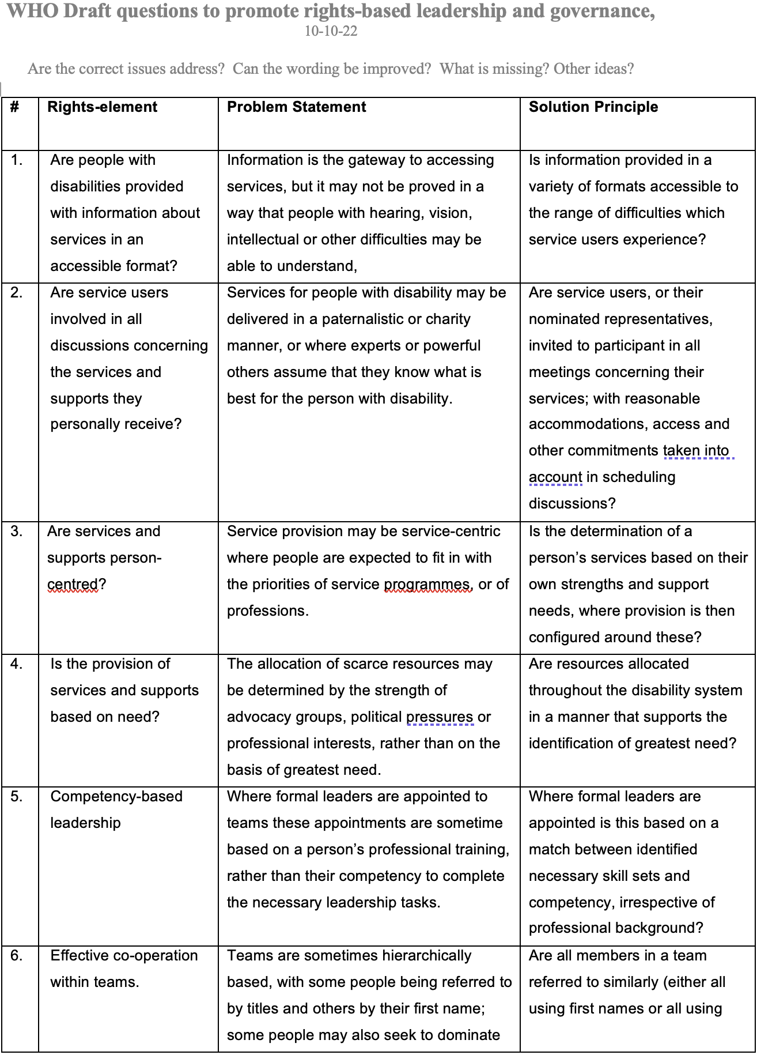

Slide 9
