Slide 1
A pathway towards resourceful network of ECI services in Serbia
Snežana Ilić
Associate professor in Special education
MoH Special working group on ECI
#FamilyCentredECI

Slide 2
Intersectoral approach – increasing resourcefulness and efficiency in service provision
Health system primary health care, pediatrics and developmental counselling units
Pre school education inclusive education
Child protection case management and social services
New model defined based on situation analyses – implemented from 2019 (5 pilot and new 14 locations, covering 60% of all districts), USA, Portugal, EURLYAID
For families of children 0-6/7 years of age
More than 2700 children (1526 boys), 300 intensive ECI support
Providers: Inter-sectorial, transdisciplinary teams from local public services, relying on existing human and organizational resources (psychologists, speech therapists, special educators, pedagogues, social workers, nurses/pre-school teachers)
Model: Family centered, home-based and pre-school-based provision is prioritized, however teleworking modalities are included as well as center-based support
#FamilyCentredECI

Slide 3
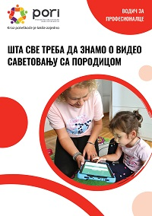
Quality and standards of care
Model: early detection by parents, papedaitritians and home visiting nurses (ASQ), functional assessment (Eco Map, RBI, AEPS), development of IFSP, 6 months evaluation, transition; intensity of support varies due to insufficient workforce – from weekly to bi-weekly/monthly
Financing: As part of existing services, in accordance with the existing legislation, free of charge for parents, case load not aligned to the needs, insufficient workforce and geographical distribution
full scope and coverage of ECI is dependent on the changes in health and education regulation
Standards: partially defined as part of existing standards of each sector engaged, new professional guideline and standards under development
#FamilyCentredECI

Slide 4
Professional development
Capacity building: In service training package and supervision over 6 months; horizontal exchange; Pre-service courses and specialization in ECI on Special education faculties
13 trainers, 3 supervisors from academia, more than 500 trained professionals involved/trained, of which app. 200 primary service providers
Acredited training courses by health and social welfare; addtional education materials (online self-paced modules, digital and hard-copy)
Additional components: Caregiver Skills Training for groups of parents (CST); Assistive technology - C board etc.; specialized capacities of professionals
„We experienced a transformation - at the level of the institution and at the personal level. New perspectives have opened up for us, we ourselves have changed - and there is no turning back for us “ – Team from Kragujevac
#FamilyCentredECI

Slide 5
Serbian Government
MoE
MoH
MoSW
MoFamily
Academia
Parents associations
Media
National institutions (e.g IPHS, IMH)
Centar for ECD and Inclusion
In every district to support every local community
LOCAL ECI Team
LOCAL ECI Team
LOCAL ECI Team
LOCAL ECI Team
LOCAL ECI Team
PHC/DCU
PHC/DCU
PHC/DCU
PHC/DCU
PHC/DCU
PSI
CSW
PSI
CSW
PSI
CSW
PSI
CSW
PSI
CSW

Slide 6
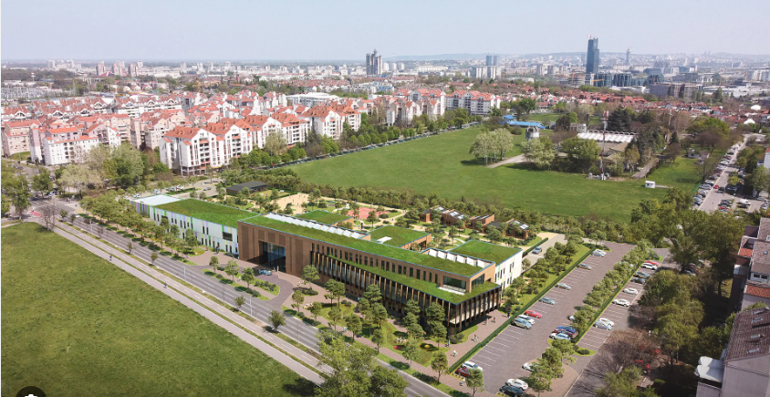
Activities of the Centre
Provision of (health-socio-education) services in accordance with the work programme of the Centre
Training and supervision of experts and practitioners in the field of early childhood development (national and regional) including university students
Research activity in the field of early childhood development
Coordination and mentoring of the early intervention (ECI) teams, coordination with institutions and services on the ground, and the Info centre and early intervention user navigation
Proposing the definition of integrated early childhood development policies and keeping the Register of Children with Disabilities and analytics resulting from that process
Information and promotional activities - a creative support and social media team – citizens’ education and awareness raising of the importance of ECI, early childhood development and inclusiveness (including information platforms)
#FamilyCentredECI

