Slide 1
European Care Certificate
The European Care Certificate has established a transnational system for the recognition and implementation of an entry level qualification for care staff
James Churchill
Director SCT
EASPD Conference Malta 2022

Slide 2
What is the European Care Certificate (ECC)?
A basic entry certificate in the care sector recognised and accepted across Europe.
Formally approved in the UK at Level III on NQF & in other countries in different ways
A way to provide evidence that the holder of the licence has a basic knowledge of working in the care sector.
Notes:
The ECL is being developed as a basic entry certificate in the care sector that we hope will become recognised and accepted across Europe. It is a pilot project running until September 2008 funded through the Leonardo Da Vinci funding stream of the European Commission.
The ECL will provide employers with evidence that the holder of the licence has a basic knowledge of working in the care sector. It will cover the knowledge for workers starting out in the care sector and could be delivered through work-based training, a single short course or as part of a larger and/or longer course.

Slide 3
Why is the ECC needed?
Shortages of care staff that is leading to an increase of foreign workers in the sector.
Significant number of unqualified workers who are currently working across Europe.
No common European understanding about the entry level needs of workers.
Opportunity to benchmark basic knowledge outcomes for the care sector for the benefit for those who use care services.
Notes:
In many European Countries there are shortages of care staff that is leading to an increase of foreign workers in the sector. There are also a significant number of unqualified workers who are currently working across Europe but, contrary to many other professions, there is no common European understanding about the entry level needs of workers. The ECL project is an opportunity for countries to benchmark basic knowledge outcomes for the care sector for the benefit for those who use care services.

Slide 4
The ECC has…
Addressed gaps in the fast growing care sector and promote workers’ mobility across Europe;
Established a database for frontline care staff across Europe holding the Certificate
Provided an accessible and transferable certificate for workers and employers.

Slide 5
The ECC - Partners
The Board of the ECC is composed of organisations from Austria, Czech Republic, Greece, Hungary, Germany, Italy, Portugal, Belgium, Poland, Cyprus, Slovenia, & the United Kingdom.

Slide 6
Basic European Social Care Learning Outcomes
BESCLO - covers 8 areas
The Values of Social Care
Promote Life Quality for the individuals you support
Working with Risk
Understand your role as a care worker
Safety at work
Communicating positively
Recognise & respond to abuse & neglect
Develop as a worker
1) Values of Scoail Care

Slide 7
ECC exam covers the 8 BESCLO areas
Can be taken on-line or in paper format
Multi-choice 96 questions chosen from a larger ‘question-bank’ = 12 per BESCLO area
Wrong answer = -1 Correct answer = +1
No answer = 0
Passmark is +70 AND you must score at least +2 in each BESCLO area
1) Values of Scoail Care
-96
All
wrong!
+96
All
right!
Passmark +70

Slide 8
ECC exam
Why is passmark so ‘high’? – this is all essential knowledge. Ask yourself - Would you want to employ (or work with) anyone who got things so wrong in any area that they could not score +2 or more?
Pass rate in the ECC exam is around 75%
Central register kept in Brussels of all who have sat the exam & hold the ECC
EC Certificate lists the 8 BESCLO areas
By 2022 over 9,000 people now hold the ECC
Exam available in many languages
‘Lead partner’ system in each country
Cost of exam varies in each country
1) Values of Scoail Care

Slide 9
ECC 2022 update
ECC has new url www.europeancarecertificate.eu and and new website
In addition to the face-to-face taught course we will soon have an online version of the ECC training course – a MOOC – massive open online course.
Access to it will be free. We aim to provide it in as many languages as possible.
Lead Partners will still be able to offer online and paper versions of the ECC exam.
Want to link the ECC to new ideas in EC’s developments in Quality Framework for Social Services
1) Values of Scoail Care

Slide 10
ECC any questions?
Ask Akos the Chair of the Board of the ECC
Ask Zoé at EASPD who is the ECC Registrar
Ask James, who has been involved in it from the start.
1) Values of Scoail Care

Slide 11
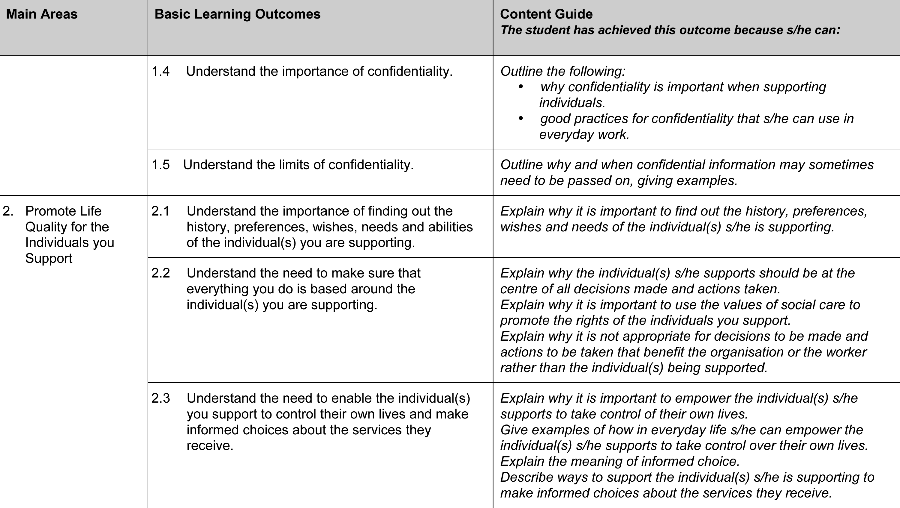
ea
Each BESCLO area has learning outcomes & key knowledge

