Slide 1
HELPDESK
The Helpdesk Project Social Services Helpdesk on EU Funds
Presentation by Lilith Alink – Policy and Project Officer, EASPD
SESK – Social sErviceS helpdesK on EU Funds
Project number: 101052902

Slide 2
The Helpdesk Project What is it?
Project funded by the European Commission
From May 2022 – April 2024
Consortium of 16 partners: European networks and national organisations
Representing all kinds of social services, as well as public authorities
Launching the building blocks of a Social Services Helpdesk

Slide 3
The Helpdesk Project What is it?
By launching the building blocks of a Social Services Helpdesk, the project aims to:
Support Social Services in accessing and using EU funds (in particular ESF+ and ERDF)
Help Managing Authorities use EU funds to finance quality interventions in the field of social services.

Slide 4
The Helpdesk Project Why do we need it?
The need for care and support in the EU is growing (because of the aging population, growing inequalities, etc.)
Social services play a crucial role in providing care and support, but face multiple difficulties such as staff shortages, chronic underfunding, and challenges in transitioning to community-based and person-centred forms of services
EU funding can help to address these challenges, support services, and thereby support Europeans who need it most.

Slide 6
Barriers Social Services and Managing Authorities
Social Services
Possible barriers: finding the right calls, building a partnership, writing a proposal, reporting, financial requirements, etc.
Managing Authorities
Complexity, what projects to fund, administrative burden, a focus on employment projects, etc.

Slide 7
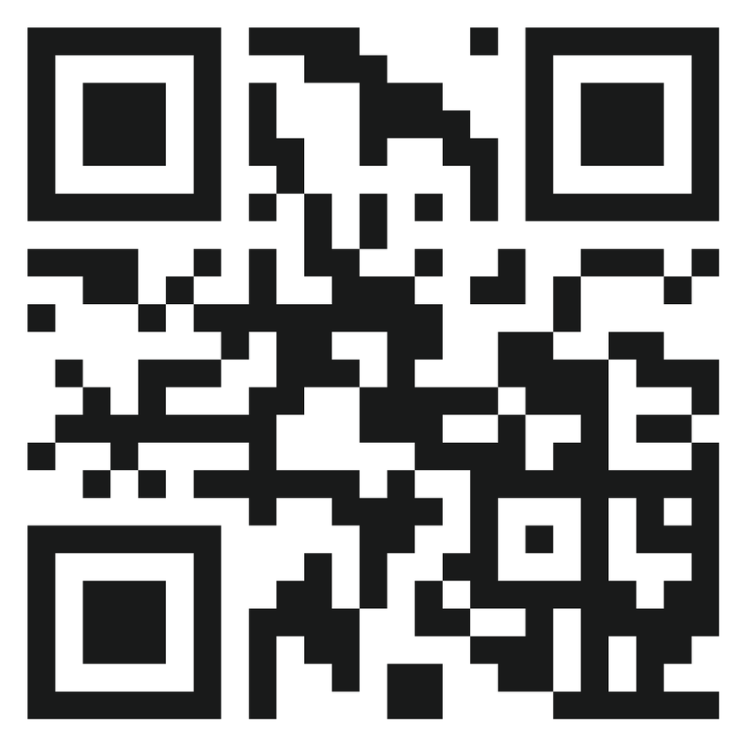
Phases of the Project 1. Evidence Gathering
Getting better insight in the barriers through a Survey: 1 for Service Providers and one for Managing Authorities. https://www.helpdesk-survey.eu/
10 National events in Sweden, Greece, Bulgaria, Slovakia, Czech Republic, Ireland, Austria, Spain, Belgium and Italy. To take place in October/November.

Slide 8
Phases of the Project 2. Knowledge Sharing
The Helpdesk Website
The actual Helpdesk
Massive Open Online Course
Example of Helpdesk Website

Slide 10
Phases of the Project 3. Facilitation
Toolkit on Facilitating ESF+ & ERDF for Social Services
7 Cross-sectoral Facilitation Workshops
15 Thematic Facilitation Workshops (themes are: child protection and families in poverty, disability, older persons with long-term care needs, poverty and homelessness, and work integration)
The toolkit will include templates and tools which should reduce the technical and administrative burden for Managing Authorities & Social Services

Slide 11
Phases of the Project 4. Policy Guidance
Technical Guidance on Effective Interventions in Social Services
3 Cross-sectoral Policy Workshops
10 Thematic Policy Workshops (themes are: child protection and families in poverty, disability, older persons with long-term care needs, poverty and homelessness, and work integration)

Slide 12
At the end of the Project We hope…
To have produced 30 Deliverables;
To have achieved our goal of making EU funds better accessible for social services;
To have set up a plan to turn the project into a longer-term Helpdesk.

Slide 13
“Funded by the European Union. Views and opinions expressed are however those of the author(s) only and do not necessarily reflect those of the European Union. Neither the European Union nor the granting authority can be held responsible for them”
THANK YOU!
Lilith Alink – Lilith.alink@easpd.eu
Fabiana Scarano – Fabiana.Scarano@easpd.eu
Thomas Bignal – Thomas.Bignal@easpd.eu

