Slide 1
#QualitySocialServices
Welcome!
We will begin shortly

Slide 2
Keynote Speaker
#QualitySocialServices
Jan Šiška
Associate Professor, Faculty of Education,
Charles University

Slide 3
Background of the study
This research was commissioned in 2021 by The European Association of Service Providers for People with Disabilities (EASPD) in response to the new European Strategy on the Rights of Persons with Disabilities 2021-2030.
The EU strategy includes the aim of developing a European Framework for Social Services of Excellence for Persons with Disabilities by 2024

Slide 4
Aim of the study
The main aims of the study:
provide an overview of frameworks used for measuring the quality of services for persons with disabilities and
identify a list of indicators of service quality, with a particular focus on those which are:
outcomes-based
focused on the quality-of-life concept
aligned with the UN Convention on the Rights of Persons with Disabilities.

Slide 5
Methods
Literature review to identify: Frameworks used to measure service quality and Indicators of service quality, with a particular focus on outcomes but not omitting processes and inputs
Country templates completed by local “experts” – focus on both formal systems (in law) AND informal “voluntary” frameworks
Consultation
Notes:
(126 publications were identified for initial review)

Slide 6
Key findings from lit. review and country template analysis
Most common way of conceptualising service quality in the research literature was in terms of STRUCTURE – PROCESS – OUTCOMES (Donabedian’s model)
In seven out of the 12 focal countries there was a system or framework related to the quality of services set out in legislation. The focus of such systems tended to be primarily on processes and practices, rather than outcomes.
Many different conceptualisations of outcomes - most commonly defined in terms of “quality of life”/1/ but not always clearly specified or operationalised – left up to service providers to interpret.
In some countries, there are several different (and sometimes competing) frameworks for measuring outcomes.
Literature on outcomes-based measures is most likely to be found in the intellectual disability field.
Notes:
More research on health than social services/social care
Countries vary in terms of whether the focus is on compliance or whether there are definitions of good/excellence.
/1/ “Quality of life” is conceptualised in different ways in different countries or by different researchers – e.g. in terms of personal outcomes; in terms of primarily emotional well-being; to mean satisfaction; primarily as a metric for measurement. In some countries a Quality of Life Framework is not used at all – for example, in Scandinavia, the focus is on “Living Conditions”.

Slide 7
Innovative frameworks and tools identified
Framework/tool
Bigby et al. (2014, Australia)
The Quality Cube (Netherlands)
ASCOT – Social Care related quality of life (UK and internationally)
Changing our Lives Quality of life Standards (UK)
Social Services Quality Standards (Czechia)
Personal Outcomes Measure (USA and internationally)
National Quality Forum framework (USA)
National Core Indicators (USA)
Home and Community-based Services Outcomes (USA)
National standards for residential services for children and adults with disabilities (Ireland)
Quality of life Outcomes Domain Framework (Ireland)
EQUASS (Europe)
Guidance on a Human Rights-based Approach in Health and Social Care Health Services. By Health Information and Quality Authority (Ireland)
National longitudinal Transition Study (Shrogren et al) USA
Standards New Zealand Health and disability services standard NZS 8134: 2021
Quality of life impact of services tool (QOLIS) (Europe)
Siska et al. (Czechia)
National Standards for Disability services (Australia)
NDIS Practice Standards and Quality Indicators (Australia)
Person-centred advocacy, vision and education (USA)
We identified and mapped 20 tools and frameworks from across the globe that included some element focused on outcomes
Mapped them to the Schalock et al QoL dimensions

Slide 8
Framework/tool (exampl.) | Mapping the Frameworks into Quality of Life domains
 | Personal development | Interpersonal relations | Rights | Social Inclusion | Self-determination | Material well-being | Physical well-being | Emotional well-being
ASCOT – Social Care related quality of life | ✓ | ✓ | ✓ | ✓ | ✓ | ✓ | ✓ | ✓
Changing our Lives Quality of life Standards | ✓ | ✓ | ✓ | ✓ | ✓ | ✓ | ✓ | ✓
The Quality Cube | ✓ | ✓ | ✓ | ✓ | ✓ | ✓ | ✓ | ✓
Personal Outcomes Measure |  | ✓ | ✓ | ✓ | ✓ |  |  | ✓
National Quality Forum framework | ✓ | ✓ | ✓ | ✓ | ✓ | ✓
National Core Indicators | ✓ | ✓ |  | ✓ | ✓ | ✓ |  | ✓
Home and Community-based S.Outcomes | ✓ | ✓ | ✓ | ✓ | ✓ | ✓

Slide 9
Looking at outcomes not enough on its own
Need to consider processes and structures in order to understand and improve outcomes.
We took this literature and the wider literature on service quality and what has been found to be important….
and summarised it in a model, using some of the headings already existing in measures of quality such as SERVQUAL Framework.

Slide 10
Consultation
Draft list of indicators were sent to:
Members of the EASPD task force
Other service providers in different parts of the world
Academics
Representatives of disabled people’s organisations
Feedback was systematically analysed and used to revise the indicators
Final set of indicators

Slide 12
Final set of outcome indicators – some examples
Outcomes at the level of an individual
Quality of life domain | Self-reported indicators - what we would like the people in receipt of services to say? | Objective indicators – what would we see and hear?
Personal Development (including meaningful occupation) | I can learn new skills and knowledge and become more independent - at home, at school or college, at work and in the community. | Individuals participate in new activities and experiences. They receive just enough help and support to experience success and therefore to develop their skills.
Interpersonal relationships | I feel staff understand me and what I need and like | Interactions between staff and those they support are observed to be warm and respectful. Staff appear to enjoy working with individuals.

Slide 13
Other outcome domains at the level of an individual
Quality of life domain | Some examples of Self-reported indicators | Some examples of Objective indicators
Social inclusion (community presence and participation) | I live in an ordinary house in an ordinary street. | The house that the individual lives in is an ordinary house in an ordinary street. It is not identifiable as “a service” from outside. It is not clustered with other houses occupied by only individuals with disabilities and is similar in size and nature to those in which people without disabilities live locally.
Self-determination/ autonomy | I have choice and control over the big things in life – where I live, who I live with, where I work, how I spend my money, who provides my support and what they help me with. | People’s choices and preferences guide what staff do rather than staff preferences and agendas. Individuals are supported to understand what is involved in bigger life decisions, with information provided in an accessible way.
Rights - Material Wellbeing – Physical Wellbeing – Emotional Wellbeing

Slide 14
Outcomes for staff and families
Staff outcomes
 | Staff feel valued and supported by their organisation.
 | Staff feel safe and that their well-being is ensured by the organisation.
 | Staff enjoy their job and working with the people they support.
 | Staff are committed to the organisation and are not considering leaving.
 | Staff feel they are involved in decisions related to the service/organisation, in monitoring and in quality improvement.
 | Staff feel that their views are listened to and are clear why decisions have been made.
Family outcomes (where appropriate and possible)
 | Family members feel connected to their relative and involved in their lives.
 | Families feel listened to and respected.
 | Families have peace of mind/trust the service.
 | Families feel the person is achieving good outcomes/is happy etc.

Slide 15
Consultation cont. - feedback from stakeholders
Feedback was overwhelmingly positive
Only a small number of changes suggested – some of which related to the indicators and some to the context in which the work was being undertaken
Positive views of the inclusion of subjective and objective indicators and the inclusion of outcomes for staff and families
Positive about the fact that indicators were presented in a way that did not require prior technical knowledge to read and understand
Notes:
One stakeholder commented on the family outcomes section: „This part is short but just what we are expecting from the service provider - nothing more. If every sentence in that list can be "ticked" with ok, then it will leave us right where we want to be - be just family members.”

Slide 16
Implications for development of measurement
Have to be able to measure the objective indicators as well as the subjective/self-reported indicators (Šiška et al. 2021).
Must be able to include the experience of people with more severe or complex communication needs – not just rely on surveys and interviews = „observation is key“
Need to provide guidance and support for people to understand what good looks like (i.e. what it is possible to achieve) and to analyse the data
Notes:
– you can’t look at the quality of support and how much people are engaged and involved in their day to day lives by just looking at the “paperwork”

Slide 18
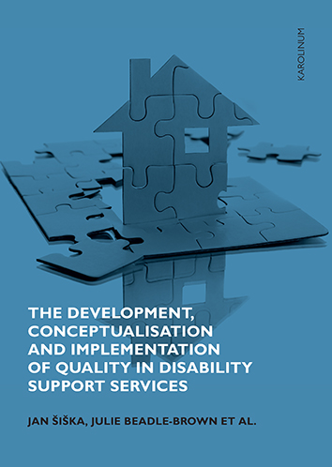
Šiška, Jan – Beadle-Brown, Julie et al. (2021). The Development, Conceptualisation and Implementation of Quality in Disability Support Services. Praha: Karolinum.

Slide 19
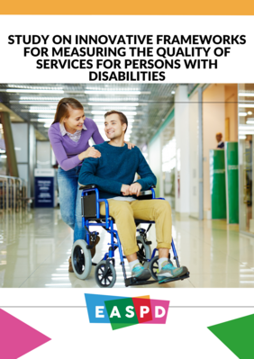
Contact email address
Jan.siska@pedf.cuni.cz
Full report can be downloaded from https://easpd.eu/publications-detail/report-on-innovative-frameworks-for-measuring-the-quality-of-services-for-persons-with-disabilities/

