Slide 1
Person-centred planning: what it is and how do we get there? Supported Decision-Making: Improving quality of life of persons with disabilities
Mr. Ferran Blanco Ros. Project & Development Officer at Support-Girona

Slide 2
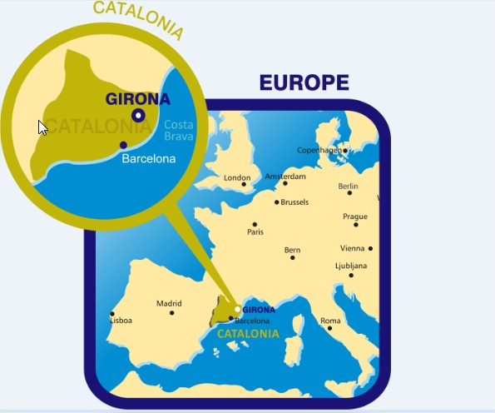
Support-Girona

Slide 3
Different approaches to Supported Decision-Making (SDM)
Legal Capacity, Disability and Mental Health Laws
Social Practice & Service Delivery Processes
UNCRPD

Slide 4
Why do we need a methodology on SDM?
Support
Respect
Ensure
Rights
Choice
Control
Support Services
National Legal Frameworks
Will
UNCRPD
Preferences

Slide 5
Some basics about SDM. How support should be?
Quality-oriented.
Accessible and available
Developed in the community
Individualised, flexible and adaptable to personal factors (age, socioeconomic condition, etc.)
Voluntary (access, development, ending)
Support as a bridge/connector to other rights (Art.19 Living Independently, Art.25 Health, Art. 23 Respect for home and the family, Art.27 Work and employment)
Part of the global scheme of services
Sufficiently financed
Coproduction at its core
01
TRAINING OF PROFESSIONALS
LEGAL FRAMEWORKS
Support to MAKE & EXECUTE DECISIONS
03
02
SUPPORTED DECISION-MAKING SERVICES

Slide 6
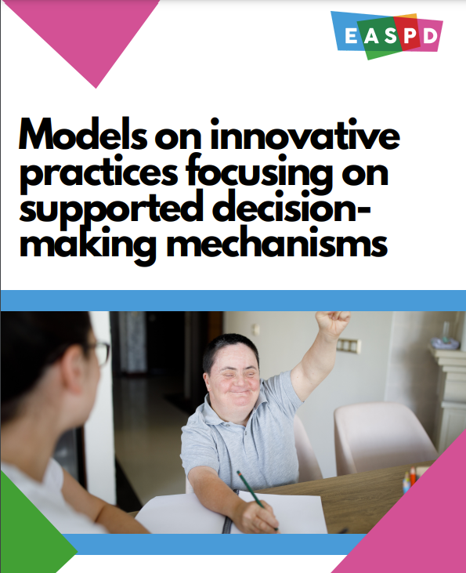
A study a bit more in deep about (SDM)

Slide 7
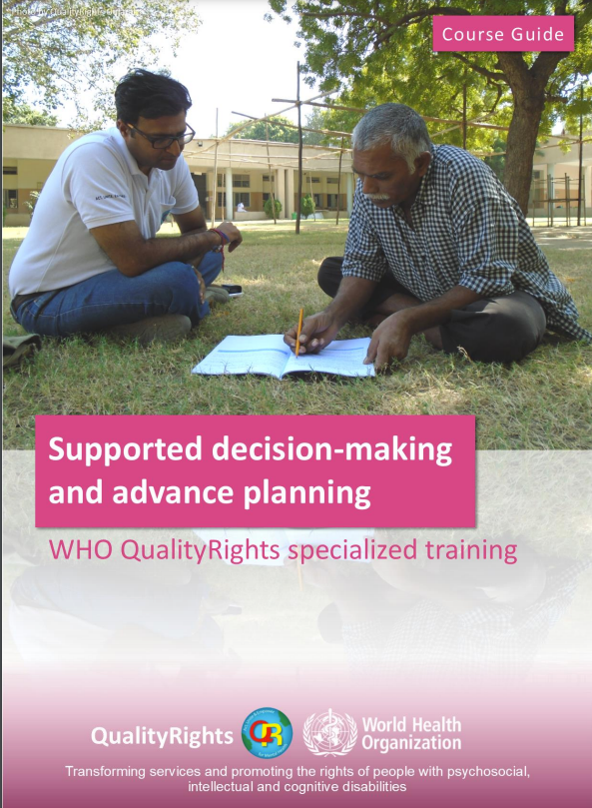
Supported Decision-Making as a quality-oriented tool

Slide 8
The decision-making process
MAKING A DECISION
MANAGING & EXECUTING A DECISION
1
2
3
4
5
6
7
Identify different options
Access & Obtain information
Understand & interpret the infromation
Ponderate the impact, consequencies of the different options (outcomes)
Communicate the decision
Actions to accomplish the decision
Safeguards to mitigate risk

Slide 9
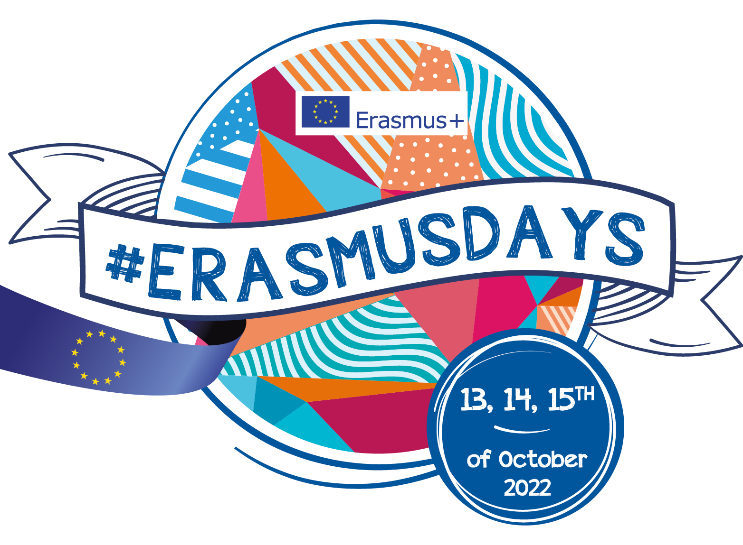
I-DECIDE Project: agreement-based SDM
I-DECIDE – Supported Decision Making using Digital Literacy & Numeracy skills : 2017-1-ES01-KA204-038185
The methodology is based on the support agreement as an instrument and defines the role of the “supporter” and the “facilitator”
I-DECIDE Staff Guide (summary of the methodology)
Personal Finances, Healthcare and Consumer Rights Manual (case scenarios, tools and strategies)
I-DECIDE SDM Agreement (persons involved & spheres where the person wants to be supported)
Digital, Literacy & Numeracy Skills Assessment (transversal competencies)
I-DECIDE Financial Assessment (practical abilities & skills)
I-DECIDE Healthcare Assessment (practical abilities & skills)
I-DECIDE Individualised Support Plan (take a decision and execute a decision)
I-DECIDE Supporter Self-assessment (satisfaction with the process and SDM service)
I-DECIDE User Self-assessment (satisfaction with the process and SDM service)

Slide 10
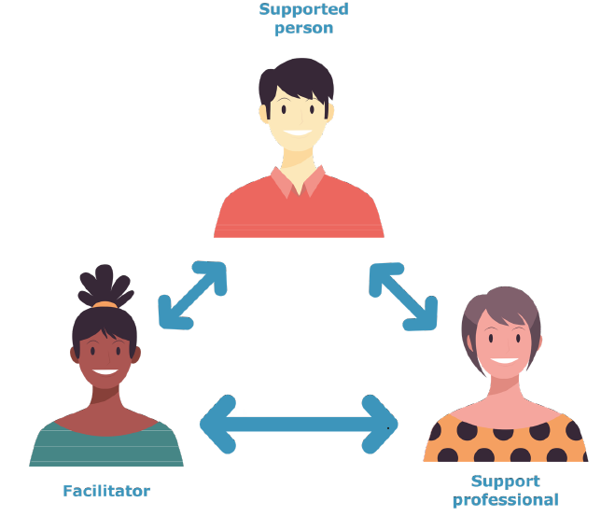
Facilitator VS. Supporter
Supporter
Person whose main task will be to guide and support the person in the decision-making process (seek and organise information and resources, clarify the person’s doubts, propose alternatives, help the person understand the impact and consequences of each decision and communicate the relevant decision.
It will co-produce with the person an individualised support plan to help the person to materialise his or her decision.
Facilitator
The facilitator acts as a safeguard between the person and the supporter.
Its task is to mediate between conflicts that may arise (ethical, practical, procedural, external, communication).
The facilitator can clarify the role of the support professional and the extent of the support as well as help the person evaluate the process and review, redefine or terminate the agreement.

Slide 11
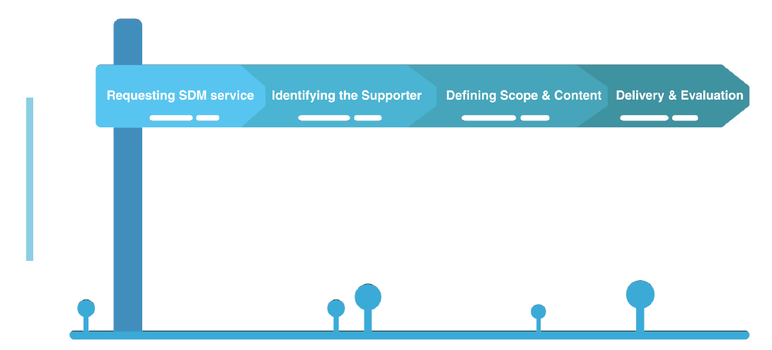
The process
Requesting the SDM Service
Identify the supporter and the facilitator
Define the scope & content of the SDM agreement
Co-produce the Individual Supported Decision Making Plan
Evaluate the process
Redefine or terminate the SDM Agreement

Slide 12
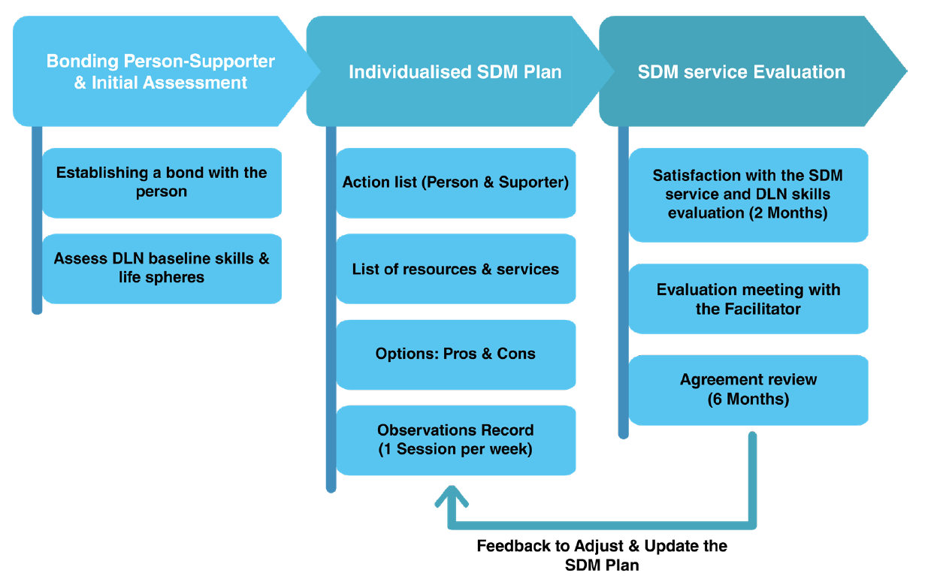
Agreement & Support Plan: two central instruments
Support Agreements are the mechanism by which a person designates another person to help them make decisions. Although they can be a tailor-made suit for the needs of the person, the agreements usually express WISHES, PREFERENCES OR EXPECTATIONS.
Support Plans are the tool through which the person and the support provider (formal or informal) agree on the way in which that wish or expectation will become a reality or the best approximation to the wishes expressed by the person. They correspond to the field of CONCRETE ACTIONS.
Both MUST include the will and preferences of the person, not the support provider, professionals or families.
Both instruments MUST be flexible, modifiable, reviewable or voidable if the situation requires it or the person so wishes.

Slide 13
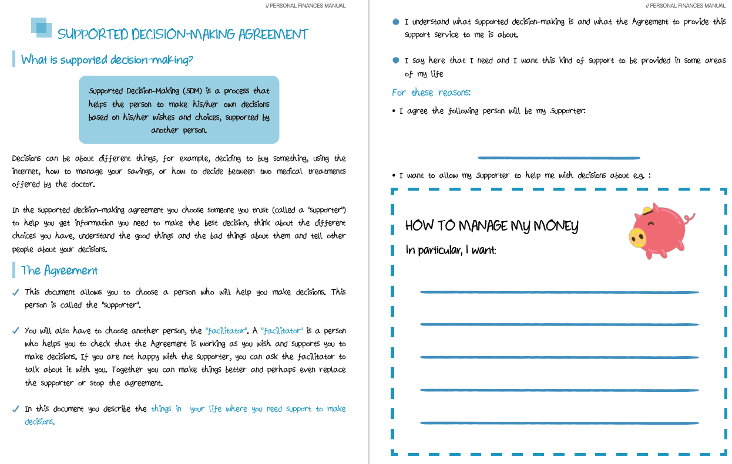
The SDM Agreement

Slide 14
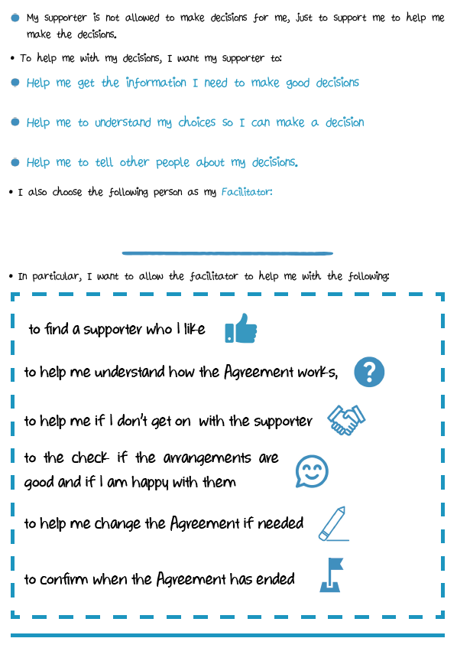
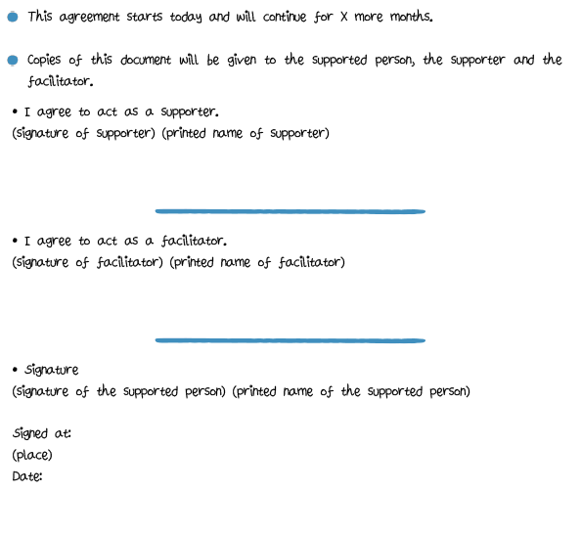
The SDM Agreement

Slide 15
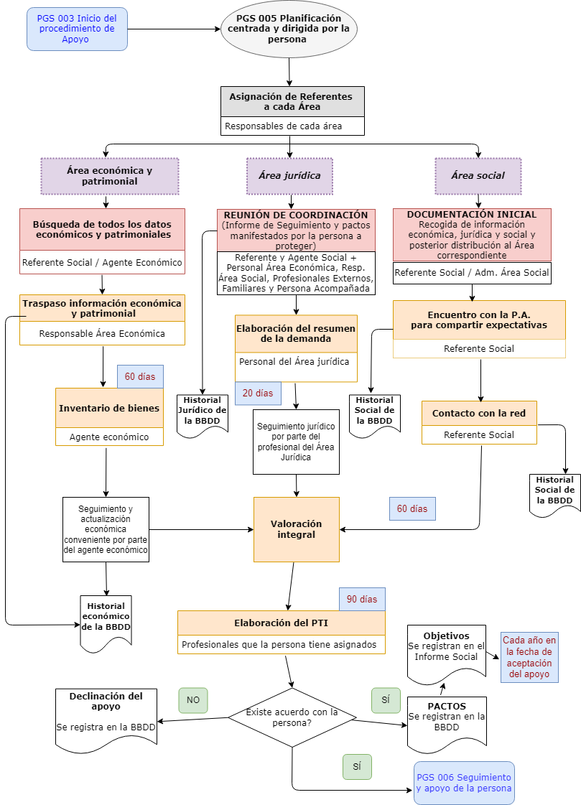
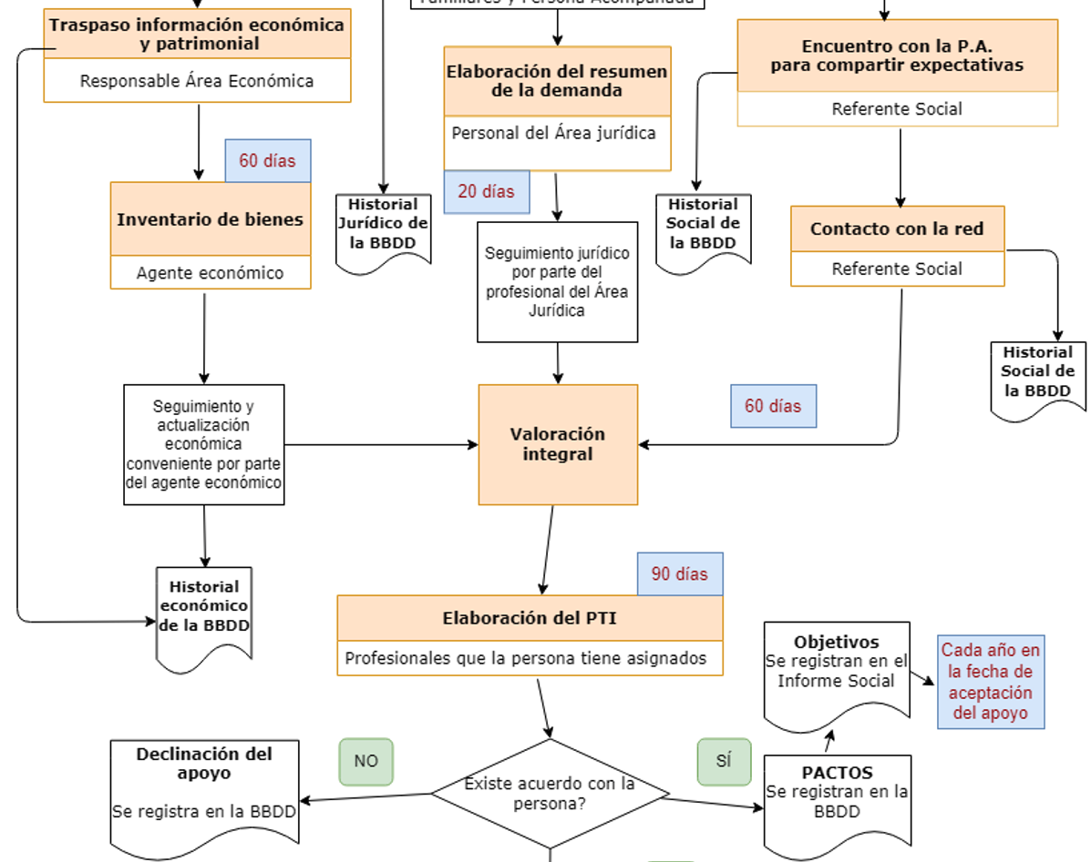
Supported Decision-Making as a quality-oriented tool

Slide 16
Let’s work together on a case scenario!
Paula is a 21 year old woman with a mild intellectual disability. She lives in a middle sized city in a shared flat and works in a garden centre in the outskirts close to the city. She earns a little bit more than minimum wage and she usually takes the bus to go to work. She receives support from a social worker that usually help her with papers and benefits but one Paula verbalises the idea that she’s not happy taking the transport to go to work provided by NGO managing the garden centre and she wants to be independent and be able to drive her own car to work and she request support to do that.

Slide 17
Conclusions
Supported Decision-Making methodologies can be applied in services even if national legislation is not entirely aligned with the UNCRPD
Training of professionals is needed to understand what respecting legal capacity really means and to learn new methodologies to deliver it in practice. Lack of training at multiple levels, including persons with disabilities themselves.
There is an academic, theoretical, legal and practical gap regarding risk management and responsibilities of support providers applied to SDM and about the intensity of safeguards against undue influence or abuse by third parties
The legislation may, apparently, be aligned with article 12 of the Convention, but the practical application of law might require professionals to take decisions by representation or substitution. Inertial and paternalistic legal operators.
That supports respecting human rights are also seen as effective in conflict situations.

Slide 18
UNIC Project
UNIC is a project that will support Public authorities to apply a user-centred funding model in long-term care and support.
With the financial support from the European Union Programme for Employment and Social Innovation “EaSI” (2014-2020). Grant agreement number VS/2020/0265
www.unicproject.eu

Slide 19
Links
I-DECIDE Project
https://supportgirona.cat/projectes/i-decide
EASPD Models on Innovative practices focusing on supported decision-making mechanisms
https://www.easpd.eu/publications-detail/models-on-innovative-practices-focusing-on-supported-decision-making-mechanisms/
QualityRights Materials & E-TRAINING Platform
https://supportgirona.cat/quality-rights
https://qualityrights.org/training/
https://apps.who.int/iris/discover?query=qualityrights

