Slide 1
#QualitySocialServices
Welcome!
We will begin shortly

Slide 2
#QualitySocialServices
Before we get started
Our speakers will speak in English.
If you are tweeting about our event, please use the #QualitySocialServices or tag @EASPD_Brussels

Slide 3
Panel 2: Promising Models Of Quality Measurement Processes From Scotland and Malta
#QualitySocialServices
Thomas Bignal
EASPD
Leigh-Anne Macdonald
ENABLE Group
Denise Fernie
ENABLE Group
Theresa Shearer
ENABLE Group
Andy Kerr
Former Scottish Minister of Health and Social Care
Jean Fred Agius
Aġenzija Sapport
Riva Scicluna
Aġenzija Sapport
Glenda Curmi
Aġenzija Sapport
Cynthia Deguara
SCSA

Slide 4
Panel 2: Promising Models Of Quality Measurement Processes From Scotland
Denise Fernie
ENABLE Group
Andy Kerr
Former Scottish Minister of Health and Social Care
Thomas Bignal
EASPD
Leigh-Anne Macdonald
ENABLE Group
Theresa Shearer
ENABLE Group
#QualitySocialServices

Slide 5
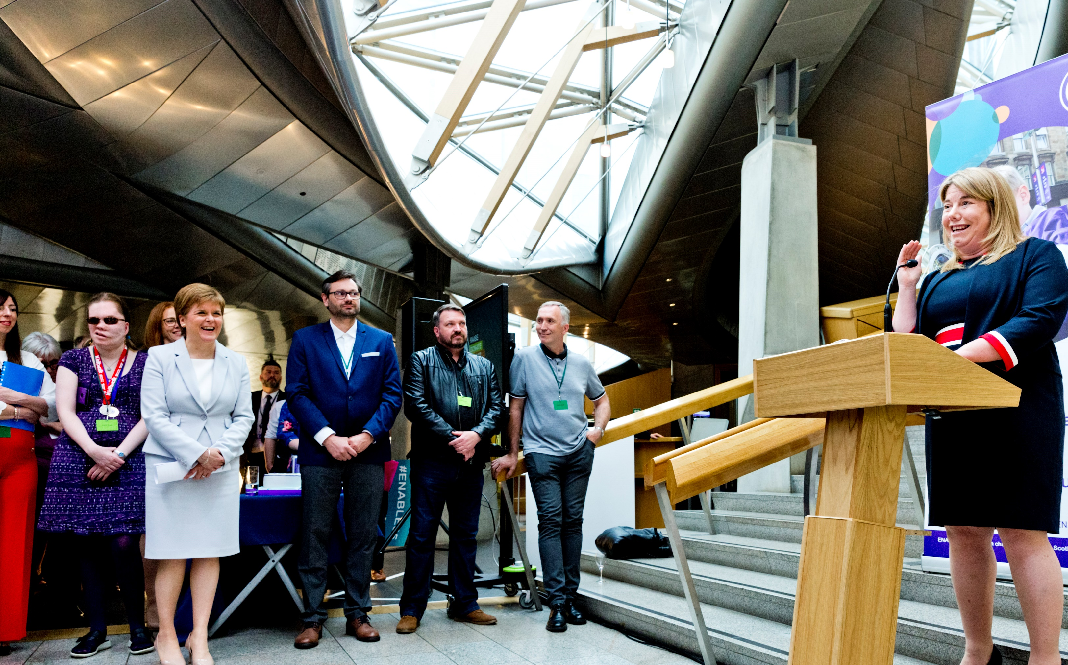
Theresa Shearer FRSE
CEO, ENABLE
Vice President, Inclusion Europe
in/theresashearer/
@Theresa_Shearer
Notes:
Thank you, Thomas.
I will give a very brief overview of the ENABLE PA Model, and then I am sure delegates will want to hear from Leigh-Anne and Denise on their experience, and a public sector perspective from Andy.

Slide 6
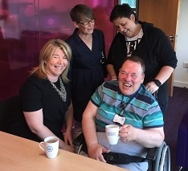
Social care: The problem for Scotland?
Institutions – like Lennox Castle; home to 1,500 people aged 6 to 80+
Deinstitutionalisation – Same As You (2000 – 2012)
Prevailing institutional culture in community-based care?
Social Care (Self-directed Support) (Scotland) Act 2013
Notes:
In 2000, the Scottish Government committed to end institutionalisation, and Lennox Castle – home to around 1,500 people with learning disabilities at any given time, ranging in age from 10 years old to over 80 – closed in 2002.
Scotland introduced highly progressive legislation giving everyone the right to Self-Directed Support in 2013, but this was not translating into most people’s real life experience.
83% of people accessing SDS let their local authority choose and arrange their support; Only 11% of people who have a learning disability were choosing to control their own care and support by receiving a direct payment.
Anyone who did not have the knowledge, skills or confidence to take on all the responsibilities of employing staff and controlling budgets was excluded.

Slide 7
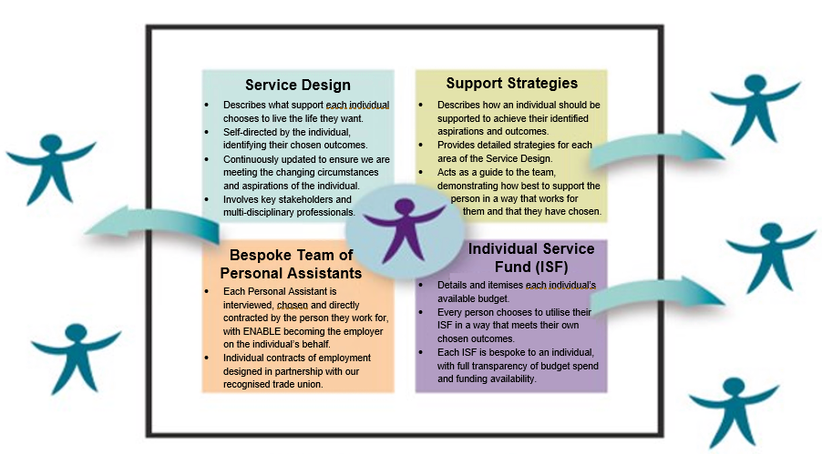
ENABLE PA Model: What is it?
The ENABLE PA Model is the democratisation of social care.
Notes:
One of the conversations that will forever stay with me was with a mother who told me 54 different people touched her disabled daughter’s body to provide intimate care, and that they had no idea who would turn up from shift to shift.
The right to choose who comes into your home and provides your support is a fundamental right.
Human rights are at the centre of the PA Model, and it makes the right to self-directed care and support reality for everyone who chooses ENABLE.
We do this by handling all the technical and administrative tasks that come with being an employer – such as advertising for and shortlisting candidates, payroll, people management, technology, legal and health and safety duties – while the person we work for has full control over every element of their care and support.
This means citizens can interview and make the final recruitment decision on candidates to be their PA, choose their hours of support, and choose the things they enjoy doing with their support in places they want to be with people they like to spend time with.
The PA Model is the democratisation of social care– making SDS truly accessible to everyone, regardless of their disability, education level, social capital or family connections.

Slide 8
What it means: For people we work for
88% of ENABLE PA Model Wellbeing grades at “excellent” or “very good” – well above the Scottish average of 63%.
54% of people accessing care in Scotland had their hours reduced during Covid lockdowns – but the ENABLE PA Model delivered 98% of all contracted hours.
Supporting people out of institutions to thrive in their own home in the community.
Notes:
The ENABLE PA Model is a proven success; 88% of ENABLE’s services receive the highest wellbeing grades of “very good” or “excellent” from Scotland’s Care Inspectorate, compared to a national average of 63%.
While 54% of people accessing care in Scotland had their hours reduced during Covid lockdowns, the ENABLE PA Model delivered 98% of all contracted hours.
An estimated 24% of people in Scotland who have a learning disability contracted Covid during the 2020 and 2021 waves, but fewer than 5% of people supported through the ENABLE PA Model contracted Covid.
As in Alan’s case, the ENABLE PA Model has a proven track record of supporting people who have lived in institutions to thrive in their community.

Slide 9
What it means: For people we work with
Enhanced pay and conditions for PAs.
PAs are paid a minimum of 14% beyond the National Living Wage.
ENABLE’s vacancy rate is less than half the Scottish average.
Independent evaluation found clear impact on employee retention and wellbeing of people we work for, built on a culture of being purpose-led, self-directedness, servant leadership and “demonstrate by doing”.
Outstanding Leadership Award from Living Wage Scotland.
Notes:
One of the most heart-breaking things for a care provider is hearing that someone who had a great relationship with the person they work for has resigned to take a job in retail or hospitality because the pay or the hours were better for them.
Recruiting and retaining people with the right values to establish those relationships that are critical to human rights-driven care and support is key to the PA Model.
In close partnership working with our recognised trade union, ENABLE’s PAs are currently all paid no less than 14% beyond the UK Government’s (minimum) national living wage, and 9% beyond the real living wage.
A new report published this week (Skills for Care) found the average vacancy rate for social care providers in England is 11%, with recent evidence suggesting a very similar picture in Scotland.
Yet ENABLE’s vacancy rate is just 5% - reducing to 3% when the most challenging geographical area of Scotland is excluded.
Independent research by the University of Strathclyde in 2021 found that the ENABLE PA model has a clear impact on employee retention and wellbeing of people we support, built on a clear people and culture strategy which is purpose-led, embodies self-directedness, servant leadership and “demonstrate by doing”.

Slide 10
What it means: For ENABLE
Supporting more than twice as many people – from 3,000 in 2017/18 to 6,500 in 2022/23.
Doubled revenue levels from £30m in 2017/18 to a projected £60m in 2022/23.
Approaches from commissioners to take on services from failing providers.
Largest community-based care charity in Scotland.
One of Scotland’s 40 largest employers.
Recognised as one of the top 30 social care providers in the UK.
More people choose the PA Model for their support.
More people choose to work for ENABLE.
Notes:
Speaking from a provider’s perspective, it is important to reflect on what moving our care and support services to this model has done for ENABLE as an organisation.
We have seen some of the fastest growing demand in the sector for our care and support services, alongside increasingly frequent approaches from local authority commissioners asking us to step in to uphold people’s human rights when their existing provider has failed or withdrawn from their service.
One of the biggest strengths of the PA Model is that it is scalable and transferable to all types of social care services. This includes services to support people with complex needs to live in their own home in the community, equipping ENABLE to be a key partner as the final stages of deinstitutionalisation are finally achieved over the next few years.

Slide 11
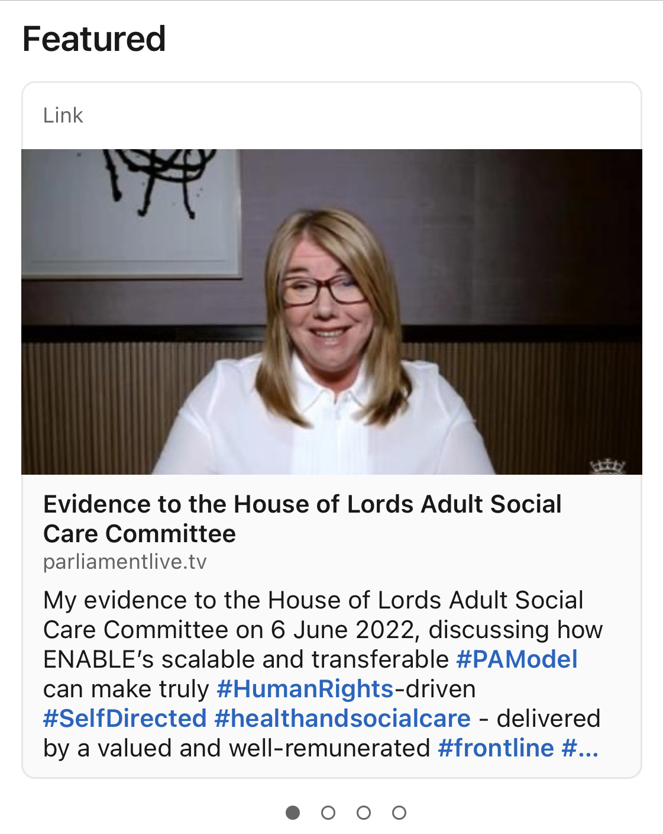
More on the ENABLE PA Model
Evidence session with the UK Parliament’s House of Lords Adult Social Care Committee
https://www.linkedin.com/in/theresashearer/
Notes:
As this is just a brief overview, I will leave it there.
However, if you would like to hear more detail about the ENABLE PA Model, I gave evidence this summer to the UK Parliament’s House of Lords Adult Social Care Committee.
You can find the link to that session as a featured item on my LinkedIn profile, and the Committee will be publishing a report from their inquiry in the coming months.
Thank you all for listening. I am really looking forward to hearing from the other speakers, and to taking your questions later.
[HAND BACK TO THOMAS]

Slide 12
Panel 2: Promising Models Of Quality Measurement Processes From Scotland
Denise Fernie
ENABLE Group
Andy Kerr
Former Scottish Minister of Health and Social Care
Thomas Bignal
EASPD
Leigh-Anne Macdonald
ENABLE Group
Theresa Shearer
ENABLE Group
#QualitySocialServices

Slide 13
Panel 2: Promising Models Of Quality Measurement Processes From Malta
Riva Scicluna
Aġenzija Sapport
Cynthia Deguara
SCSA
Thomas Bignal
EASPD
Jean Fred Agius
Aġenzija Sapport
Glenda Curmi
Aġenzija Sapport
#QualitySocialServices

Slide 14
#QualitySocialServices

Slide 15
Strengths & Challenges
Strengths
The Social Care Standards Authority: establishes standards and monitors services being provided to ensure good quality services to persons with disabilities;
Collaboration between the national agency and other NGOs and service providers;
Moving towards independent living rather than institutionalisation
Challenges
Lack of human resources specialising in disability
Lack of legal framework to safeguard and protect vulnerable persons with disabilities
Some parents are still holding to the myth that persons with disability should be institutionalised to ensure quality of care/life
#QualitySocialServices

Slide 16
Panel 2: Promising Models Of Quality Measurement Processes From Malta
Riva Scicluna
Aġenzija Sapport
Cynthia Deguara
SCSA
Thomas Bignal
EASPD
Jean Fred Agius
Aġenzija Sapport
Glenda Curmi
Aġenzija Sapport
#QualitySocialServices

Slide 17
#QualitySocialServices
CONFERENCE DINNER
Join us for the conference dinner at Xara Lodge in Rabat at 19h30!
For more information regarding transport, check the EASPD conference App.

