Slide 1
Building national ECI systems
Aleksandra Jovic
UNICEF, Regional Office for Europe and Central Asia
#FamilyCentredECI

Slide 2
Continuum of services for children with disabilities
Environment
Capacity
Attitudes
Pregnancy
6+
0-3 years
3-6 years
Prenatal screening and counseling
Perinatal visits
Home visiting
Parental counseling for nurturing care
Family centered, multidisciplinary ECI in natural environment
Inclusive education
Support for transition to mandatory education
Transition plan and support
Inclusive pre-primary education
ECI continues
Developmental monitoring
Health care and specialized health services
Social protection, social services in the community (respite care, day care, other)
Assistive technologies
Family friendly policies Parenting support Soc. protection and income support
Notes:
When discussing support for young CWD and their families we have to have in mind that they require holistic and diverse support, provided in a continuum by all sectors, from conception towards their transition to compulsory education and further
The broader eco system of support needs to be based on provisions that create an enabling environment that fosters inclusion, that nurtures development and adoption of appropriate attitudes and that supports capacity building of all actors
Some provisions and support modalities are age specific or more important at a particular age of the child but there are also those that should be available as a continuum such as developmental monitoring for timely detection of risks, delays and disabilities, adequate health care and access to social protection benefits
TODAY we focus on ECI as fundamental support services to young children with dev difficulties and their families and we have heard today how they build on evidence on child development and what is their potential
Ideally, they should start as early as possible within the period of first 3 years and support effective inclusion to preschool but we know that many children are identified only later so ECI supports them through the first 6 years through inclusion to primary education

Slide 3
Contemporary ECI
Integrated Social Model: focus on comprehensive and holistic development of the family and child.
Family-centred: contextual and consultant-based delivery of supports and services to the family
Individualised: focus on the strengths, needs and challenges of each individual child within the family context.
Interdisciplinary, usually transdisciplinary, integrated and team-based - integrated across both sectors and disciplines to provide one united service to families and their children.
Delivered in the child’s natural environments
Notes:
We have heard what are the key principles of contemporary ECI and we should have them in mind when thinking which system elements should support their operationalization in practice
We need systems that can support family centred, individualized, transdisciplinary services provided in natural environment of the child

Slide 4
From Legacy to Evolving to Contemporary ECI Services in Europe
Legacy Services
Rehabilitation
Medical Model
Evolving Services
Mixed Medical and Social Model
Contemporary ECI Services
Social Model: family centred
Medical Diagnostics & Health Care
Many variants found
Emily Vargas-Baron, 2022
Notes:
In majority of countries of our region we see that national systems are in different stages of transition from the old models of support to CWD primarily based on rehabilitation and therapeutical services provided directly to the child by health systems.
As new evidence on what are effective approaches of support to young children is informing professional communities and policy makers, we see more and more efforts to reform provisions to align with the contemporary ECI principles
This evolution and transition requires significant efforts as it implies change in understanding, a shift of a paradigm between what we believed works the best , it includes changes of policies, new approaches and building new skills and understanding among professionals and new financial streams
“Legacy systems” abound in Europe and many of them are evolving from medical systems and models to a variants of a social model and to contemporary ECI services.

Slide 5
ECI – key elements
Identification of developmental difficulties
Comprehensive assessment of the development
ECI services
Transition to inclusive early childhood education
Notes:
Before we go further into system elements, let us remind ourselves of the key steps in the provision of ECI services as we should have these steps in mind when defining system elements that will support them
We need to ensure systematic and universal timely detection of risks, delays and disabilities
Following that, identified children and families need comprehensive assessment of child development and family situations as a basis for planning and provision of ECI service
Finally, we need to ensure support for smoot transition to inclusive education

Slide 6
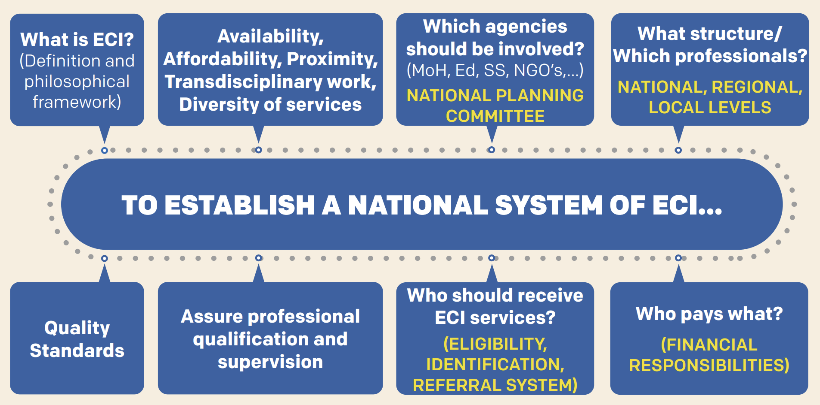
ECI ROADMAP
Boavida, 2022
Notes:
This slide present the Roadmap developed by Eurlyaid, dr Jose Boavida and contains key questions that need to answered when we start with ECI system building
We need to reach a national consensus on how do we conceptually define ECI, that we adhere to the principles of contemporary evidence based ECI
Recommendations of the European Agency for Special Education Needs highlights the importance of availability, proximity, affordability, interdisciplinary working and diversity of ECI services. They point that ECI should reach all children and families in need of support as early as possible. Services should be community-based, available as close as possible to families and free of charge, provided through public funds. ECI professionals ideally should come from different agencies and belong to different disciplines, facilitating the exchange of relevant information among team members, as well as community services.
The next step is to define for our country, which resources we have that could support this new approach in service provision. Implementation of ECI situation analysis is a very useful step in mapping of those resources and building first recommendations on where to start with system building. Waiting for the ideal context to start can be a waste of time, as it may never happen. In few situations is Arthur Ashe’s famous quote “start where you are, use what you have, do what you can”, so appropriate.
Define key stakeholders, at all levels, their roles and accountabilities. At the national level those are usually ministries of health, education and social welfare and their delivery platforms, civil society organizations, parental organizations and academic institutions. Parents should be part of every step and mechanism. National ECI planning and coordination bodies should be established, tasked with development of national ECI strategy and policies. They should also be mirrored with adequate structures at regional and local levels. Defining composition, housing and structure of Local teams providing ECI services requires careful consideration of resources from all sectors that can meet requirements of availability, affordability, proximity, transdisciplinary work
We need to carefully look at and decide which agency/authority, at which level of governance will ensure financial support for ECI
Defining eligibility criteria and referral system is the next step
We also need to ensure that we have defined professional competences and training opportunities that will help create and sustaine cadre of professionals adhering to values and principles of ECI, and who will be supported through supervision
Finally we need quality standards and mechanisms that will help us to adhere to them such as supportive supervision, a culture of evaluating outcomes, intervention conditions and practices, and of “accountability”.. Family Satisfaction Questionnaires are also important tools to assess the perceived quality of services as well as Scales of Service Evaluation.

Slide 7
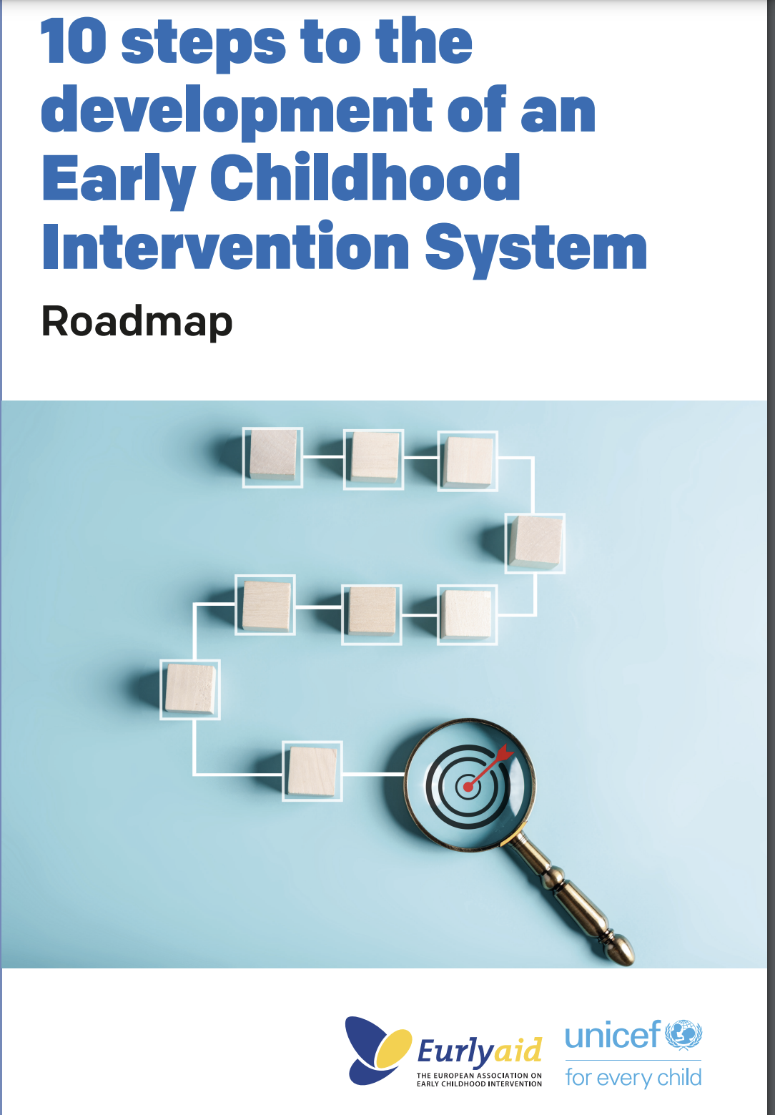
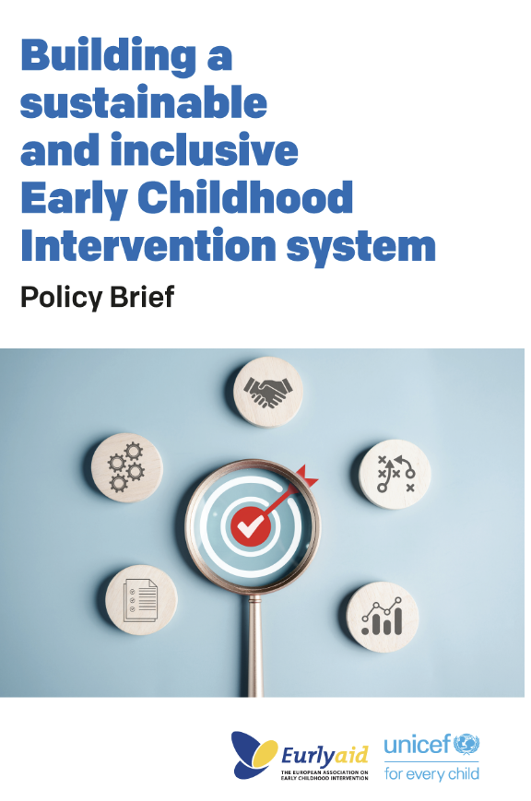
Available resources
Guide for national situational analysis on ECI
Roadmap for building national ECI systems
Policy brief
Quality standards for ECI services
Competency framework for ECI practitioners
Case study on ECI
Recommendations from regional ECI conference, 2022

Slide 8
Foundational course on ECI - coming soon!
5-module course:
Module 0: Introduction
Module 1: How do infants and young children develop and learn
Module 2: Introduction to ECI
Module 3: Key steps in the ECI process
Module 4: Authentic assessment
Module 5: Implementing ECI
Visit LearnECD learning platform!

Slide 9
Challenges of implementing ECI
Flavia Shehu
Down Syndrome Albania Foundation
#FamilyCentredECI

Slide 10
Main areas
Early identification of developmental difficulties and potential environments for children at risk for developing any kind of disability
Shifting the attitude of professionals towards family centered ECI
Quality of service provision (standards of the service) and professional qualification
Referral systems towards specialized services and transition to inclusive early childhood education
#FamilyCentredECI

Slide 11
Circa 10% (3,700) to 15% (5,550) of children from 0 to 6 years should require ECI services annually​
universal system for systematic developmental monitoring and screening and effective referrals to ECI services ​is missing in majority of countries
Few service institutions and organisations conduct comprehensive developmental assessments. Assessments tend to be specialised, using a therapeutic disability approach rather than addressing balanced child development ​
Few service providers develop Individualized Family Service Plans,
Few service providers involve parents in ECI sessions; most still work mainly directly with the child​
No continuous system of pre- and In-service training in ECI currently exists
Supervision tends to be lacking in most of providers (institutions and NGOs) ​
Detailed areas
#FamilyCentredECI

Slide 12
NATIONAL MODEL OF SERVICE PROVISION
CLEAR COMPETENCES OF NATIONAL AND LOCAL GOVERNMENT
ALL IN ONE GOVERNMENT PROCESSES AND TOOLS
PROFESSIONAL EDUCATION AND TRAINING
MOBILIZATION OF FAMILY RESOURCES
EMPOWERING FAMILIES (INCREASE INFORMATION AND ACCOUNTABILITY)
ESTABLISHING THE NATIONAL REFERRAL SYSTEM (INCLUDING EARLY IDENTIFICATION)
STRONG STANDARDS OF SERVICE PROVISION
SHIFTING THE APPROACH TOWARDS FAMILIES (FAMILY FIRST)
Overcoming the challenges
#FamilyCentredECI

