Slide 1
The portuguese national system
Miguel Valles @
#FamilyCentredECI

Slide 2
Premises that lead to the construction
The start
What we wanted to build
Signature of the UNCRPD
Academic papers that supported the reform
Identification of champions on the need of reform in each ministry
High costs of the current system per user
Lost information between services
A cost-effective full coverage national system and free for all users
A team that represents all ministries and consolidates all the information
A system that enables parental competencies and knowledge
#FamilyCentredECI

Slide 3
Premises that lead to the construction
In order to:
Increase the learning oportunities of the child
Strengthening care givers competencies
Promote family and communities resources
#FamilyCentredECI

Slide 4
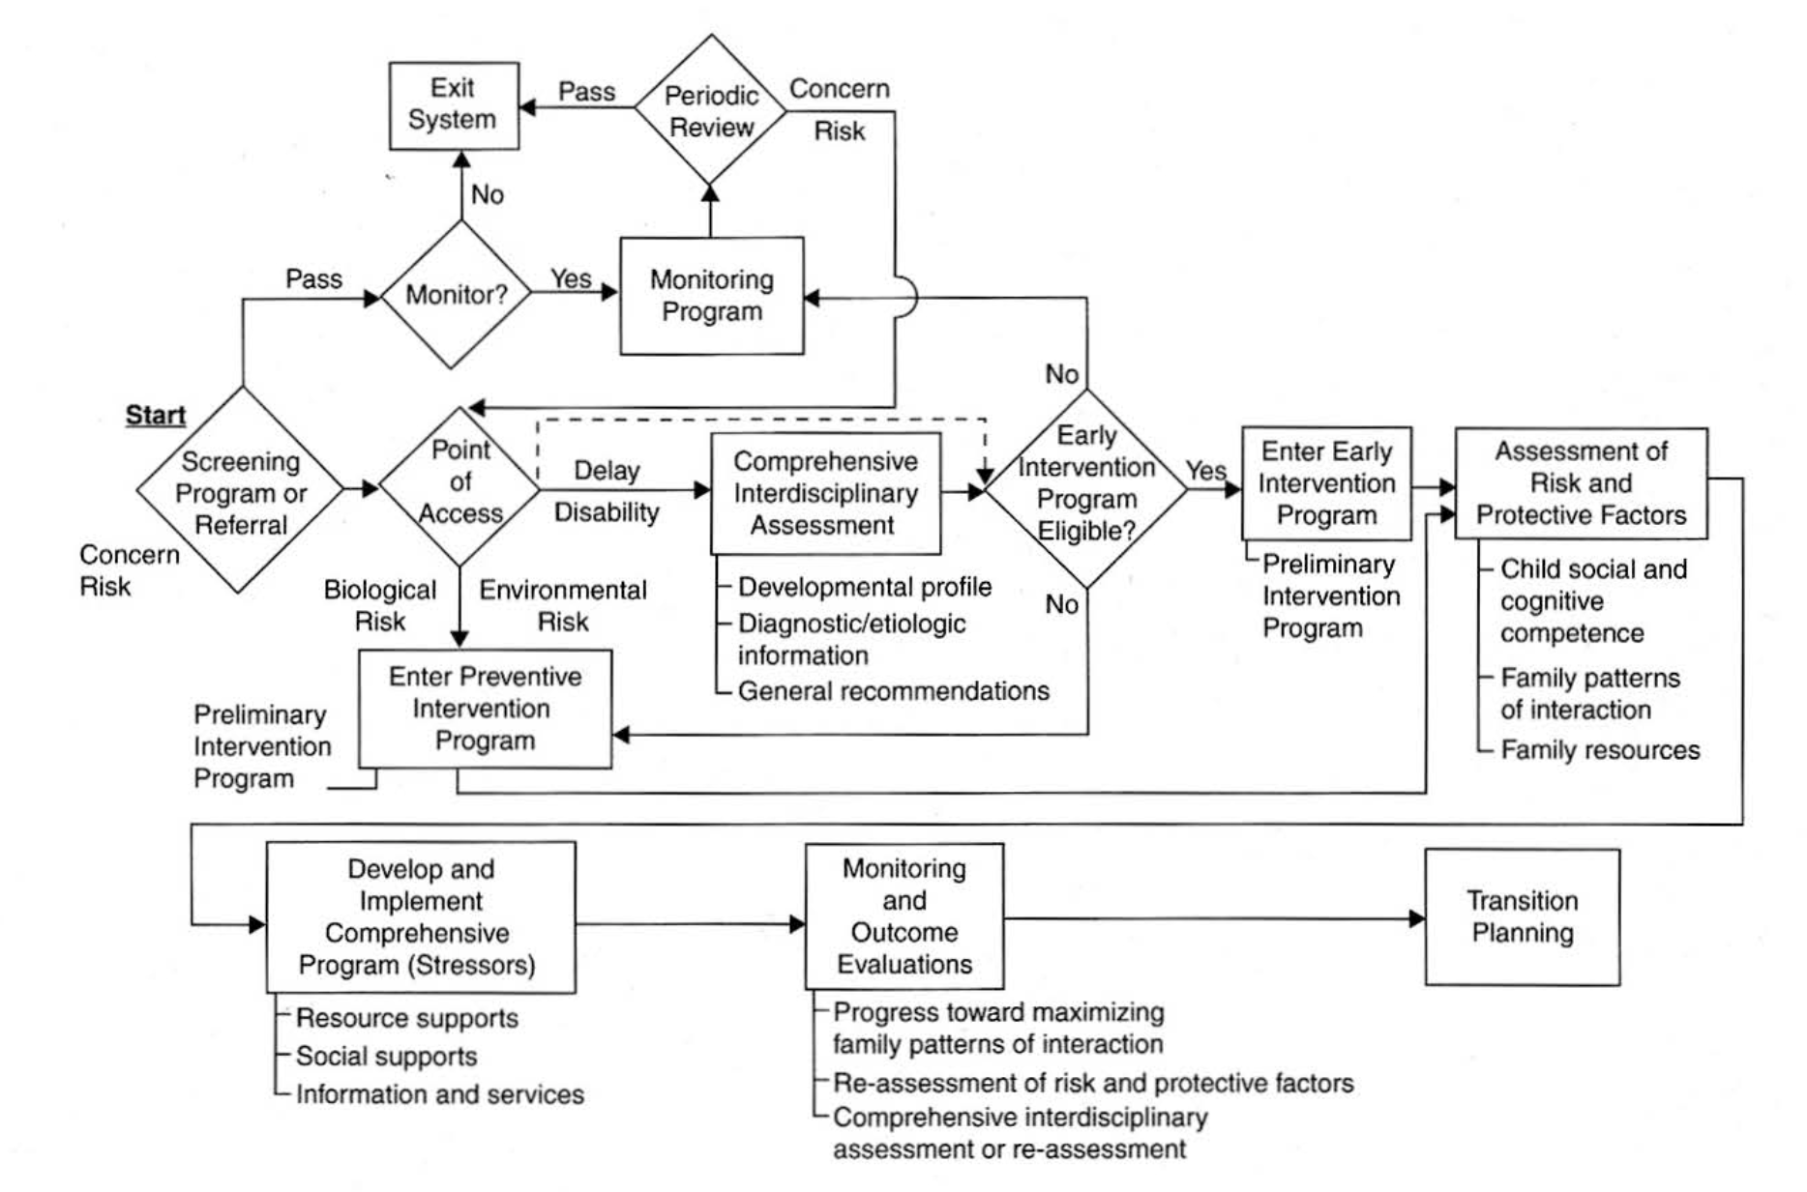
The system
National Coordination
Regional Subcomissions
Local ECI Teams
1
5
154
1
Transdisciplinary
Team Assessment
Adapetd Guralnick, 2001

