Slide 1
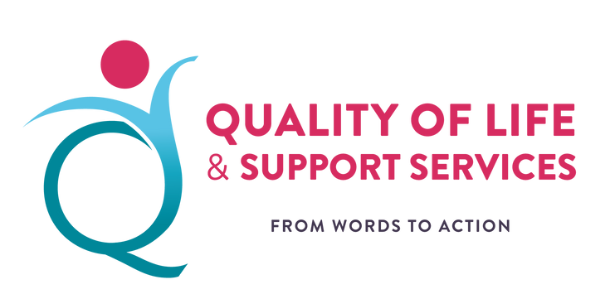
Workshop 14: Self-advocacy in service development and improvement
Moderated by Rhoda Garland
Executive Director – CRPD Malta
#QualitySocialServices

Slide 2
Agenda
11:30 – 12:05
Presentation by Marthese Mugliette – President, Malta Federation of Organisations Persons with Disability
Presentation by Nadia Hadad – Co-chair, European Network for Independent Living
Presentation by Justin Spiteri – Self-advocate from Malta
12:05 – 12:15
Q&A
12:15 – 13:00
Discussion in small groups
#QualitySocialServices

Slide 3
Self-advocacy in service development and improvement by ENIL
The importance of adequate regulating frameworks
Access to support (PA) should be a legal right, to ensure that all disabled people who need support can get it, regardless of where they live, to have equal access to services and chances to live independently (no ‘postcode lottery’) with Direct payment models to allow more control over their support.
There should be a range of services available for disabled people to choose from.
Personal assistance is a key independent living service. It should be available to all regardless of their impairment or age (people with intellectual disabilities and children)
Mobile services should be developed as a way to ensure access to quality support for people living in small towns or remote areas, to prevent institutionalisation and ensure a better quality of life for disabled people.
Guardianship laws, which deprive disabled people of legal capacity, should be abolished and supported decision-making alternatives should be introduced.
Peer support is one of the pillars of independent living. Its development should be supported financially by the State, to ensure that all disabled people have access to such support for as long as they need it.
#QualitySocialServices

Slide 4
The importance of adequate regulating frameworks
The provision of housing and support should be separated.
Accessible and affordable housing options should be made available to disabled people in regular apartments or houses dispersed in the community.
Disabled people should be involved at all levels – design, strategic, operational, monitoring and evaluation.
The need to involve disabled people should be set in law, to ensure that it is implemented. The process should be democratic and transparent – there should be clear rules with regard to who can participate and how, and information about the discussions and decisions made should be publicly available. It is essential to ensure that the process is accessible for all disabled people. This might involve the provision of information in accessible formats, organising meetings in accessible places, securing sign language interpretation during meetings or other support. It may also involve providing enough time for consultations.
Self-advocacy: Accessible information and training about their rights should be made available to all disabled people. Development of self-advocacy should be supported financially by the state, as it is essential for empowering disabled people, for supporting their independence and for changing public attitudes.
#QualitySocialServices

Slide 5
Inspiring practice:
Self-Advocacy of Disabled People – Ceva De Spus, Romania
Background
Most people with disabilities in Romania remain excluded from society.
At present, there are still more then 17,000 children and 18,000 adults with disabilities living in residential institutions, where they face abuse, violence and inhuman treatment.
Those living in the community, in their families, remain isolated and excluded because of the limited availability of support services. Families that have a disabled member live in poverty and are struggling to survive.
The only cross-disability organisations of self-advocates, is Ceva de Spus (in English – something to say).
Ceva de Spus unites self advocates with physical and intellectual disabilities, working to raise society’s awareness about the barriers disabled people face to participate in the community and to show that they too can live an ordinary life.
Ceva de Spus started in 2010 in Timisoara as an informal group of people with disabilities living in the community.
One year later, as they grew and realised they needed to be more visible, they recruited a support person to help them get organized and in 2013 they were officially registered as a legal entity.
#QualitySocialServices

Slide 6
Description of the organisations decision-makers
The organisation is run by a Board, consisting of five people – two co-presidents and two vice-presidents (one with a physical and one with an intellectual disability) and one secretary.
The Board meets every week to discuss the work of the organisation, to plan activities for the coming week and to decide what needs to be discussed with the members of the organisation.
The Board reports to the General Assembly, which meets twice a year.
Active members also meet every week to talk about pending issues and to decide on which activities they would like to get involved in. The minutes from the meeting are then sent to all members.
The staff of the organisation include two self-advocates – one full-time and one part-time – and two fulltime support persons.
The role of support persons is to help the Board and the members make decisions, for example, by providing information and asking questions. The final decision may differ from the opinion of the supporter but their role is to help self-advocates to put it in practice.
Supporters also have project management responsibilities. While all decisions are made by self-advocates, the day-to-day management and reporting is done by one of the support persons.
Finally, supporters help self-advocates prepare for meetings and to deliver presentations at conferences, and they translate into easy-to-understand language during meetings.
The work of the organisation is also supported by a Consultative Board. It is comprised of non-disabled people coming from different sectors. The Consultative Board is not involved in decision-making, but supports the organisation with advice and guidance, especially in crisis situations.
#QualitySocialServices

Slide 7
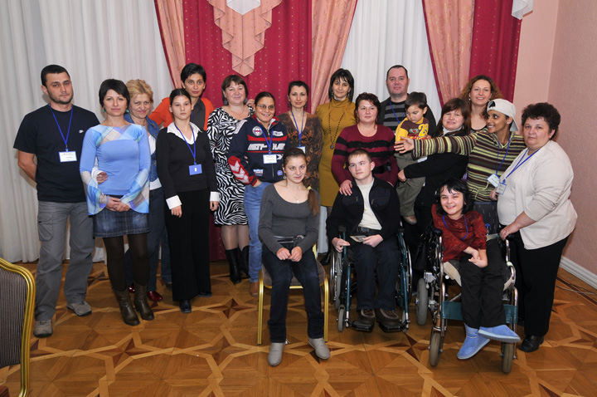
Description of the practice
Ceva de Spus’ work is to support its members to become more active and speak up for themselves.
This involves:
Organising weekly meetings with members, where they can speak about things that are important for
them and make decisions about the actions they would like to take.
• Organising training sessions for members to help them improve their skills related to working
in teams, communication, strategic planning, story-telling, conflict management, personal budget
management, cooking, English language, and other. Activities, such as yoga sessions are also organised.
• Supporting members to understand their rights and learn what to do if they are discriminated against.
For example, at the members’ meetings, the Convention on the Rights of Persons with Disabilities is read in an easy-to-read format and discussed.
• Providing financial support to the members to enable them to overcome
the lack of support in the community and be more independent and active.
Each member has a personal budget, which depend on their disability,
the support they have at home, and the number of children they have, can be
between 450 and 1000 EUR per year. It can be used to pay for services –
for example, to improve the accessibility of an apartment, to get support at
home, to access different services in the community, such as psychotherapy,
medical services and assistance.
The funds for these personal budgets are raised through various fundraising events.
#QualitySocialServices

Slide 8
Description of the practice
In addition, Ceva da Spus currently works on three main priorities, identified by the members:
- de-institutionalisation, community living and the use of EU Structural and Investment Funds (at national level), accessibility (at local level) and awareness raising (at local level).
They have been very successful in raising awareness within the local community and attracting support at the local level.
They have also helped make transportation, traffic lights and playgrounds in Timisoara more accessible.
The work of Ceva de Spus is funded by a foreign donor – the Open Society Foundations Public Health Programme – but they are also supported by the local business sector.
They organise various fundraising activities at the local level, which also aim to raise the community’s awareness and address stereotypes about disability, by involving both people with and without disabilities. For example, they organise a wine fair and an annual community race, where everybody is welcome to take part, regardless of fitness level. There are plans to start a social enterprise to help fund its work.
#QualitySocialServices

Slide 9
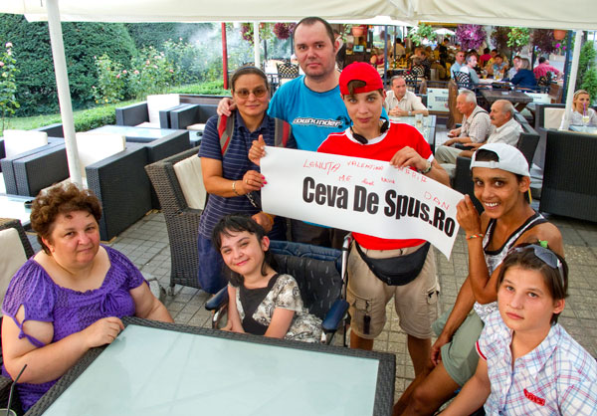
Why this is a good practice
• Independence and inclusion: Self-advocates have become more confident to make choices and decisions about their lives and to be more independent.
Some of them have started jobs.
They know what to do if they face discrimination –
with whom to speak, what legislation to use.
• Participation in decision-making:
Self-advocates have become more aware about
their rights and empowered to speak up.
They are also more engaged with policy-making at
local level and have a say in the decisions that affect them.
• Awareness-raising:
Disabled people became more visible in
the local community and better accepted.
#QualitySocialServices

Slide 10
Limitations, challenges and lessons learned
The authenticity of the organisation – people with disabilities speaking up for themselves – has been key for the progress achieved at local level. The local authorities were more willing to listen and take actions when disabled people themselves presented a problem or asked for a solution.
There have been a number of internal and external challenges.
A key external challenge is related to the barriers some disabled people face when joining Ceva de Spus. For example, people living in protected homes in the area were discouraged from joining the organisation by the manager of the setting.
The internal challenges include poor self-esteem and self-confidence among self-advocates, especially in the first years.
Other challenges included a lack of management skills and internal conflicts.
Further information: www.cevadespus.ro;
This inspiring practice is extracted from the research publication: “TOWARDS INDEPENDENT LIVING: COLLECTION OF EXAMPLES FROM EUROPE” realised by EDF & ENIL
Find more about it : www.enil.eu;
#QualitySocialServices

Slide 11
Discussion in small groups
1. What are you currently doing to involve persons with disabilities in service delivery? (sharing good practices)
2. What is needed to better involve persons with disabilities in all stages of the design, development and delivery of services? What are the criteria for self-advocates to be part of service development and delivery (e.g. training, financing, etc)?
3. How can persons with disabilities better be involved in the evaluation of (newly developed) services?
#QualitySocialServices

