Slide 1
Workshop 4: Accessibility: A step forward in the quality of online services
Antonio Ingelmo
Enrique García
#QualitySocialServices

Slide 2
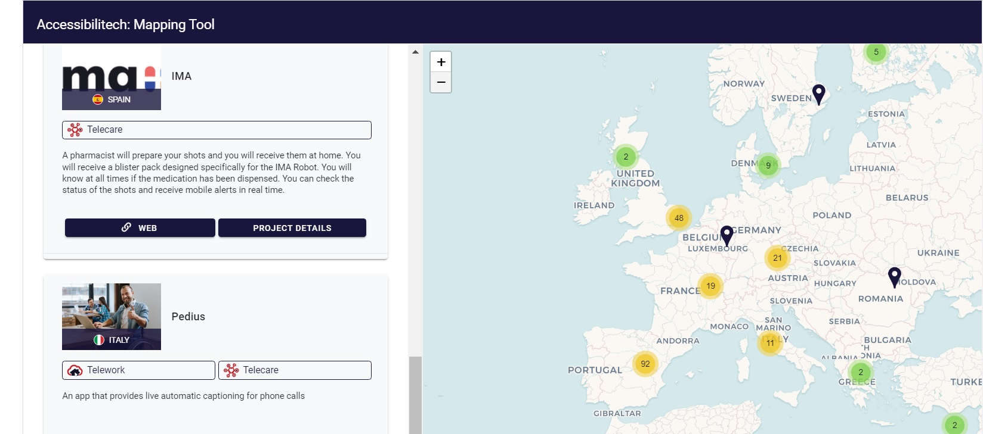
ACCESSIBILITECH PROJECT
Identify and map accessible solutions in
Telecare
Teleworking
eLearning
February 2021 to January 2023
https://accessibilitech.accessibilitas.es/en/home/
#QualitySocialServices

Slide 3
ACCESSIBILITECH VIDEO
https://www.youtube.com/watch?v=7bfaykG-GwI
#QualitySocialServices

Slide 4
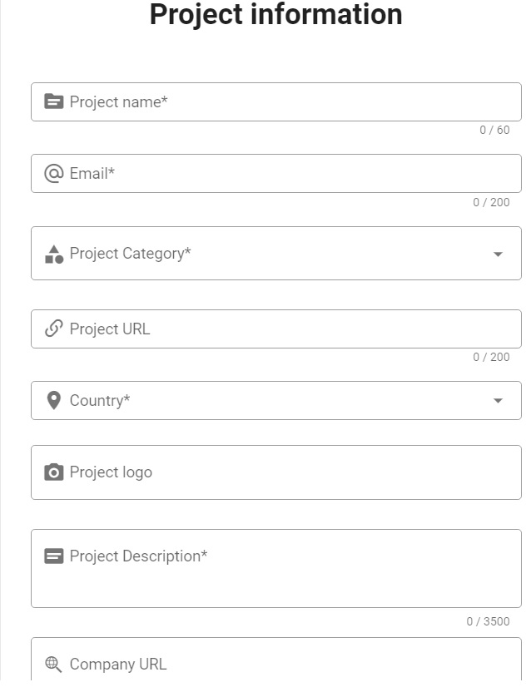
Register in
ACCESSIBILITECH
Mapping Tool your
Projects
Solutions
Service
Product
https://mappingtool.projects-espaciainserta.com/new-project
#QualitySocialServices

Slide 5
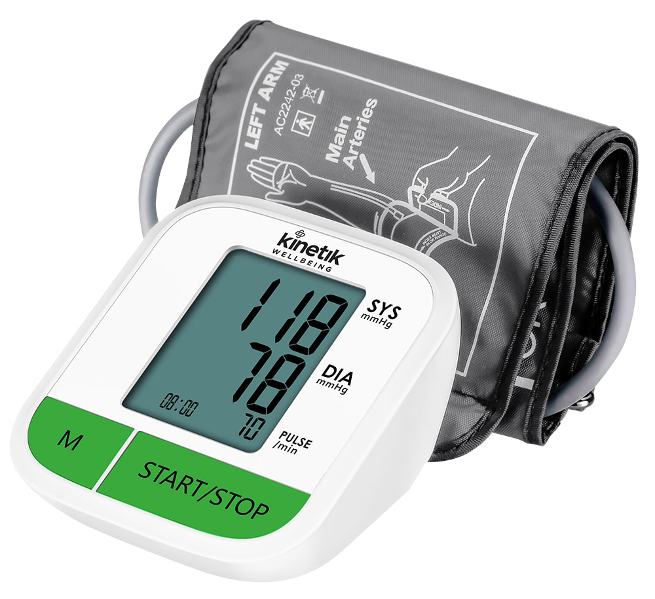
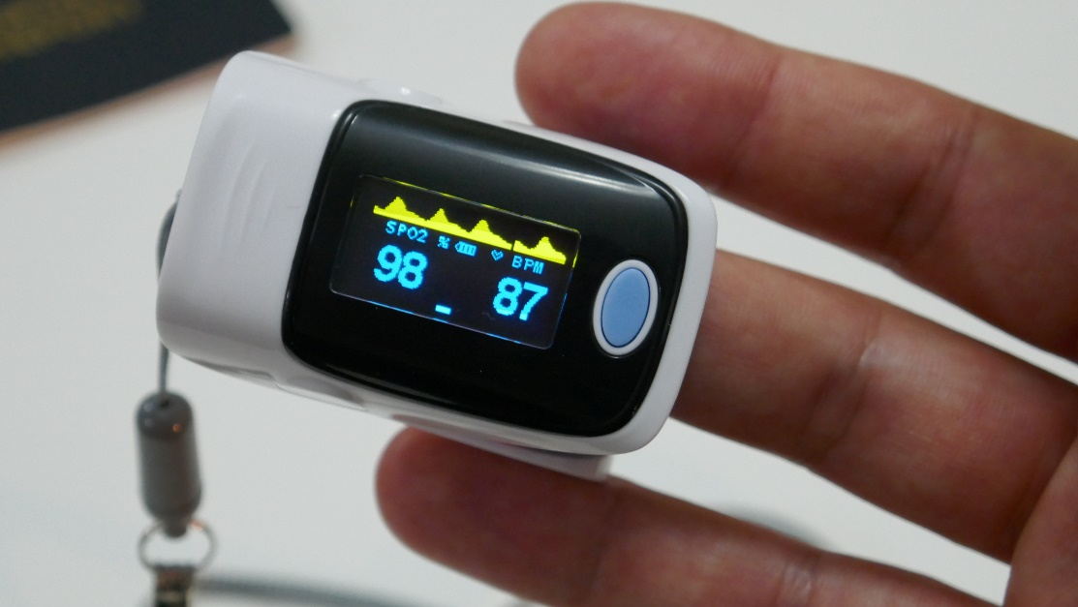
Accessibility requirements in online services
Based on an Accessibility in Health Care Telemonitoring systems research
Analysis of devices to take biometric measurements
Blood pressure monitor
Pulse oximeters
Glucometer
#QualitySocialServices

Slide 6
Accessibility requirements in online services
+ User experience
blind users
users with low vision
users with hearing impairment (deafness / hearing loss)
user with cognitive disability
users with motor disability
users over 65 years old
users with no disability
#QualitySocialServices

Slide 7
Accessibility requirements in online services
Reference Standards
The European Accessibility Act
EN 301 549 - Accessibility requirements for ICT products and services (public procurement but recommendable for the private sector
W3C Web Content Accessibility Guidelines (WCAG 2.1)
#QualitySocialServices

Slide 8
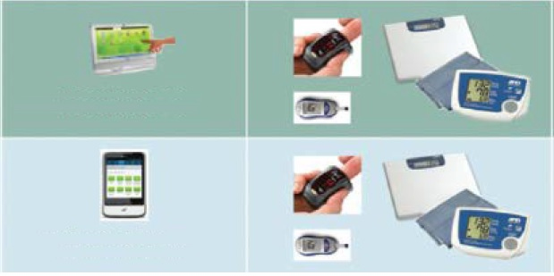
Accessibility requirements in online services
Applicable to systems composed by web platform and/or end user’s device
#QualitySocialServices

Slide 9
Accessibility requirements in online services
Recommendations for devices
Appropriate font, controls size, and contrast.
Easily identifiable by touch buttons.
Text alternatives to visual content get the information visually displayed and navigate.
Easy manipulation and ability to be grasped.
Compatibility with assistive technologies.
#QualitySocialServices

Slide 10
Accessibility requirements in online services
Recommendations for devices
Compatibility with health platforms (Web/App)
Users must be involved in the creation of the products.
#QualitySocialServices

Slide 11
Accessibility requirements in online services
Recommendations for web-based platforms W3C Web Content Accessibility Guidelines (WCAG 2.1)
Provide text alternatives for non-text content.
Provide captions and other alternatives for multimedia.
Create content that can be presented by assistive technologies, without losing meaning.
Make all functionality available from a keyboard.
#QualitySocialServices

Slide 12
Accessibility requirements in online services
Recommendations for web-based platforms W3C Web Content Accessibility Guidelines (WCAG 2.1)
Help users navigate and find content.
Make it easier to use inputs other than keyboard.
Make text readable and understandable.
Help users avoid and correct mistakes.
#QualitySocialServices

Slide 13
ACCESSIBILITECH
Thanks for your attention
Antonio Ingelmo
Enrique García
accessibilitech@gen.fundaciononce.es
#QualitySocialServices

Slide 14
ACCESSIBILITECH
Advanced Methodologies to Identify, Assess and Transfer Innovative
Solutions for the Accessibility of People with Disabilities
Antonio Ingelmo
Enrique García
#QualitySocialServices

Slide 15
ACCESSIBILITECH PROJECT
Identify and map accessible solutions in
Telecare
Teleworking
eLearning
February 2021 to January 2023
https://accessibilitech.accessibilitas.es/en/home/
#QualitySocialServices

Slide 16
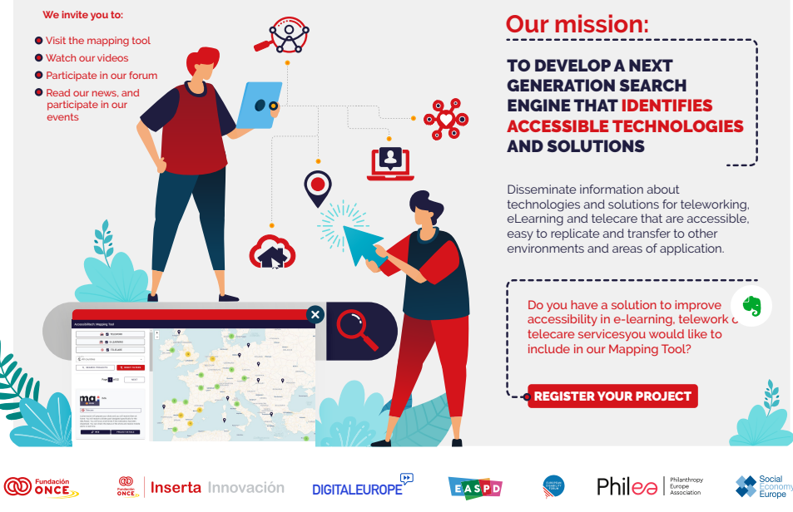
About
February 2021 to January 2023
Contributing to the future AccessibleEU centre
Learnings & recommendations
Mapping Tool on solutions
Awareness-raising materials
Creating synergies
#QualitySocialServices

Slide 17
Register in
ACCESSIBILITECH
Mapping Tool your
Projects
Solutions
Service
Product
https://mappingtool.projects-espaciainserta.com/new-project
#QualitySocialServices

Slide 18
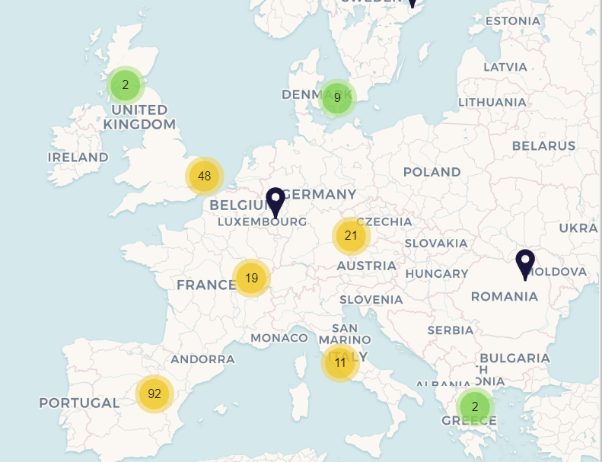
Join ’s Mapping Tool
Showcase for your products and services
Manual feed > market niche.
Reliable source of information
https://mappingtool.projects-espaciainserta.com/tool
#QualitySocialServices

Slide 19
ACCESSIBILITECH PROJECT’S OBJEVTIVES
Raise awareness on accessible technology
Workshops.
Awareness-raising materials
Learnings and recommendations
Create synergies
Contribute to accessibility in Europe
#QualitySocialServices

Slide 20
Value of
Knowledge - Current legislation
Encourage innovation
Improve organization’s social image
Increase market reach
Comply with legislation
#QualitySocialServices

Slide 21
How I can contribute to
Contribute to the Mapping Tool
Send good practice solutions in telework, eLearning and Online Care Services to the ACCESSIBILITECH Mapping tool
1
Contribute to the Awareness-Raising Toolkit
Send resources on accessibility for the repository of third-party materials (e.g. guides, best practices)
2
Contribute to the expert database
Send contacts of European experts in accessibility services, programming, policy, awareness-raising or other fields.
3
Join the ACCESSIBILTIECH Final Conference in Brussels on 23/24 January 2023
4
accessibilitech@gen.fundaciononce.es
#QualitySocialServices

Slide 22
ACCESSIBILITECH
Thanks for your attention
Antonio Ingelmo
Enrique García
accessibilitech@gen.fundaciononce.es
#QualitySocialServices

