Slide 1
Workshop 4: Methodologies and findings on collecting good practices in family support
Moderator: Lilith Alink
Speakers: Wilfried Kainz, Fabrizio Serra
#FamilyCentredECI

Slide 2
Innovative Practices in ECI
Wilfried Kainz
#FamilyCentredECI

Slide 3
MISSION
WHO WE ARE
Our mission is working for a world with zero barriers. Worldwide, the Zero Project finds and shares innovative solutions that improve the daily lives and legal rights of all persons with disabilities.
Notes:
For all who don’t know us yet:
Global Foundation based in Vienna, Austria
All disabilities
all continens

Slide 4
BACKGROUND
WHO WE ARE
Zero Project is an endowed project of the Essl Foundation.
Foundation based in Vienna, Austria – works across all continents and disabilities.

Slide 5
ZERO PROJECT & UNITED NATIONS
Economic and Social Council (ECOSOC) consultative status since 2014.
Zero Project Conference hosted at United Nations Office at Vienna since 2014.

Slide 6
PRINCIPLES
WHO WE ARE
GLOBAL
CROSS-SECTORAL
EQUAL FOR ALL
ACCESSIBLE & INCLUSIVE
INNOVATIVE & INSPIRING
BUILDING THE ECO-SYSTEM

Slide 7
Zero PRojECT Model
RESEARCH
SELECT & AWARD
INFORM & CONNECT
DATA & DATABASE

Slide 8
RESEARCH
Four-year cycle:
Annually:
Information & Communication Technology (ICT)
Education
Employment
Accessibility
Independent Living & Political Participation
Cross-cutting:
The Arts

Slide 9
EDUCATION
RESEARCH
Article 24 of the UNCRPD requires state parties to “recognize the right of persons with disabilities to education” and asks for an “inclusive education system at all levels”.
Formal education (primary, secondary, tertiary)
Pre-school and early intervention
Technical/Vocation Education/Training
Non formal education (art, dance, music, sports)

Slide 10
EDUCATION TOPICS
RESEARCH
Early childhood and preschool
Formal education (primary and secondary education)
Universities (tertiary education)
Vocational education and training
Non-formal education
ICT-driven solutions related to education/digital skill

Slide 11
EMPLOYMENT
RESEARCH
Article 27 of the UNCRPD requires state parties to “recognize the right of persons with disabilities to work on an equal basis with others”; “this includes the right to the opportunity to gain a living by work freely chosen or accepted in a labour market and work environment that is open, inclusive and accessible to persons with disabilities.”

Slide 12
EMPLOYMENT TOPICS
RESEARCH
Supported employment
Vocational training
Transition models from sheltered workshops
Entrepreneurship and micro-finance
Transition from education to employment
Matchmaking employees and employers
Higher education to prepare for the labour market

Slide 13
ACCESSIBILITY
RESEARCH
Article 9 of the CRPD states: “. . . shall take appropriate measures to ensure to persons with disabilities access, on an equal basis with others, to the physical environment, to transportation, to information and communications, (. . .) and to other facilities and services open or provided to the public, both in urban and in rural areas.”

Slide 14
ACCESSIBILITY TOPICS
RESEARCH
Built environment
Products and services
Urban development
Tourism
Arts and museums
Emergency and disaster recovery
Access to financial services
Workplace adaptation
Universal Design (UD)

Slide 15
INDEPENDENT LIVING & POLITICAL PARTICIPATION
RESEARCH
Article 19 of the UNCRPD requires state parties to “to recognize the equal right of all persons with disabilities to live in the community, with choices equal to others (…)”, including by ensuring that:
To choose their place of residence and where and with whom they live on an equal basis with others;
have access to a range of in-home, residential and other community support services, including personal assistance necessary
Community services and facilities for the general population are available on an equal basis to persons with disabilities

Slide 16
INDEPENDENT LIVING TOPICS
RESEARCH
Deinstitutionalization
Supported Living
Early Childhood Intervention
Personal Assistance
Assistive Technology
From Guardianship to Decision Making
Inclusion & Rights Based Approaches
Self-Employment & Microfinance
Moving away from Sheltered Employment

Slide 17
POLITICAL PARTICIPATION TOPICS
RESEARCH
Political Leadership and Self- Representation
Participation in Public Life
Voting Policies and Procedures
Voter and Civic Education
Access to Justice
Notes:
Within political participation, we have identified different subtopics. Political Leadership and Self-Representation refers to the need and right of persons with disabilities to have adequate political representation in all levels of political parties as well as in political, public, and private institutions. We welcome nominations that enable persons with disabilities to bring their issues to the frontline.
Participation in Public Life refers to the right of persons with disabilities to express their concerns in a public space through different means of communication. We encourage nominations by all sectors of society, including government agencies that are expected to create platforms for inclusive dialogue.
Voting Policies and Procedures, as well as facilities and materials needed to vote, shall be accessible, appropriate, and easy to understand and use for all. This subtopic includes all solutions that focus on these features, and especially cater to persons with disabilities.
Voter and civic education encompasses all the solutions that aim to conduct campaigning inclusively, educating every voter, persons with disabilities included, to make a rational choice.
Finally, the last subtopic identified is access to justice, which refers to the ability persons with disabilities to access justice on an equal basis with non-disabled peers. Nominations shall include support provisions, appropriate accommodation as well as training of personnel involved.

Slide 18
INFORMATION & COMMUNICATION TECHNOLOGY (ICT) TOPICS
RESEARCH
ICT nominations do not have to relate to the other topics, and encompass 12 themes, including:
Orientation Systems
Supported Communication
Mobile Services and Smartphone Apps
E-Libraries and experts platforms
Digital literacy for all
Notes:
ICT includes all information and communication technologies that are designed to positively affect the lives of persons with disabilities. This includes the areas of Gaming Solutions, Translation & Conversation Tools, Orientation Systems, Community and Knowledge Platform, Digital Library, Computer Steering Technologies, Mobile Services and Smartphone Apps, AI – Machine Learning – Big Data Solutions, Robotics and Automated Machinery, Social Media, IOT, 3D Printing.

Slide 19
SELECT AND AWARD
#ZeroCall: Global call for nominations
Screening against formal criteria and proof of concept
Extensive peer reviewing through the Zero Project Network
150 nominations Shortlisted, 75 Selected through global voting process

Slide 20
NOMINATION CRITERIA
SELECT
Innovation
Impact
Scalability

Slide 21
AWARDEES
Zero Project Awardees are the most outstanding innovations from the Zero Project Shortlist
Promotion through Zero Project Network and social media platforms
International recognition of Zero Project increases the national and international standing of Awardees
Zero Project Awardee Factsheets added to the Zero Project Database and published in the Zero Project Report
Announced on the International Day of Persons with Disabilities, December 3rd
Exclusive invitation to the Zero Project Conference
Opportunities for matchmaking, accelerating, and global promotion

Slide 22
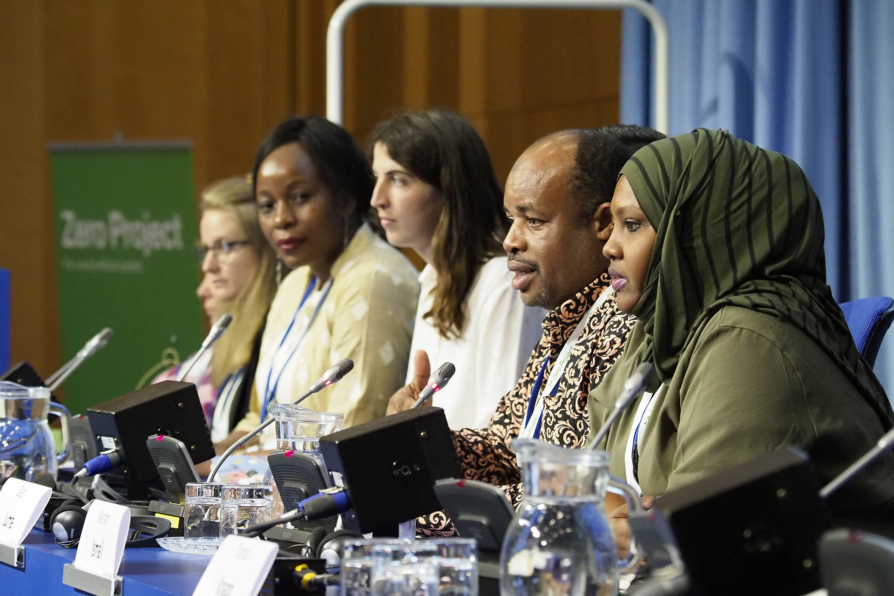
THE ZERO PROJECT CONFERENCE
CONNECT
Spotlight on Awardees
Hosted at the United Nations Office in Vienna, Austria
#ZeroCon22 hybrid event:
380 Participants
114 Sessions
200 Speakers
10,600 Livestream Views
Panel of Awardees and international policy makers presenting solutions at ZeroCon
Credits: Zero Project/Pepo Schuster, austrofocus.at

Slide 23
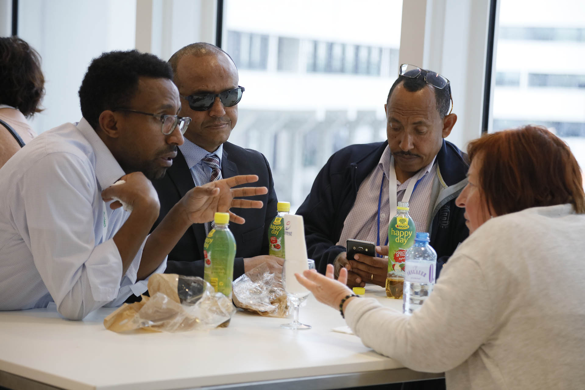
NETWORKING @ ZEROCON
CONNECT
Awardees showcase innovative solutions during parallel sessions
Curated networking sessions between Awardees and cooperative partners
Coffee & Connect for all participants to individually schedule networking 1:1 meetings
Scheduling appointment times for exhibitions to showcase their work
Pitch session for ICT solutions
Participants in conversation at ZeroCon.
Credits: Zero Project/Pepo Schuster, austrofocus.at

Slide 24
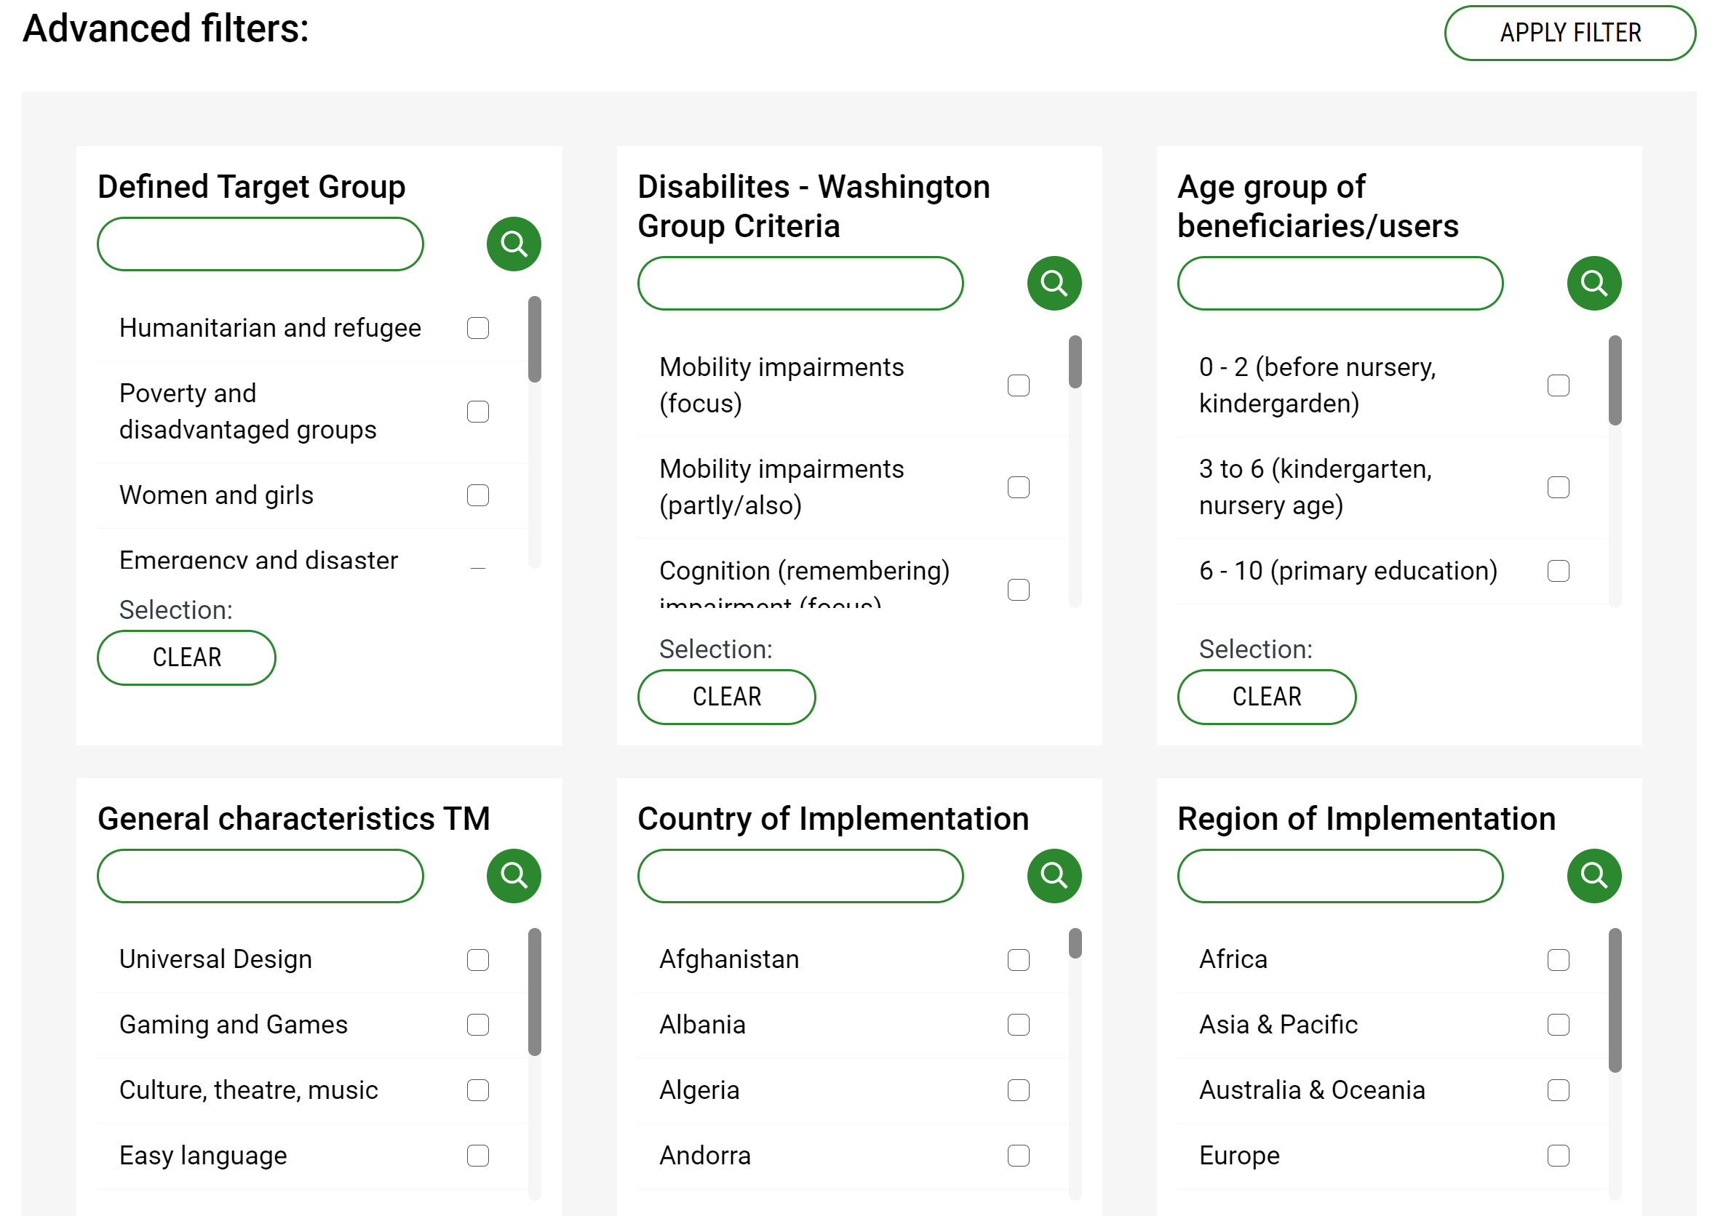
ZERO PROJECT DATABASE
IMPACT
Search 780+ innovative solutions from 120+ countries
Connect with innovators around the world
https://zeroproject.org/research/database
Notes:
The Zero Project Database is based on extensive peer-reviewed research. It's mapping and connecting solutions, experts, and organizations for a world with zero barriers. It is publicly available and free to use for anyone who wants to help creating a world with zero barriers. Along with your search results among 700+ solutions, you will also find contact details to connect with organizations and experts, videos about these projects, and stories from people using these solutions.
780+ SOLUTIONS
600+ ORGANIZATIONS
120+ COUNTRIES
6000+ EXPERTS

Slide 25
Access and Inclusion model - AIM Ireland
EXPAND
AIM is a non-binding standard for early intervention services addressing children with disabilities. In agreement with the parents, pre-schools can apply for seven different measures for implementation: These include mentoring, support equipment, targeted therapy services as well as personnel and financial assistance.

Slide 26
Access and Inclusion model - AIM Ireland
EXPAND
AIM has started in 2016 and the participation of children with disabilities in mainstream education has risen significantly in the years following.
https://aim.gov.ie/

Slide 27
Therapy on wheels - India
EXPAND
In 2019 the Samphia Foundation, an NGO based in Kullu in Himachal Pradesh, a mountainous state in India, started Therapy on Wheels. A team consisting of a therapist, a nurse, a social worker, and a driver travel from village to village in an accessible bus, providing services such as physio, occupational, and speech therapy to children with disabilities. Between 2020 and 2021 some 100 children received therapy, visited on average once a week.

Slide 28
Therapy on wheels - India
EXPAND
The project continued during lockdown times and is looking forward to being replicated.
https://chai-international.org/projects/therapy-on-wheels/

Slide 29
Thank you!
#FamilyCentredECI

Slide 30
Methodologies and findings on collecting good practices in family support
Supporting families with children with disabilities:
Fondazione Paideia’s approach
Fabrizio Serra
#FamilyCentredECI

Slide 31
Fondazione Paideia
Fondazione Paideia is a Family Foundation founded in 1993 in Turin, Italy, that offers tangible support to children with disabilities and their families.
Paideia adopts a systemic perspective that doesn’t just look after the children, but all those who take care of them, through an approach that places the family at the centre of the process.
Paideia develops projects aimed at providing direct support to families with children with disabilities to reduce the risk of social exclusion through a Family Centered Care approach.
#FamilyCentredECI
Notes:
is a Family Foundation founded in 1993 in Turin, Italy, that offers tangible support to children with disabilities and their families, participating in the development of a more inclusive and responsible society.
Paideia adopts a systemic perspective, to look not only after the children, but at all those who take care of them, through an approach that places the family at the centre of the process.
Paideia develops projects aimed at offering direct support to families with children with disabilities, but also social and leisure activities, to reduce the risk of social exclusion.
Paideia also develops specific cultural projects to promote social inclusion.
The Foundation has supported over 4000 families in almost thirty years of activity.
we often say that we do not deal with disabilities, but with families with children with disabilities

Slide 32
Family Centered Care approach
Paideia’s FCC approach, is based on:
respecting each family in its diversity;
being flexible in facing different family’s needs;
supporting and strengthening the family to be an active part in the child's development;
building a network of support around the family;
empowering of the family.
#FamilyCentredECI
Notes:
we often say that we do not deal with disabilities, but with families with children with disabilities

Slide 33
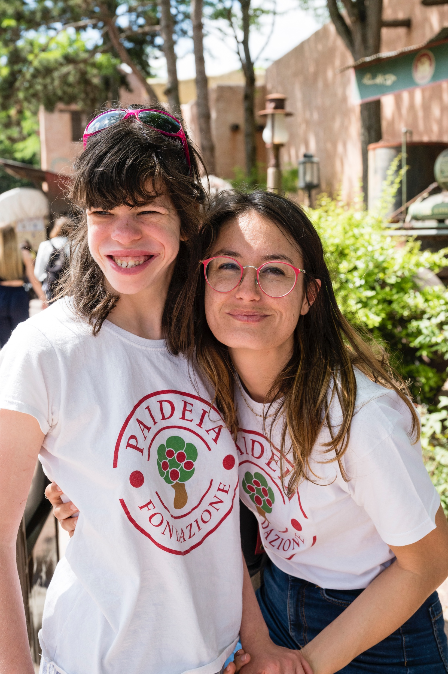
Paideia’s
numbers
Families supported | 2022 | 854
Children with disabilities | 2022 | 924
Autism | 417 | 45%
Genetic chromosomal diseases | 137 | 15%
Intellectual disability | 70 | 8%
Speech disorder | 42 | 4%
Early neuromotor impairment | 58 | 6%
Neuropsychological disorders | 50 | 5%
Developmental delay | 34 | 4%
Complex malformative framework | 25 | 3%
Dyspraxia | 26 | 3%
Sensory deficits | 16 | 2%
Epilepsy | 16 | 2%
Without specific diagnosis | 33 | 3%
#FamilyCentredECI

Slide 34
Paideia’s numbers
Age of children with dis.
208 | 0-5 y. | 22%
464 | 6-10 y. | 50%
181 | 11-14 y. | 20%
71 | > 15 y. | 8%
Age of siblings | 165
0-5 y. | 40 | 24%
6-10 y. | 57 | 35%
11-14 y. | 35 | 21%
≥ 15 y. | 33 | 20%
Nationality
205 | Foreign | 24%
649 | Italian | 76%
#FamilyCentredECI

Slide 35
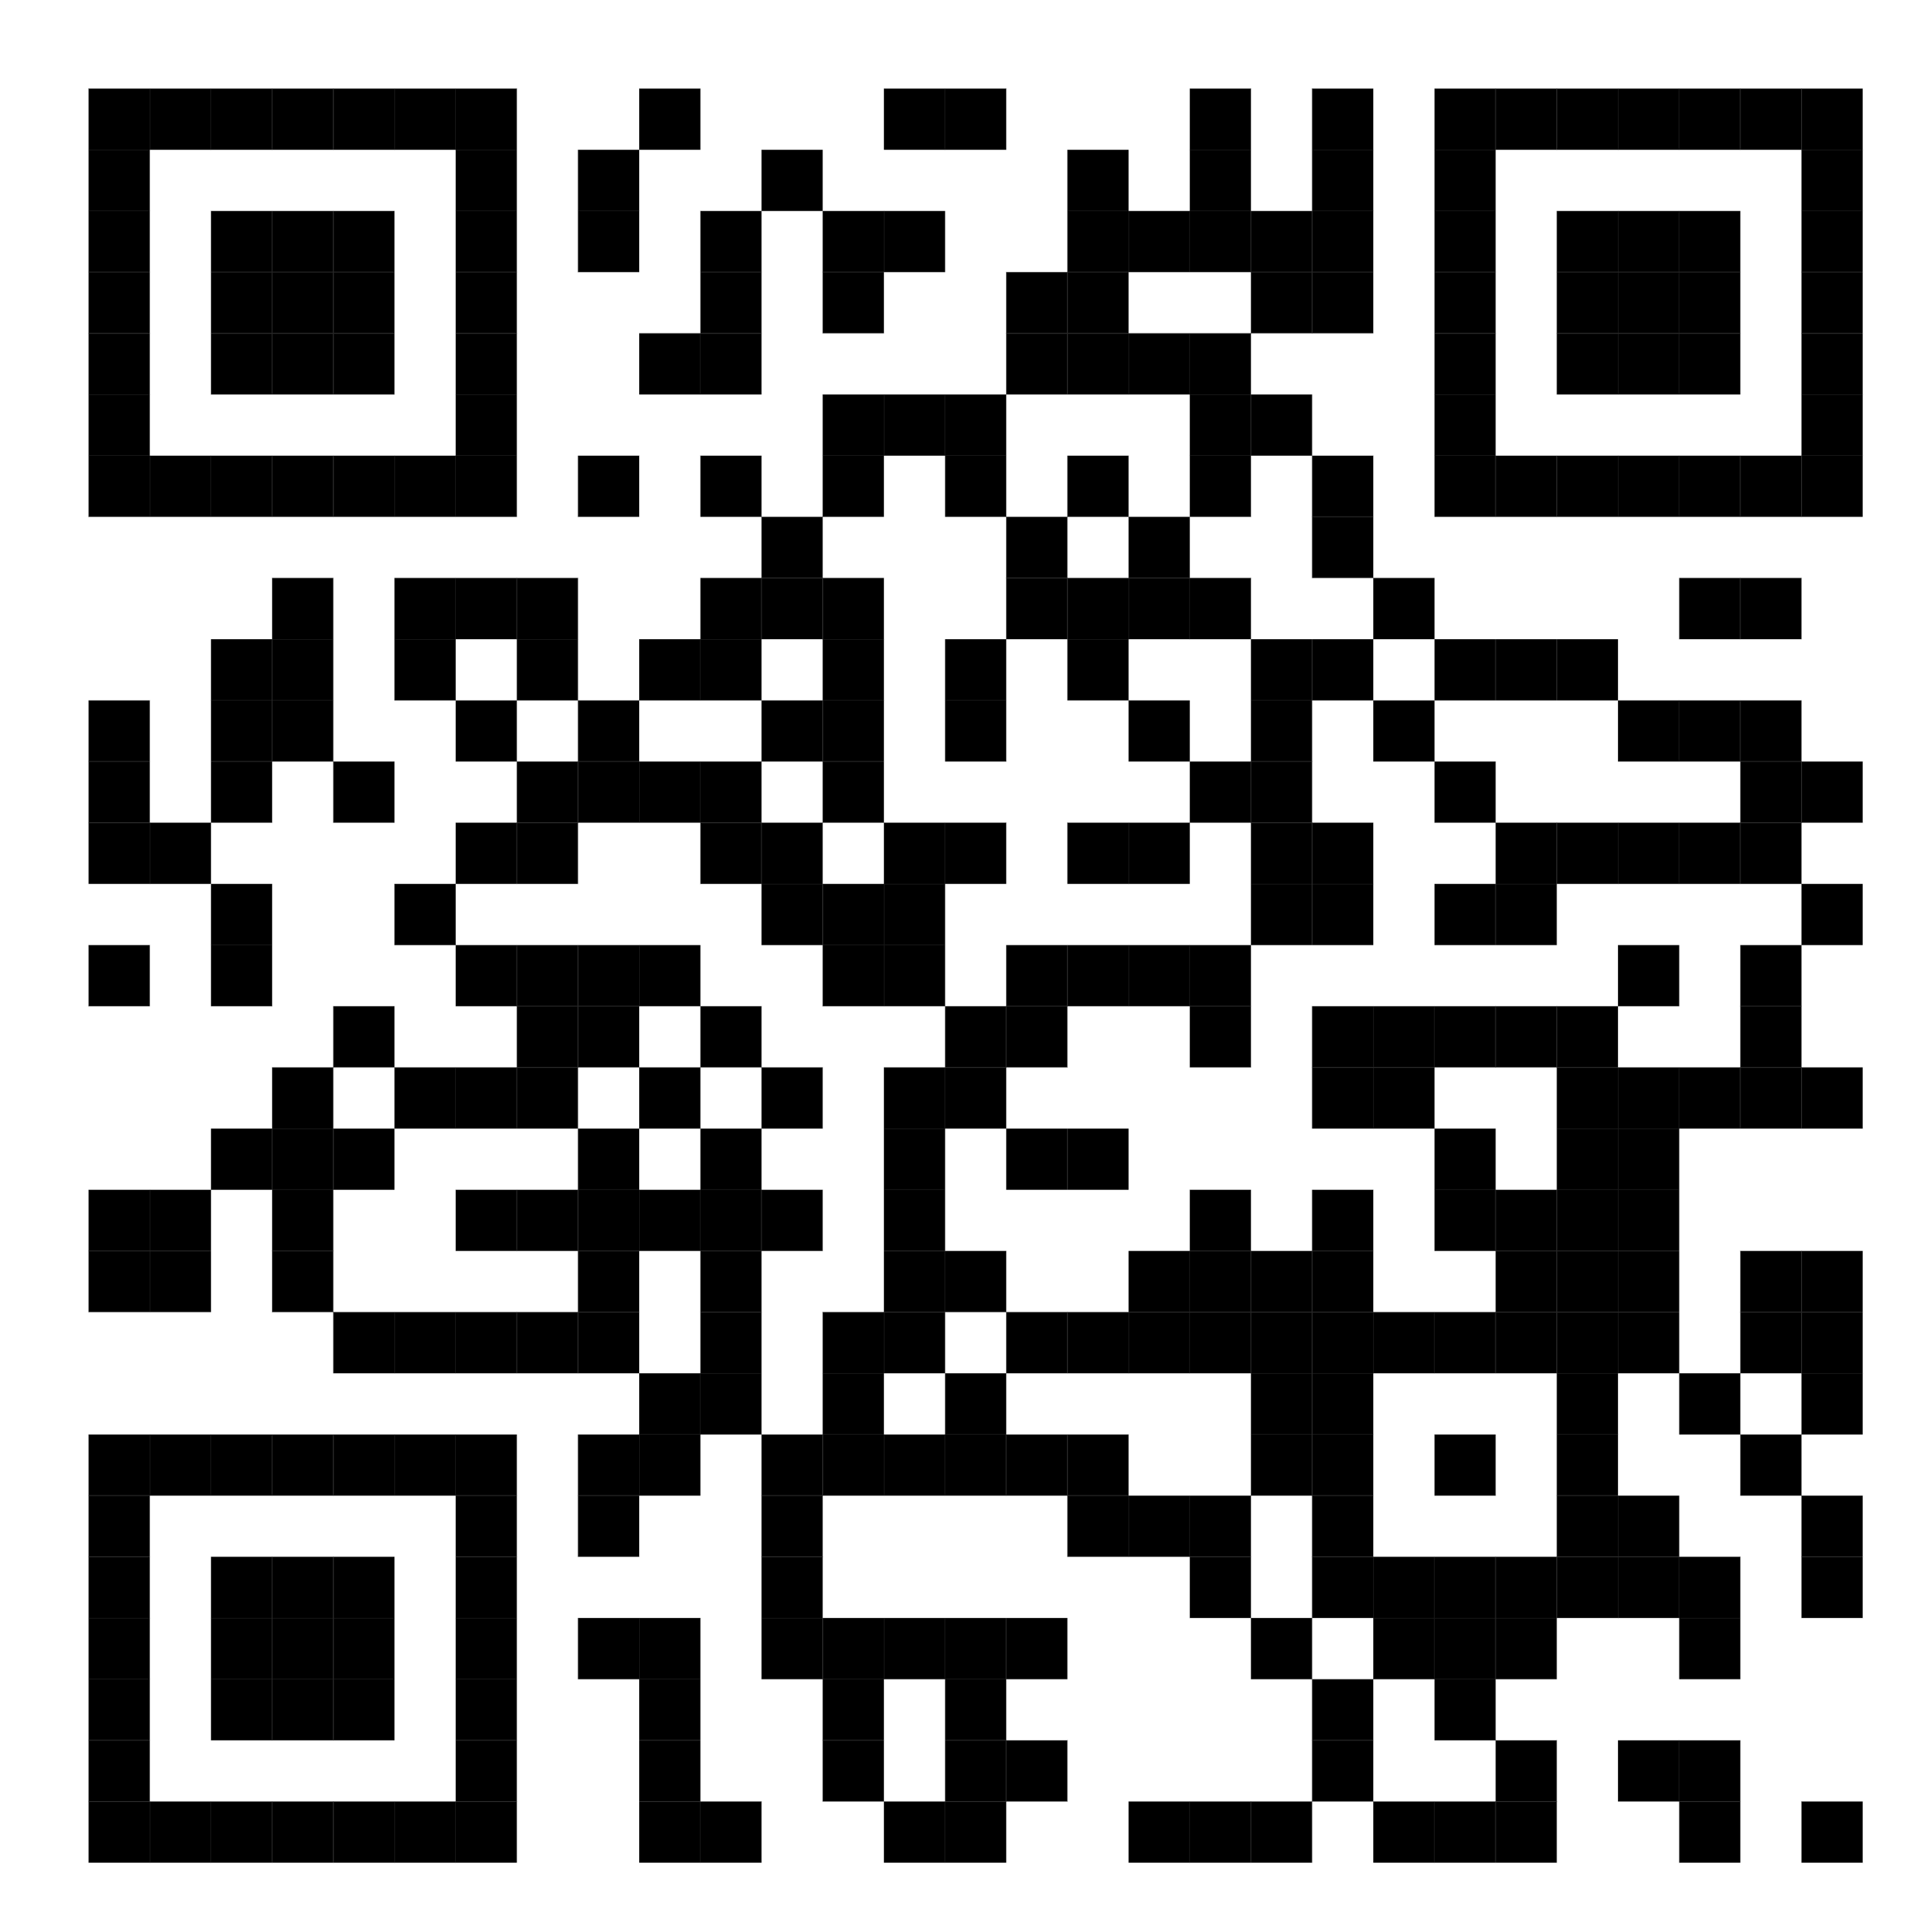
Fondazione Paideia
https://youtu.be/heUtYnDvCdU
#FamilyCentredECI
Notes:
Paideia Foundation’s work is based on a Family Centered Care approach, a way of working that focuses on the whole family. We start by evaluating family needs and enhancing its strengths and resources: every family is unique, indipendently from the type of disability, in particular because the impact of disability depends on the capacity of facing it in their personal life experience.
The main objective of the Paideia Foundation, in synergy with the external network of Social Services and the school system, is to become a driver of change in every aspect of life, going beyond the borders of an exclusively rehabilitative and health vision, working on the psychophysical and emotional well-being of each family member, providing differrent opportunities.

Slide 36
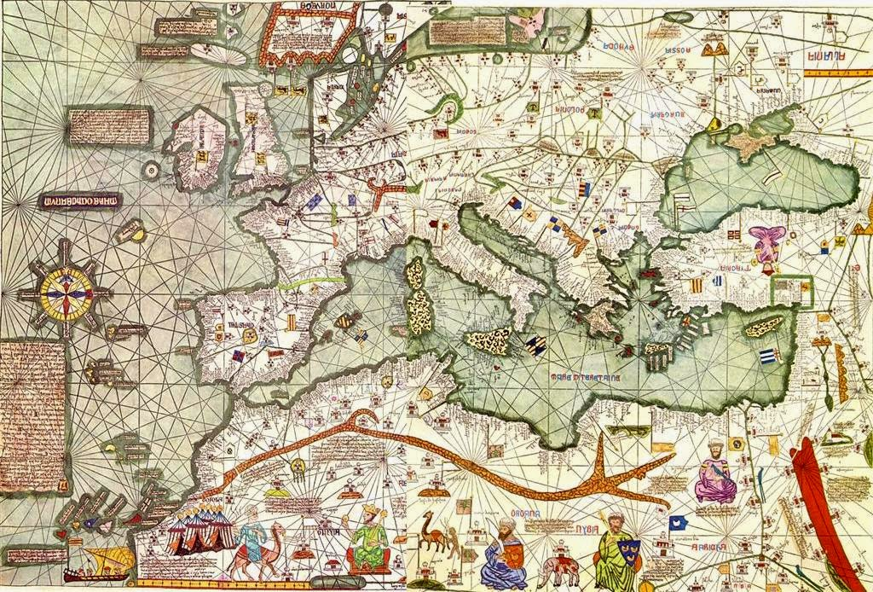
Focus Group
Through the experiences of others you can cope better with your own journey.
In fact, the contributions of other families and group experiences can help you strengthen your self-esteem, enhance your abilities, and understand how to face new challenges and activate effective strategies to handle the most difficult situations.
#FamilyCentredECI

Slide 37
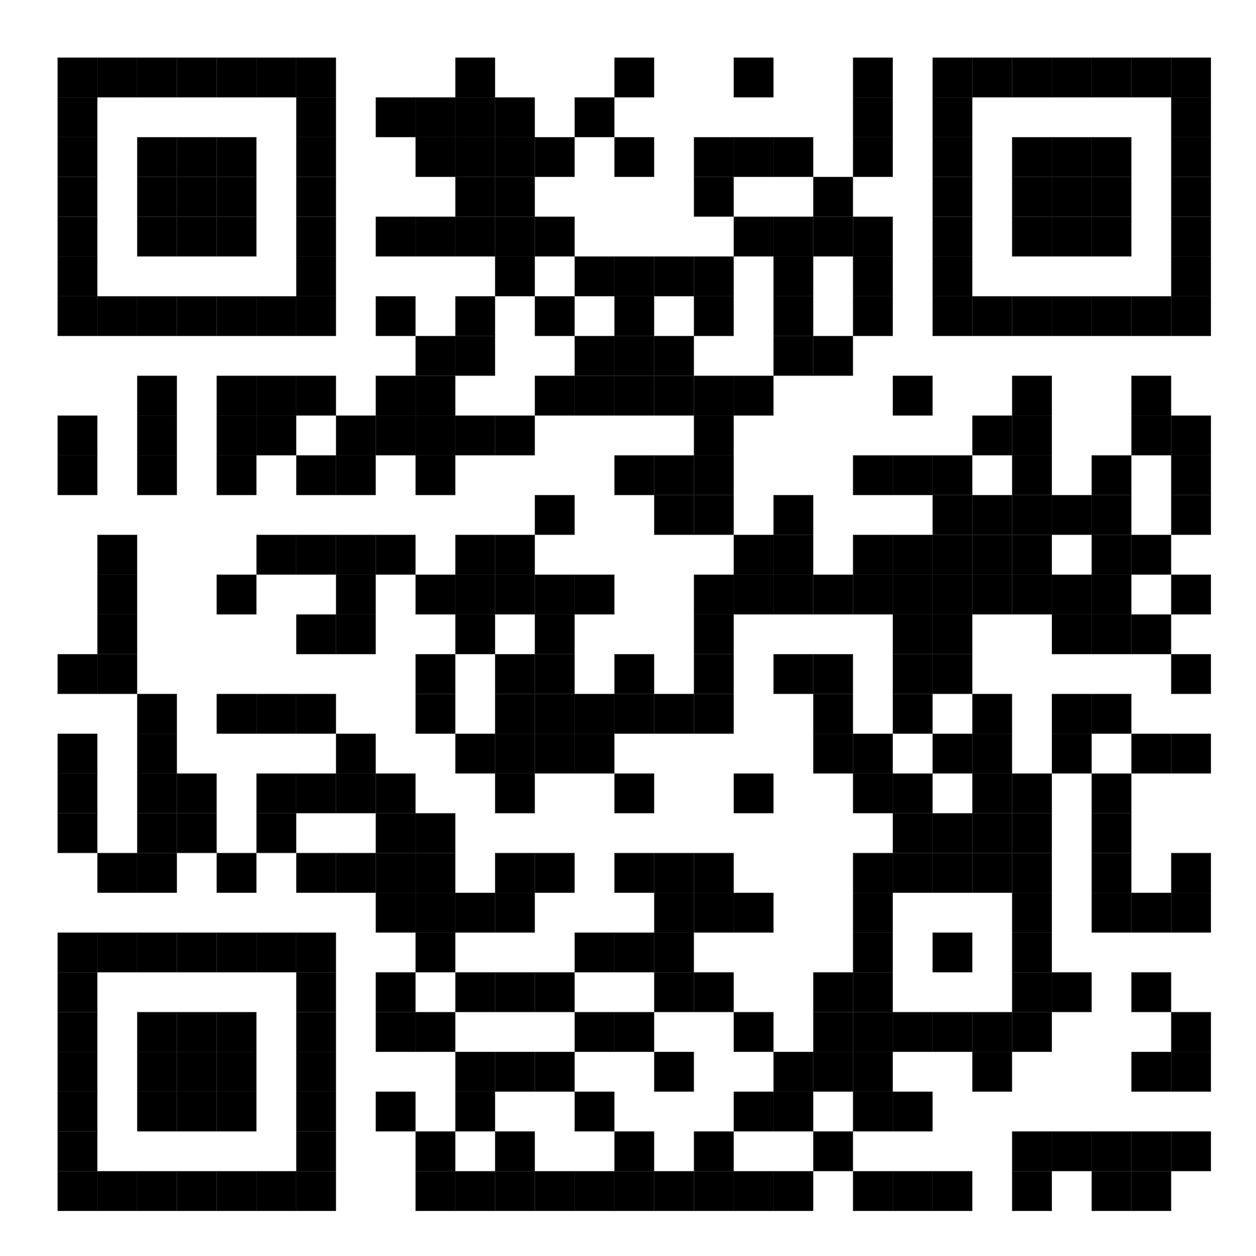
Centro Paideia
https://www.youtube.com/watch?v=heUtYnDvCdU
Paideia Center was created in 2018 to translate a shared concept, INCLUSION, into a TANGIBLE experience.
#FamilyCentredECI
Notes:
In particular services include:
Rehabilitation courses (speech therapy, psychomotor therapy, psychoeducational interventions).
Social and psychological counselling.
Financial support to families.
Targeted support to siblings ("Giving voice to siblings") and support activities for other family members (incl. grandparents).
Training for professionals for facilitating support groups/interventions.
Holiday and socialisation programs, sports, and recreational activities.
Social farm and multisensory park.
Receiving and training of volunteers.

Slide 38
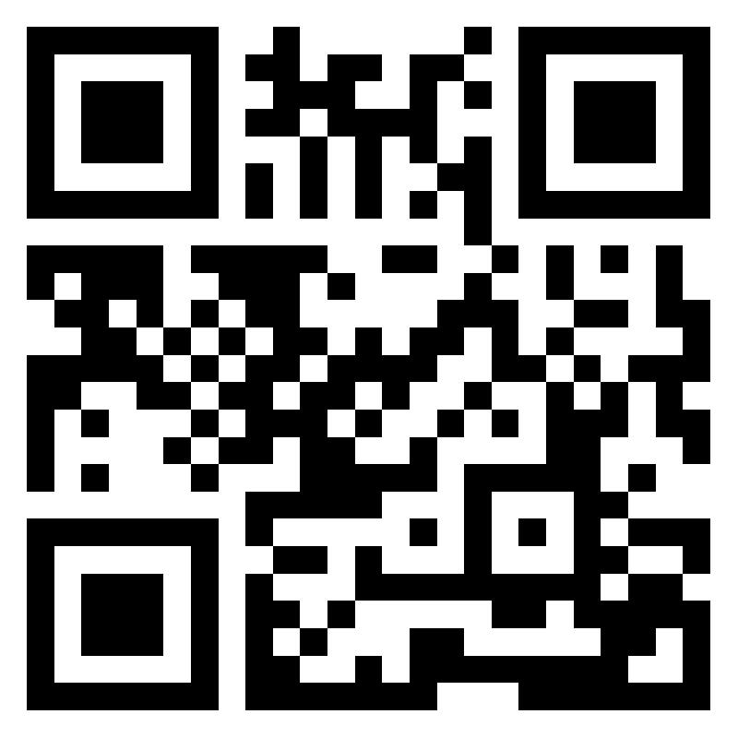
Thanks for your attention
fondazionepaideia.it
#FamilyCentredECI

Slide 39
Q&A and Discussion
Have you come across any particular practices that you would like to share?
Are there any specific tools or resources that you would like more information about to support their implementation?
Can you share any examples of obstacles or setbacks you have encountered while implementing new practices and how you overcame them?
#FamilyCentredECI

Slide 40
Announcements
The Conference dinner will take place at 19h30 in the Plenary Room (Room Alkernia)
Member fora
Join us tomorrow for our 2nd day of the conference. Starting time: 09h30
16h15-18h15 | Member Forum on Person-Centered Technology | Room: Bogdani
16h15-18h15 | Member Forum on Workforce Development | Room: Onufri
16h15-18h15 | Member Forum on Policy Impact Group | Room: Metropol
#FamilyCentredECI

Slide 41
Thank you for your attention
fondazionepaideia.it
#FamilyCentredECI

