Slide 1








Workshop 5:
Routine-based Intervention and home visiting
Moderator: Eric Bloemkolk
Speakers: Anna Kukuruza, Maria Kastanis
#FamilyCentredECI

Slide 2


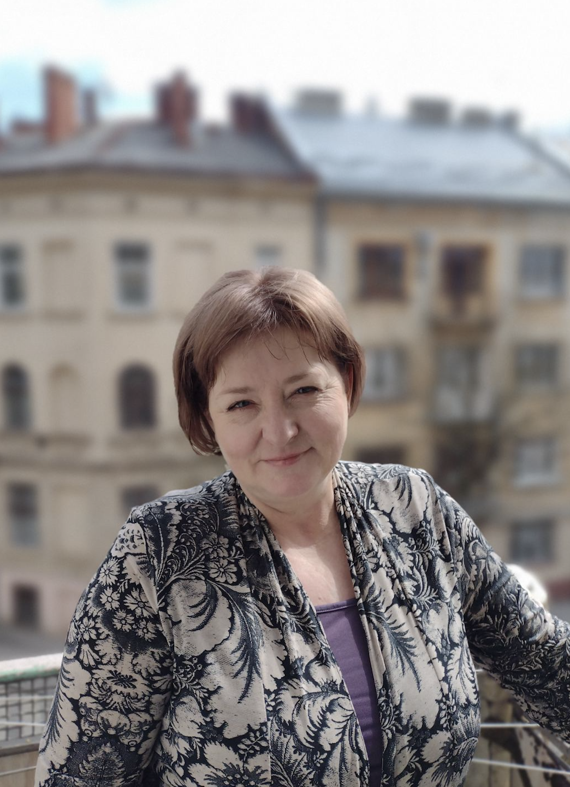

Introductions
Anna Kukuraza
Head of the Department of Developmental Psychology, Institute of Children and Juvenile Health Protection, Ukraine
Executive Director, CF Early Intervention Institute, Ukraine
#FamilyCentredECI

Slide 3
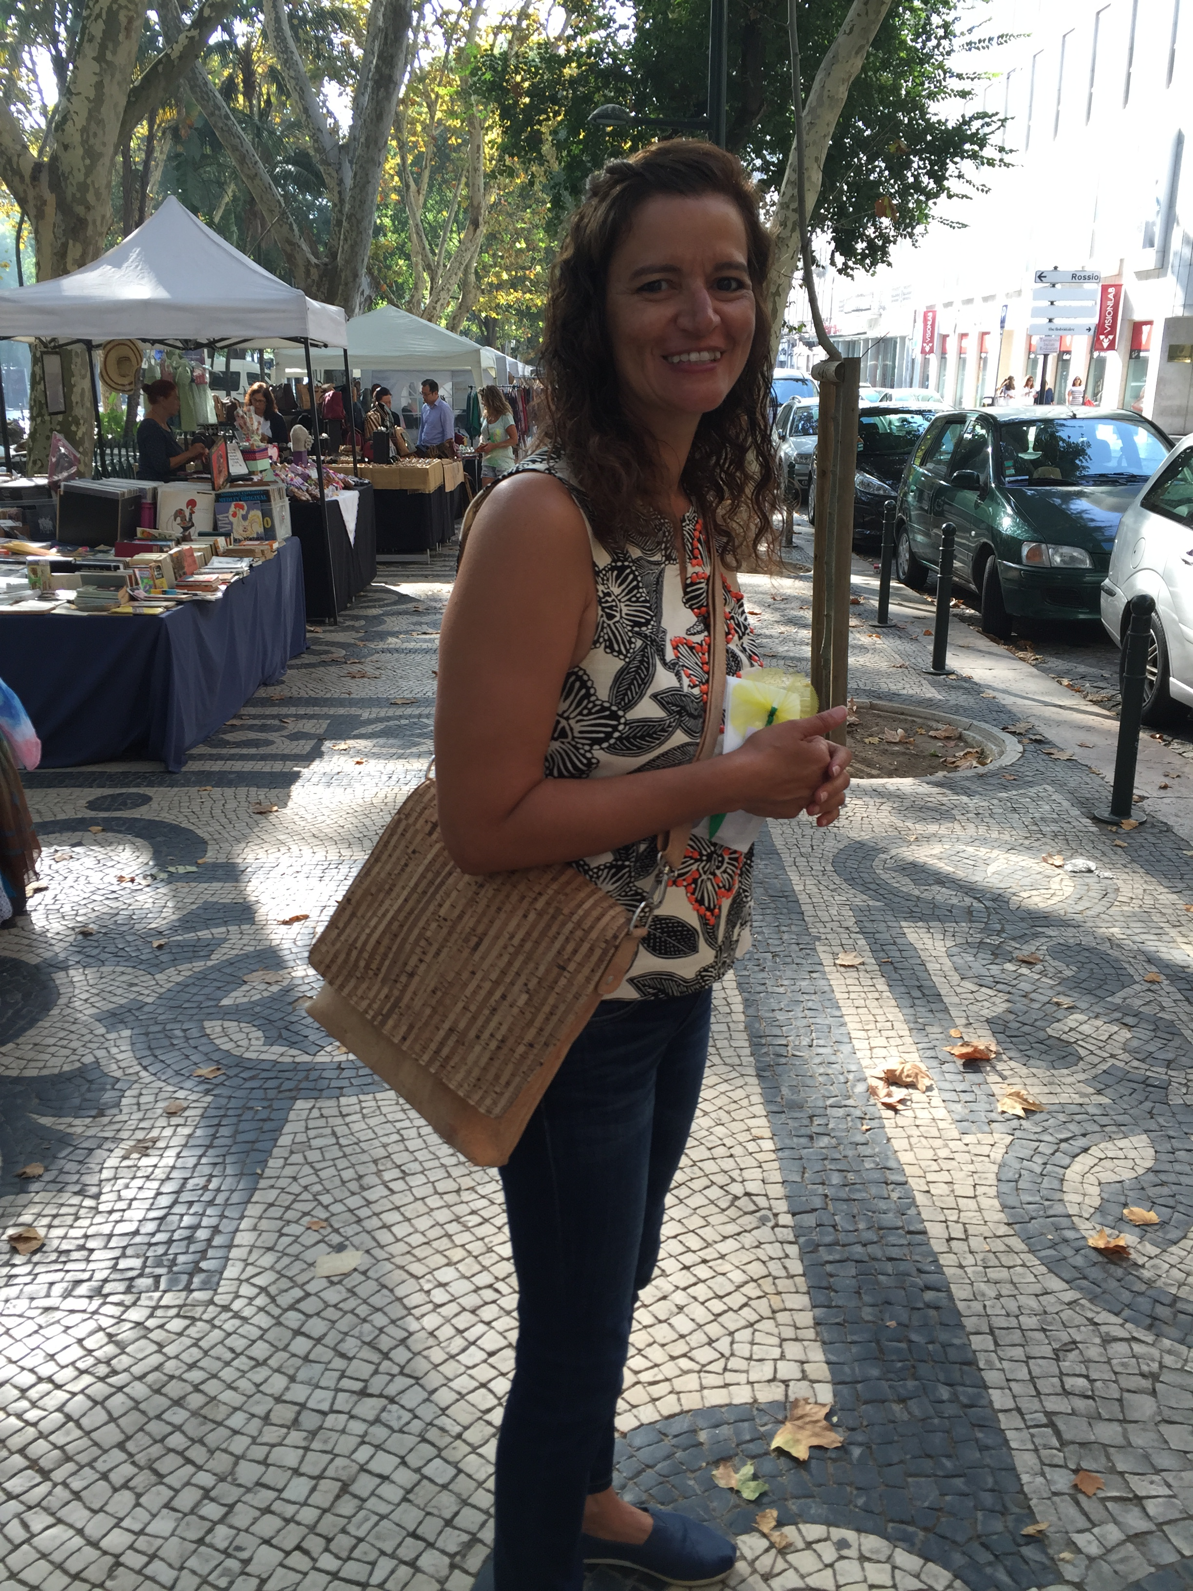

Introductions
Maria Kastanis
Associate Director Early Intervention Training Program At The University Of Illinois Urbana Champaign
#FamilyCentredECI

Slide 4

GETTING TO KNOW YOU
Who is in the room with us today?
What do you like to do on the weekend?
#FamilyCentredECI

Slide 5

Mock RBI
Pair up with someone you do not know
1 Interviewer, 1 Interviewee
Find out:
Their name, age, family structure including marital status, children, siblings
University – where attended, what activities they participated in
Best and worst moments on a job
Their routine this morning
#FamilyCentredECI

Slide 6
Getting to Know You
What did you learn about your interview partner?
How easy or hard was it to engage in a conversation with someone you don’t know and share personal information?
Did you ask questions directly or let the conversation flow and try to fill in gaps?
#FamilyCentredECI

Slide 7
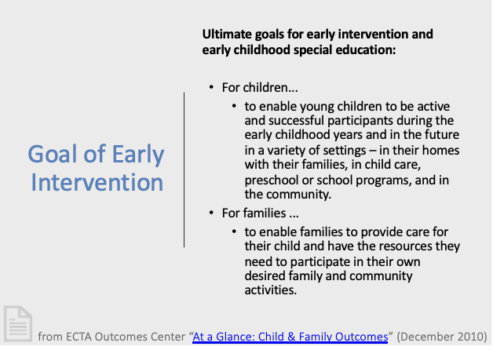
#FamilyCentredECI

Slide 8

AGENDA
How children learn and how services work
Needs assessment
Service decision making
Support provision
#FamilyCentredECI

Slide 9
Getting to Know You
What did you learn about your interview partner?
How easy or hard was it to engage in a conversation with someone you don’t know and share personal information?
Did you ask questions directly or let the conversation flow and try to fill in gaps?
#FamilyCentredECI

Slide 10
How Children Learn
How services work……
#FamilyCentredECI

Slide 11
How Children Learn
The Environment
The Child
Through repeated interactions with the environment, dispersed over time.
Not in massed trials
#FamilyCentredECI

Slide 12
Who Has Influence on What
Professional Support
Caregiver Competence & Confidence
Child Outcomes
#FamilyCentredECI

Slide 13
Between Visits
Child/Family Interactions
+
Other Learning Opportunities
Home Visit
FAMILY
Child Learning
+
FAMILY
#FamilyCentredECI

Slide 14
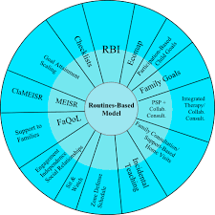
Routines-Based Model
R.A McWilliam
#FamilyCentredECI

Slide 15
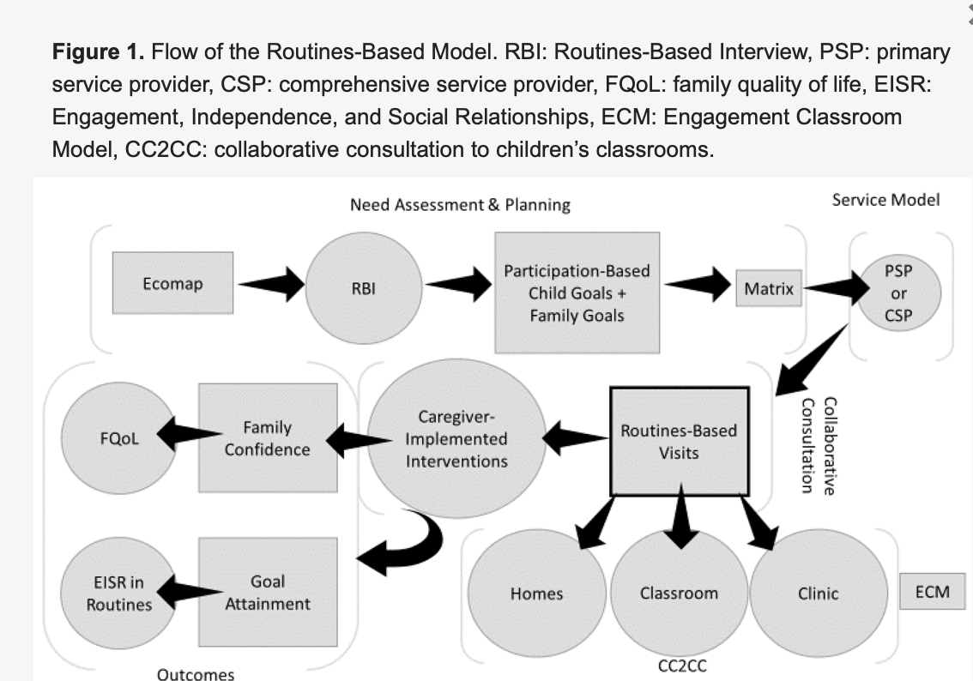
Routines-Based Model
R.A McWilliam
#FamilyCentredECI

Slide 16
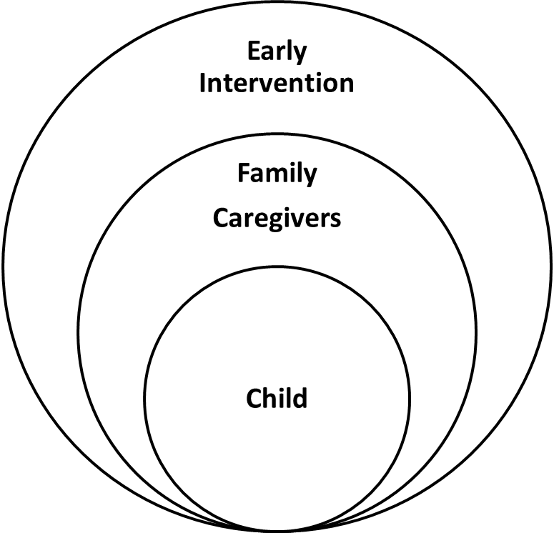
Routines-Based Model
Principles
  All the intervention occurs between visits
  Caregivers are competent adults
  Function = participation = engagement
  Avoid non-evidence-based, highly popular treatments
Characteristics
  Family centered
  Naturalistic
  Functional
  Research-based
  Contextual
  Consultative
  Streamlined
  Individualized
  Comprehensive
R.A. McWilliam
#FamilyCentredECI

Slide 17
Routines-Based Model
Evidence Based Model
Family Centered
3 Types of Support
Opportunities for meaningful decision making
Functional
In routines
Meet family needs
Interventions by caregivers
#FamilyCentredECI
Notes:
3 types of Support:
Informational –what is EI, info about their child’s development, disability
Material – food, shelter, basic needs
Emotional – feeling a sense of belonging, entire family, positive feelings about their child

Slide 18
Example: War in Ukraine
Material Support
Informational Support
Emotional Support
#FamilyCentredECI
Notes:
3 types of Support:
Informational –what is EI, info about their child’s development, disability
Material – food, shelter, basic needs
Emotional – feeling a sense of belonging, entire family, positive feelings about their child
Anna Talk about how war can affect the type of support and how the type of support may be shifting

Slide 19
Needs Assessment
What do families need?
#FamilyCentredECI
Notes:
How do you currently determine family needs? We need to go beyond what are the major concerns but also look at how these concerns impact daily life, how do those concerns impact the child’s and family’s participation in home, community and school activities

Slide 20
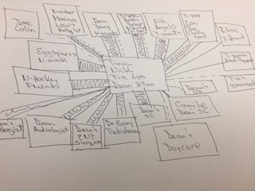
The Ecomap
#FamilyCentredECI
Notes:
Has anyone ever used Ecomaps?

Slide 21
The Ecomap
We need to show that we are interested in the family, not just the child
Children live in families
We need something to establish a friendly interested relationship
Could be used as an alternative to finding out about who lives in the home
#FamilyCentredECI

Slide 22
Stated Purpose
I’d like to find out about the people in your life, so we know what supports you have and who might be able to help meet the goals you set.
I’ll ask you some questions and draw a picture we call an ecomap.
If there’s anything you don’t want to say, don’t say it.
Is this ok?
Who lives in the home with your child and you?
#FamilyCentredECI

Slide 23

Supports
Informal Supports
People living with the child
Mother’s family
Father’s family
Neighbors and family friends
Mother’s friends
Father’s friends
Community friends (worship, play groups, gym, etc)
Work friends
Formal Supports
Doctors
Teachers
Therapists
Financial agencies
#FamilyCentredECI
Notes:
Anna/ Talk about how this has changed

Slide 24
Questions
How often do you see or talk to them
If something cool were to happen to one of your children, who would you call
    The important thing is to find out how supportive or stressful this person is
CAUTION: What could happen if we asked… “How do you get along with them?”
#FamilyCentredECI
Notes:
MK
Don’t ask “do you like them?” Not about judging the relationship
The only time you ask them about “do you like them?” is when we ask about formal supports
Handout: RBI with Ecomap Checklist

Slide 25
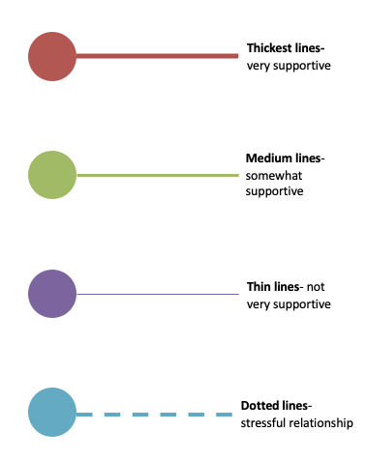
Thickness of the Line
#FamilyCentredECI

Slide 26
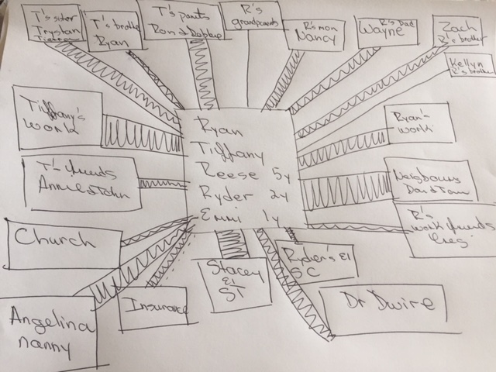
Thickness of the Line
#FamilyCentredECI

Slide 27
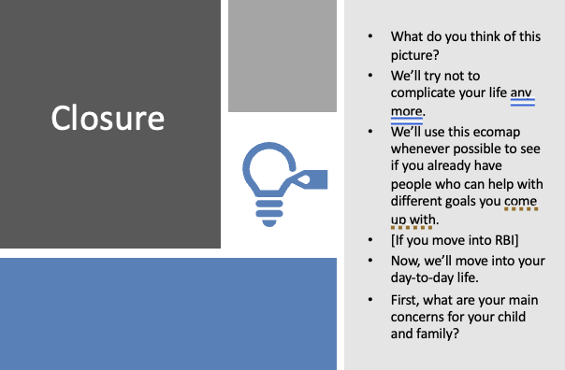
Closure
#FamilyCentredECI

Slide 28

Needs Assessment
#FamilyCentredECI

Slide 29
Why a Functional Needs Assessment
Functional IFSP Outcomes to address independence, engagement, and social relationships
Family priorities should be reflected in the IFSP
Outcomes need to be broad yet specific
Strategies need to directly related to the functional need of the child
Caregivers, other than family members, need to be invested in the plan
#FamilyCentredECI

Slide 30
3 Purposes of the RBI
Establish positive relationship with the family
01
Rich and thick description of functioning
02
List of functional, family-centered outcomes
03
#FamilyCentredECI

Slide 31
Routines-Based Interview
A semi-structured interview to gather information for both child & family assess
Assessing Child:
  Engagement
  Independence
  Social Relationships
Assessing Family
  Satisfaction with routines
#FamilyCentredECI

Slide 32
Foundations of Learning
Engagement
Independence
Social Relationships
#FamilyCentredECI
Notes:
What do we mean by Enagagement , Independence, and social relations. Handout EISR

Slide 33
Engagement
How does the child participate in this routine?
How does the child spend most of his or her time?
How sophisticated is the child’s engagement?
  Nonengaged?
  Passive attention?
  Repetitive behavior?
  Differentiated behavior?
  Solving problems?
  Following the conventions of the routine?
#FamilyCentredECI
Notes:
Engagement can be defined as - The amount of time the child spends interacting in a contextually and developmentally appropriate manner with adults, peers, and materials.
Invite the group to think about what engagement would look like for a child during an activity like circle time or getting dressed– provide an example if needed
Nonengaged?
Passive attention?
Repetitive behavior?
Differentiated behavior?
Solving problems?
Following the conventions of the routine?

Slide 34
Independence
What does the child do by him- or herself? What does he or she need help with?
Can the child be left to participate in this routine without assistance?
How does the child indicate a need for help?
How does the child respond when help is given?
What do you want them to do more independently, if anything?
#FamilyCentredECI
Notes:
Important to think about cultural preferences of the family and to ask about them.
Cultural considerations

Slide 35
Social Relationships
How does the child communicate during this routine?
How does he or she respond to communication from others?
How does he or she express him- or herself?
How sophisticated is the child’s communication?
What communicative mode does the child use?
How easy is it for the child to be understood?
#FamilyCentredECI

Slide 36
Social Relationships Con’t
How does the child get along with others during this routine?
How cooperative is he or she?
How much does he or she initiate interactions?
How interested is he or she in others?
How does he or she respond to correction from adults?
What kind of correction do adults provide?
#FamilyCentredECI
Notes:
Important to think about cultural preferences of the family and to ask about them.
Cultural considerations

Slide 37
Let’s Observe
Oliver Feeds Himself
#FamilyCentredECI
Notes:
Show video and explain to the group that we are going to think about the questions you would ask to be able to learn about this routine -- what questions would you ask to be able to visualize the movie in your head.
1st part of activity is pulling information about what we saw related to engagement, independence, and social relationships .
2nd part of the activity is to think about your questions you ask and identify which ones “get at’ each of these aspects of development?
https://www.youtube.com/watch?v=r6bM4sOOOV4

Slide 38
Routines-Based Interview
“The purpose of structuring the interview around family routines is to identify what the family already does and what the family wants to do…The stress on routines is because of the behavioral-ecological notion that routines are the context in which the need for intervention is “authentically” determined.”
McWilliam, R.A., Casey, A, Sims, J (2009) The Routines-Based Interview: A Method for Gathering Information and Assessing Needs. Infants & Young Children, 22, 224-233
#FamilyCentredECI

Slide 39
Effects of Conducting RBIs
Meatier Intervention plans
More functional and participation-based outcomes-Fewer irrelevant clinical or vague outcomes
More family-based outcomes
Meaningful to families
Reinforces the parent’s role as the expert of their family
#FamilyCentredECI

Slide 40
Service Decisions
More is Not Better
One primary or comprehensive service provider
Support family with all child and family needs
Use secondaries as necessary
R. A. McWilliam
#FamilyCentredECI

Slide 41
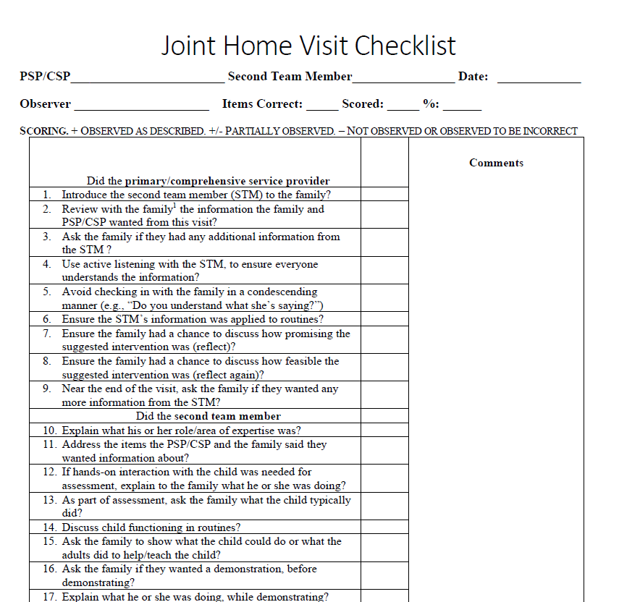
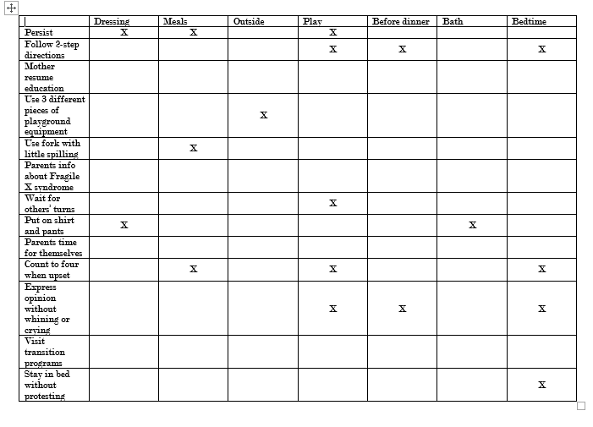
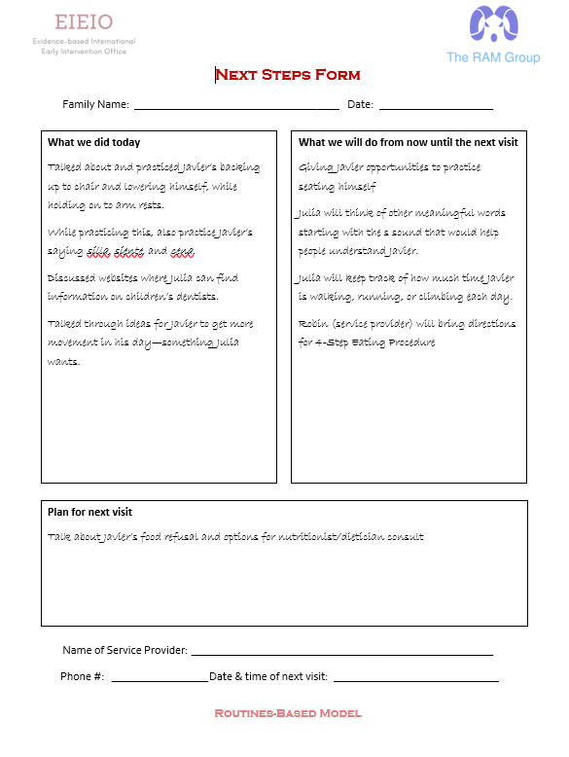
Tools: Routines-Based Model
Matrix
Next Steps Form
R. A. McWilliam
#FamilyCentredECI

Slide 42
Support Provision and Capacity Building
Hoosiers Rule
Incidental Teaching in Routines
Use Informal Supports
R. A. McWilliam
#FamilyCentredECI

Slide 43
Things Not to Do
Pile
Mindlessly pile on services
Restrict
Restrict yourself to one discipline
Work directly with the child. No toy bags
Give caregivers recommendations right away
Work
Give
Go
Go it alone
R. A. McWilliam
#FamilyCentredECI

Slide 44
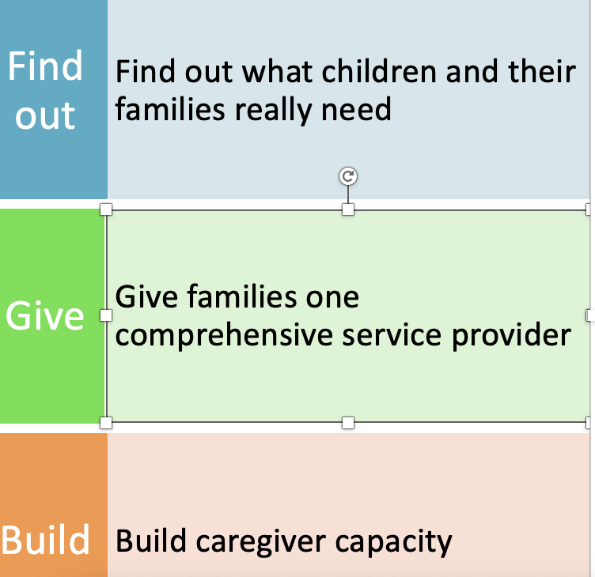
Do
R. A. McWilliam
#FamilyCentredECI

Slide 45

Questions
#FamilyCentredECI

Slide 46
Keep in Touch
Anna Kukuruza avkukuruza62@gmail.com
Maria Kastanis mkastani@Illinois.edu
#FamilyCentredECI

Slide 47
Announcements
The Conference dinner will take place at 19h30 in the Plenary Room (Room Alkernia)
Member fora
Join us tomorrow for our 2nd day of the conference.
Starting time: 09h30
16h15-18h15 | Member Forum on Person-Centered Technology | Room: Bogdani
16h15-18h15 | Member Forum on Workforce Development | Room: Onufri
16h15-18h15 | Member Forum on Policy Impact Group | Room: Metropol
#FamilyCentredECI

Slide 48

Thank You
This Photo by Unknown Author is licensed under CC BY-NC-ND
#FamilyCentredECI

