Slide 1
Workshop 6: UNICEF’s safeguarding policies and procedures to redefine organisations
Lucy M Richardson
Child Protection Specialist – Disability Inclusion,
Programme Division, HQ, UNICEF.
#QualitySocialServices

Slide 2
About this session
Definitions
Frameworks
UNICEF’s Safeguarding Framework
UN PSEA Framework
UNICEF’s PSEA Framework
UNICEF’s PSEA Programming
Reporting
Survivor Support
Accountability
Taking Action
#QualitySocialServices

Slide 3
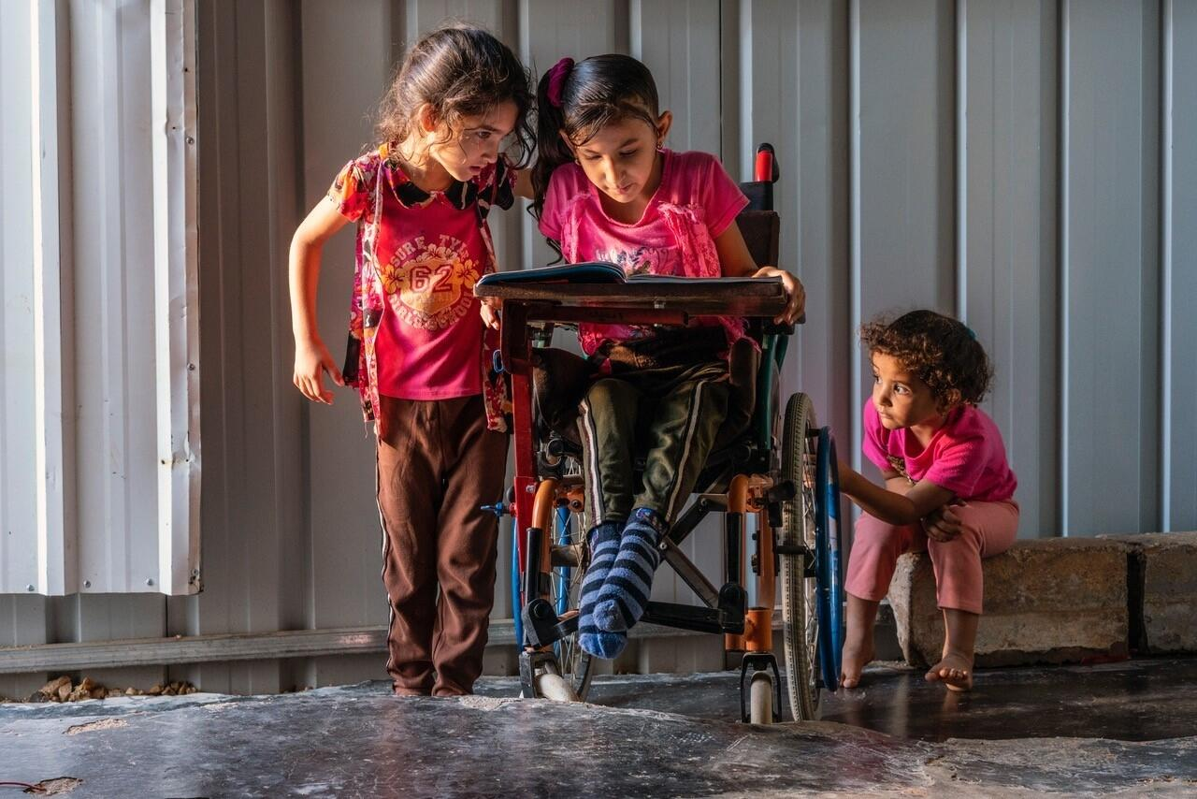
Definitions
© UNICEF/UN0374251
#QualitySocialServices

Slide 4
Definitions
Sexual Exploitation: actual or attempted abuse of a position of vulnerability, differential power, or trust, for sexual purposes, including, but not limited to, profiting monetarily, socially or politically from the sexual exploitation of another.
Sexual Abuse: actual or threatened physical intrusion of a sexual nature, whether by force or under unequal or coercive conditions.
(SEA = Sexual Exploitation and Abuse)
#QualitySocialServices

Slide 5
Definitions
Protection from Sexual Exploitation and Abuse (PSEA) is the responsibility to prevent and respond to incidents of sexual exploitation and abuse (SEA) by United Nations, NGO, Government implementing partners and intergovernmental organization personnel against beneficiaries of assistance and other members of affected populations.
PSEA is the responsibility of all actors, at all levels, in all places.
#QualitySocialServices

Slide 6
Definitions
Safeguarding: The proactive measures taken to limit direct and indirect collateral risks of harm to children, arising from an entity’s work, personnel or associates.
Risks may include those associated with physical violence (including corporal punishment); sexual violence, exploitation or abuse (SEA); emotional and verbal abuse; economic exploitation; failure to provide for physical or psychological safety; neglect of physical, emotional or psychological needs; harmful cultural practices; privacy violations.
#QualitySocialServices

Slide 7
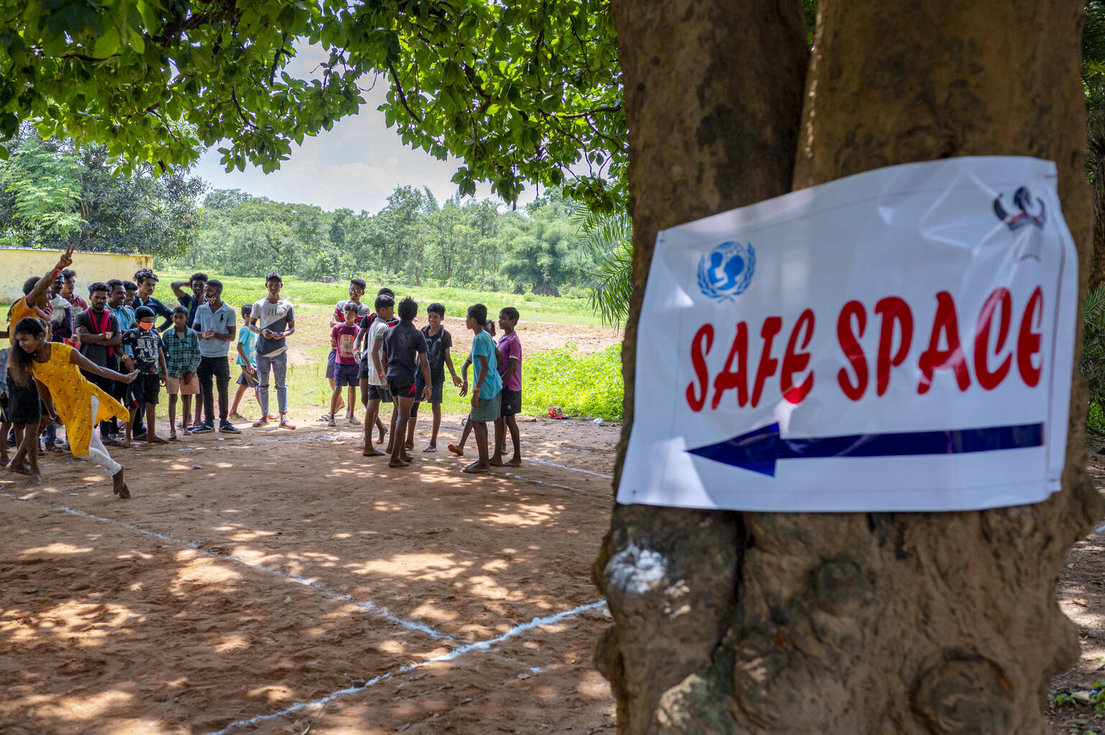
Frameworks
© UNICEF/UN0516621/Panjwani
#QualitySocialServices

Slide 8
UNICEF’s Safeguarding Framework
Policy on Conduct Promoting the Protection and Safeguarding of Children
UNICEF Procedure for a Child Safeguarding Framework
#QualitySocialServices

Slide 9
United Nations Actions on PSEA
UN Secretary-General Bulletin on PSEA, incorporating IASC Principles
IASC Minimum Operating Standards for PSEA
2019
OECD Development Assistance Committee Recommendation on PSEAH
UN Protocol on the Provision of Assistance to Victims of SEA.
Revised IASC Core Principle #4
2003
IASC Principals
set the Transformation Agenda and establishes the PSEA Championship
2013
2017
UN System Wide Strategy
on PSEA
Circle of Leadership
on PSEA
Voluntary Compact
on PSEA
2011
KEY UNITED NATIONS DEVELOPMENTS ON PSEA
UN Special Coordinator on PSEA role created
UN Security Council Resolution 2272: Repatriation of peacekeeping forces
UN Protocol on Allegations of SEA involving Implementing Partners
IASC Plan for accelerating PSEA in Humanitarian Response at Country Level
Management Accountability Framework (including PSEA responsibilities for Resident Coordinators)
IASC 6 Core Principles adopted
UN General Assembly Resolution: Strategy on Assistance and Support to Victims of SEA
2002
2008
2016
2018
2021
#QualitySocialServices

Slide 10
IASC 6 Core Principles for PSEA
1. NO SECOND CHANCE
2. NO SEXUAL ACTIVITY
WITH CHILDREN
3. DO NOT HIRE
OR BRIBE
ANYONE FOR SEX
SEA by workers constitute acts of gross misconduct and are grounds for termination of employment.
Sexual activity with children (persons under the age of 18) is prohibited regardless of the age of majority or age of consent locally.
Exchange of money, employment, goods, or services for sex, is prohibited. This includes hiring prostitutes.
5. ALWAYS
REPORT SEA
6. DISCOURAGE SEA AROUND YOU
4. NO SEXUAL RELATIONSHIPS WITH BENEFICIARIES
Workers are obligated to report any concern of SEA by a fellow worker, whether in the same agency or not, he or she must report such concerns via established agency reporting mechanisms
Workers are obliged to create and maintain an environment which prevents SEA
Any sexual relationship with beneficiaries that involves improper use of position is prohibited.
#QualitySocialServices

Slide 11
Zero Tolerance Approach
#QualitySocialServices

Slide 12
Roles and responsibilities of UN personnel
Know the standards of conduct on SEA
Comply with the standards of conduct on SEA
Report SEA by UN and related personnel
Cooperate with SEA investigations and victim assistance
Participate in SEA trainings and awareness-raising
Identify, mitigate, avoid SEA-related programme risks
ALL
PERSONNEL
MANAGEMENT
PSEA FOCAL POINT
HUMAN RESOURCES
Support to management on PSEA.
Support Country Office action plan.
Coordinate responses to allegations.
Conduct training, awareness-raising.
Coordinate with other actors on PSEA.
Support inter-agency actions on PSEA.
Oversee SEA prevention and response.
Review & update PSEA policies/guidance.
Ensure resources for PSEA.
Oversee investigations of SEA.
Coordinate with other actors on PSEA.
Screening of candidates.
Ensure code of conduct is signed.
Ensure staff complete training.
Include PSEA in contract agreements.
Communication during investigations.
Retain PSEA-related documents.
#QualitySocialServices

Slide 13
UNICEF’s
PSEA
Framework
Strategy on Preventing and Responding to SEA & SH
PSEA Results Monitoring Framework
Procedure for Managing Risks of SEA in Implementing Partnerships
Core Commitments for Children
Emergency Procedures
Strategic Plan & Results Framework
Programme Cooperation Agreement
Disability Inclusion Policy & Strategy
Child Protection Strategic Plan
UN Protocol on Allegations of SEA involving Implementing Partners
IASC 6 Core Principles
UN SG Bulletin
on SEA
UN Protocol on the Provision of Assistance to Victims of SEA
#QualitySocialServices

Slide 14
Handouts
#QualitySocialServices

Slide 15
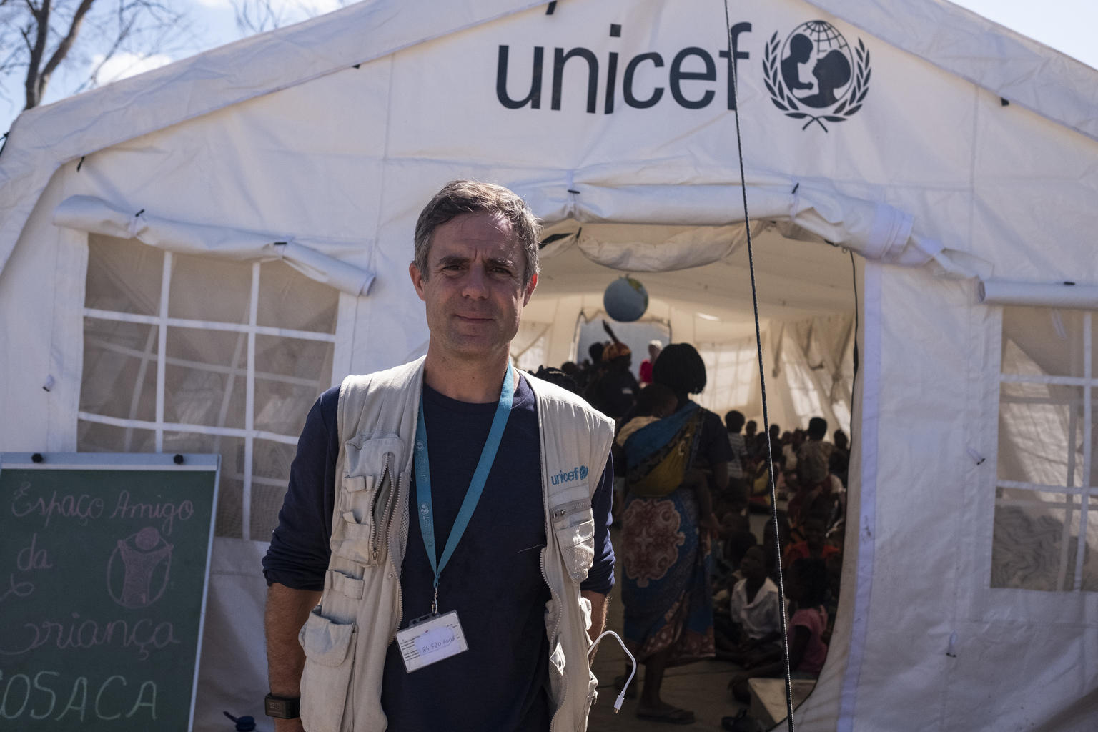
UNICEF Approach to PSEA Programming
© UNICEF/UN0320997/De Wet
#QualitySocialServices

Slide 16
UNICEF Approach to PSEA Programming
1. REPORTING
Safe and accessible reporting for every affected child and adult.
2. SURVIVOR SUPPORT
Quality and accessible SEA survivor assistance.
Every SEA survivor has their case investigated in a prompt, safe and respectful way.
3. ACCOUNTABILITY
#QualitySocialServices

Slide 17
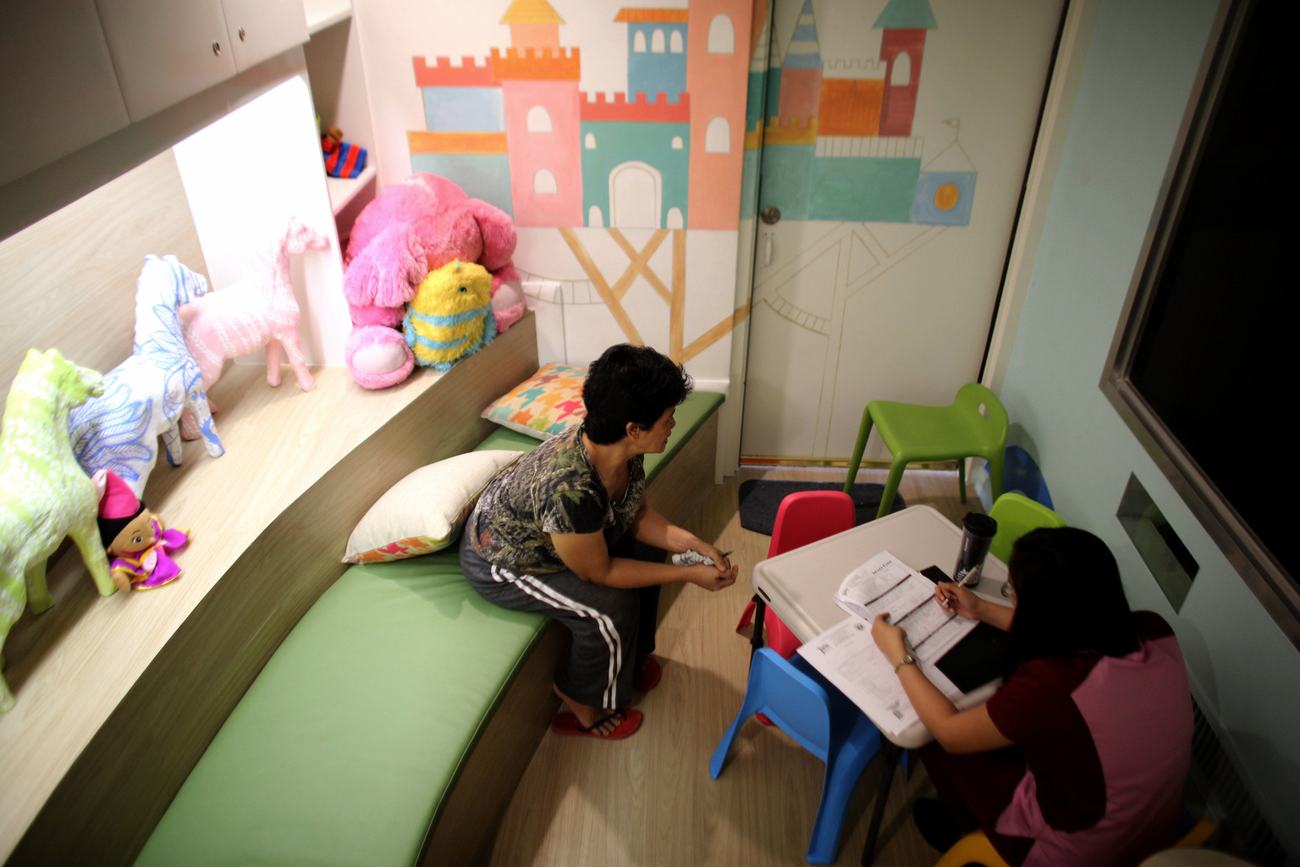
PSEA Programming - Reporting
© UNICEF/UN014994/Estey
#QualitySocialServices

Slide 18
UNICEF Approach to Reporting
Program design criteria:
Safe and confidential
Accessible
Child and gender sensitive
Contextually appropriate
Linked to GBV/CP referral pathways
Scalability across all UNICEF programme sectors
Modalities:
PSEA & Safeguarding package at all sites
Face-to-face PSEA focal points at community level
Community and digital engagement
Rights-based messaging
Integration into child helplines and broader protection mechanisms
Established pathways / options for internal reporting
PSEA focal points in all offices
Training of all staff
Training, capacity development, roll-out of PSEA procedure for Implementing Partners (IPs)
IP PSEA focal points designated and trained
SOPs on SEA complaint referral and integration of GBV referral pathways - signed by all UN Country Team / Humanitarian Coordination Team members
Coordinated messaging to affected populations
Training and capacity development of partners
UNICEF PROGRAMMING
INTERNAL UNICEF REPORTING
INTER-AGENCY PSEA NETWORK
#QualitySocialServices

Slide 19
UNICEF internal reporting process
Instruction for reporting allegations of Sexual Exploitation and Abuse and Concerns of Abuse, with accompanying Guidance Note
Enables reporting on SEA against children and adults
Enables reporting on all “concerns of abuse” against children
Enables reporting directly to the Country Representative or directly to the Office of Internal Audit and Investigations
Outlines who must report what, when and to whom?
Gives step by step for staff in different positions
#QualitySocialServices

Slide 20
Handout
#QualitySocialServices
Notes:
HANDOUT

Slide 21
Implementing Partners
Prescribes ‘zero tolerance’, preventative measures (including training), reporting obligations to UNICEF, and investigation obligations.
Includes assessments of capacity to address SEA or child safeguarding violations (PSEA assessment).
SEA or child safeguarding violations by IP workers, or a failure of IP to properly address such issues, each constitutes grounds for immediate termination of the agreement.
Sub-sub contractors are also required to adhere to the agreement on PSEA and CSP.
#QualitySocialServices

Slide 22
Reporting Channels
Phone (Hotlines / Call centres)
Dedicated email addresses
Digital/online reporting
Suggestion boxes
SMS feedback loops
Complaints / Info Desk at facilities
Verbal complaints to staff
Written complaints to staff
Safe Spaces (e.g. for Children)
Health Centres / Facilities
Informal visits with beneficiaries
Monitoring and evaluation activities
Targeted or randomized 1-to-1 interviews
Focus group discussions
Supply Distribution Sites
Community leaders
#QualitySocialServices

Slide 23
Barriers to reporting
Concern over negative impacts
Confidentiality
Accountability
Lack of knowledge or information
Limited support or assistance
Stigma and shame
Fear of reprisal
Accessibility and availability
#QualitySocialServices

Slide 24
Barriers to reporting
“Maybe I should investigate more first”
"This kind of thing is normal in this culture"
"He seems like such a nice guy, surely he wouldn't do something like this"
“I don’t have any evidence or proof”
“She was probably just being friendly”
“This allegation might not even be true”
"What if I'm wrong, and cause a big fuss for nothing?”
“Nobody has come forward to complain, I should just let it be”
“The victim probably doesn’t even remember it”
#QualitySocialServices

Slide 25
PSEA Programming - Survivor Support
© UNICEF/UNI166347/Noorani
#QualitySocialServices

Slide 26
UN Victim Assistance Protocol
Aim: common standards and norms on providing assistance and support to victims of sexual exploitation and abuse. ​
Scope: all UN System organizations (including UNICEF)​
Operational Framework: informed by Gender Based Violence and Child Protection programming and best practices
UNICEF’s Role: co-chaired development process; global lead on rolling out the Protocol; provider of last resort
UN Protocol on the Provision of Assistance to Victims of SEA
#QualitySocialServices

Slide 27
Guidance & Training
Technical Note on the Implementation of the UN Victim Assistance Protocol
Practical guidance for organizations
Available in 7 languages
Training package in 5 languages
Available on the IASC PSEA website
Webinar recording for NGOs
#QualitySocialServices
https://psea.interagencystandingcommittee.org/

Slide 28
Principles of support
Safety and dignity in their care and treatment, respecting privacy, confidentiality, and “do no harm” principle.
Assistance and support provided in a manner that is victim-centered; age, disability, gender sensitive; culturally appropriate. Consider the “best interests of the child.”
Provision of immediate basic assistance and support begins upon the receipt of the initial complaint.
#QualitySocialServices

Slide 29
Survivor Centred Approach
Respect the survivor’s right to:
Self-determination
Non-discrimination
Choose a course of action or refuse assistance
Privacy and confidentiality
Comprehensive information to help make their own decision
Have a support person
Have reasonable accommodations
Ensure interactions with the survivor:
Treat them with dignity and respect
Prioritize their safety – physical, emotional, and psychological safety
Seek informed consent and/or assent (including for children)
Do No Harm
Best interest of the child
Age, gender, disability sensitive
#QualitySocialServices

Slide 30
Survivor Support Essentials
Basic material assistance
Medical care
Mental Health and Psychosocial support
Safety and security
Legal/justice response
#QualitySocialServices

Slide 31
Specific Considerations
Children with disabilities may have specific needs, such as:
Psychosocial support before, during, and after an investigative interview;
Accompaniment by a case worker, security, support person, family member or friend during the investigation processes;
Logistical support for the victim such as Sign Language interpreter, accessible transportation, accessible spaces, and other accommodations
Providing information on the status of their case in a way and format that they understand, and on a regular basis
#QualitySocialServices

Slide 32
PSEA Programming - Accountability
© UNICEF/UN0645977/Mugisha
#QualitySocialServices

Slide 33
Investigations
Investigating allegations is essential to implementing zero-tolerance and increasing accountability for violations.
UNICEF personnel and related associates should not conduct investigations of SEA allegations unless trained and mandated to do so – no interviewing alleged victims or perpetrators, no gathering evidence.
UNICEF reports are investigated by OIAI: the Office of Internal Audit and Investigations
Partners must inform UNICEF about the conduct of the internal investigation and its outcome to the extent legally possible.
The decision to report to authorities rests solely with the complainant.
IASC Core Principles 5, 6
UN Protocol on Allegations of SEA involving Implementing Partners
#QualitySocialServices

Slide 34
Office of Internal Audit and Investigations
Upon receiving an allegation, OIAI may:​
Instruct the Head of Office and/or someone in the field to make enquiries​.
Send an investigative team​.
Decide to take no further action.​
Refer a case to a national authority.
An OIAI investigation is an administrative fact-finding activity, which means collecting evidence to either support or refute the reported violations.
#QualitySocialServices

Slide 35
Principles of Investigation
Confidentiality
Commitment to safety, health and welfare
Independence
Impartiality
Survivor-centered
Respect for the law
Objectivity
Due process
Timely
Professionalism
Accuracy and documentation
National authorities
#QualitySocialServices

Slide 36
Specific Considerations
Rights of children with disabilities:
Best interests of the child
Child’s right to be heard
Do no harm
Access to information throughout process
Access to justice, including reparations
Accessibility and reasonable accommodations
Non-discrimination
#QualitySocialServices

Slide 37
Case Study
Kinda is 14 years old and at risk of dropping out of school to support her parents and 3 siblings economically.
She recently met John, who works for a development organization. He promised to support her, and her family financially (provide monetary assistance) in exchange for a sexual relationship.
Kinda thinks it is a good way to remain at school, so her family is relieved and is encouraging her to maintain this relationship with John.
John’s colleague Salah has noticed that John keeps leaving the office early, and today she looked out the window at the local school nearby, and saw John with a teenage girl.
Their body language seems inappropriate to Salah, but she is of a different culture to the community they are working in, so she wonders if perhaps she is misinterpreting things.
#QualitySocialServices

Slide 38
Response to Case Study
Kinda
Kinda’s family
Kinda’s teacher
Salah
John
#QualitySocialServices

Slide 39
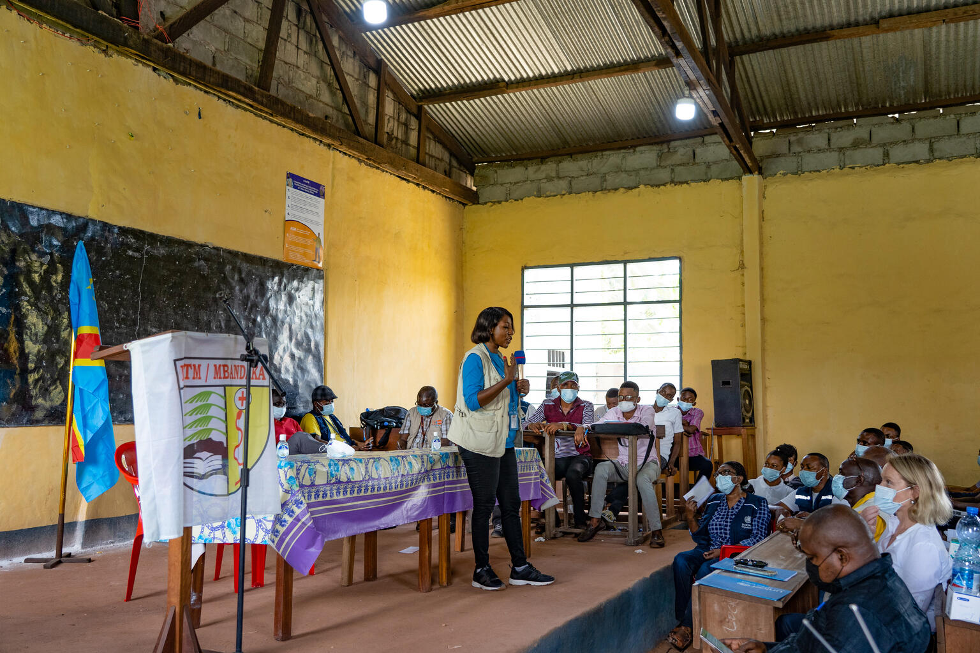
Taking Action
© UNICEF/UN0632861/Mulala
#QualitySocialServices

Slide 40
Suggestion actions
Build capacity inside of your organisation on aspects of PSEA & Safeguarding e.g. Prevention, Safeguarding, Safe Programming, Implementing Partner support
Identify or expand PSEA & Safeguarding Focal Points and Resource persons
Roll out general training and awareness raising on PSEA & Safeguarding
Add PSEA & Safeguarding to regular meeting agendas
Engage with local or regional networks for shared learning
Review existing PSEA & Safeguarding resources
Consider innovations like digital and integrated approaches
#QualitySocialServices

Slide 41
UNICEF’s Digital Innovations
UNICEF DIGITAL PLATFORM
#QualitySocialServices

Slide 42
Resources
https://psea.interagencystandingcommittee.org/
https://conduct.unmissions.org/
https://www.unicef.org/protection/protecting-children-from-sexual-exploitation-and-abuse
https://www.unicef.org/auditandinvestigation/report-wrongdoing
#QualitySocialServices

Slide 43
Summary
Definitions
Frameworks
UNICEF’s Safeguarding Framework
UN PSEA Framework
UNICEF’s PSEA Framework
UNICEF’s PSEA Programming
Reporting
Survivor Support
Accountability
Taking Action
#QualitySocialServices

