Slide 1
Workshop 7: Mentoring as a tool in achieving a change in attitudes in the workplace
Michelle Borg
Occupational Therapist
M.A in Intellectual and Developmental Disabilities, University of Kent
#QualitySocialServices

Slide 2
Outline
Variability in Service Quality
The use Person-Centred Active Support
The importance of Practice Leadership
#QualitySocialServices

Slide 3
Variability in the Quality of Service Given
Positive quality outcomes were reported amongst individuals who moved from institutional to community accommodations.
staff-to-client interaction
improvement in personal development and competencies
increased engagement in meaningful activities
increased community participation
decrease in behaviours of concern (Emerson & Hatton, 1994)
#QualitySocialServices

Slide 4
Variability in the Quality of Service Given
Substantial variability in the quality of community services (Mansell, 2006)
Variation in quality outcomes between supported living and small group homes (Emerson et al., 2001)
Engagement levels in everyday activities were very low (Mansell, Beadle-Brown, & Bigby, 2013)
#QualitySocialServices

Slide 5
Variability in the Quality of Service Given
The lowest engagement levels were reported amongst people with severe disabilities (i.e. one minute each hour)(Emerson et al., 1999)
The way staff support people with intellectual disability and, especially, whether staff are providing good Active Support (Mansell & Beadle-Brown, 2012)
Institutional practices cannot be replicated !
#QualitySocialServices

Slide 6
Factors that hinder the use of active support
“Those with severe ID participate in sensory activities only”
“It’s a hotel”
“Too disabled!”
“Honestly, not all service users can participate”
“Too dangerous to use the kettle”
#QualitySocialServices

Slide 7
Factors that hinder the use of active support
‘Care’ model
‘Charity’ model
‘Support’ model
#QualitySocialServices

Slide 8
Training
Autism and SPELL framework developed by the National Autistic Society
Training on non-abusive psychological and physical intervention to prevent and manage behaviours of concern
Person-Centred Active Support (classroom-based and hands-on training)
It has been indicated in the national strategy (‘Freedom to Live’) that by 2030 the agency will set up a train the practitioner unit (Objective 10).
#QualitySocialServices

Slide 9
What is Person Centred Active Support?
Active Support is in line with international policies, including the UNCRPD which emphasis the importance of enabling people to be active members in their community. Participating in sports, cultural activities, recreation, and choice-making (UNCRPD, 2006).
Using the Active Support approach, staff give the right level of assistance to individuals to enable engagement in meaningful activities and relationships.
#QualitySocialServices

Slide 10
What is Person Centred Active Support?
4 Principles:
Every Moment has potential
Little and often
Graded Assistance to ensure success
Maximising choice and control
(Mansell & Beadle-Brown, 2012)
#QualitySocialServices

Slide 11
Implementation of Active Support
- Observations
- Meetings with front-line management staff
- Discussions with senior management to understand what to observe when they go into a service
- Training to front-line staff (classroom-based and hands-on)
#QualitySocialServices

Slide 12
Observations
- 2-hour observation, before mealtime
Observing how staff are interacting and supporting people
Observe whether people are engaged in meaningful activities and relationships
Talking to people and staff
Talking to the practice leader
Looking at plans, protocols, and paperwork
(Mansell & Beadle-Brown, 2012)
#QualitySocialServices

Slide 13
The Role of the Practice Leader
Practice leader focus in quality of life of service users, and ensure that staff are also doing this.
Practice leaders also involves allocating and organising staff (shift planning), to ensure that staff are delivering support when and how service users need and want it.
Practice leaders work alongside the staff to coach them and inform staff what they are doing well and not so well to provide better support.
#QualitySocialServices

Slide 14
The Role of the Practice Leader
Providing regular one-to-one supervision to review and improve the quality of support provided.
Holding regular team meetings to review how well the team is enabling individuals to engage in meaningful activities and relationships (Mansell & Beadle-Brown, 2012; Mansell et al., 2004).
#QualitySocialServices

Slide 15
The Role of Senior Managers
Provide the right message and motivation to the staff to empower service users to engage in daily activities
Staff give more importance to activities with the most immediately visible consequences (Mansell & Elliott, 2001)
Coherent team values and actions (Bigby et al., 2019)
#QualitySocialServices

Slide 16
Training in Active Support
Both classroom and hands-on active support training is delivered
In situ training helps to observe, give feedback, and model good practice to improve staff skills.
Training is ongoing and tailored to the needs of service users and staff values and beliefs, linked with practical examples.
#QualitySocialServices

Slide 17
Factors that facilitate the use of active support
- Managers providing the necessary skills and motivating the staff to use AS all the time
(Bigby & Beadle-Brown, 2016)
- Knowledge and understanding of the importance of engagement
- Good teamwork
(Fyffe, McCubbery, & Reid, 2008)
#QualitySocialServices

Slide 18
Factors that facilitate the use of active support
- Practice Leadership
Training in active support
Senior managers understand and are committed to practise AS
The size of the whole organization and setting
(Flynn et al., 2018)
Accommodation settings hosting more than six individuals
(Bigby, Bould, Iacono, Kavanagh, & Beadle‐Brown, 2019)
#QualitySocialServices

Slide 19
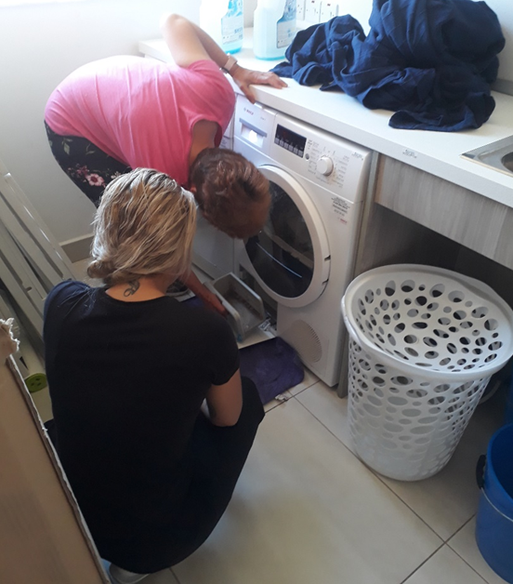
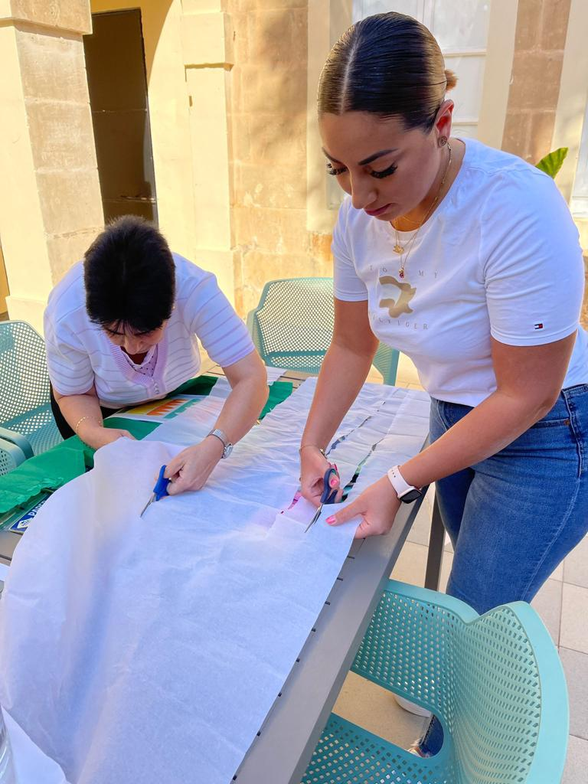
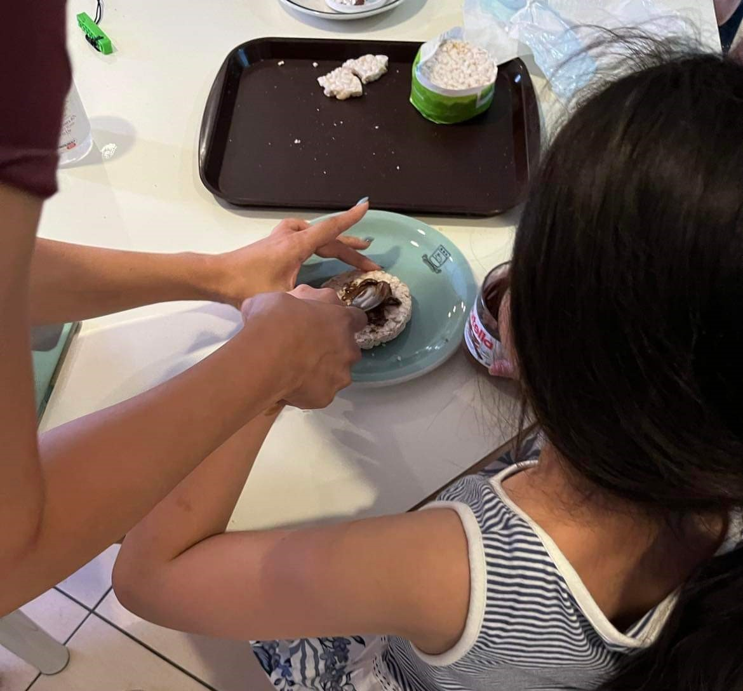
Active Support- Types of Assistance
Verbal prompts
Showing
Physical Assistance
#QualitySocialServices

Slide 20
References
Beadle-Brown, J., Bigby, C., & Bould, E. (2015). Observing practice leadership in intellectual and developmental disability services. Journal of Intellectual Disability Research, 59, 1081–1093.
Beadle-Brown, J., Mansell, J., Ashman, B., Ockenden, J., Iles, R., & Whelton, B. (2014). Practice leadership and active support in residential services for people with intellectual disabilities: An exploratory study. Journal of Intellectual Disability Research, 58, 838–850.
Bigby, C, & Beadle-Brown, J. (2016). Culture in better group homes for people with severe and profound intellectual disability. American Journal on Intellectual and Developmental Disabilities, 54, 316–331.
#QualitySocialServices

Slide 21
References
Bigby, C., Bould, E., Iacono, T., Kavanagh, S., & Beadle‐Brown, J. (2019). Factors that predict good active support in services for people with intellectual disabilities: A multilevel model. Journal of Applied Research in Intellectual Disabilities, 33(3), 334–344.
Bigby, C., Clement, T., Mansell, J., & Beadle‐Brown, J. (2009). ‘It’s pretty hard with our ones, they can’t talk, the more able bodied can participate’: Staff attitudes about the applicability of disability policies to people with severe and profound intellectual disabilities. Journal of Intellectual Disability Research, 53(4), 363–376.
Emerson, E. & Hatton, C. (1994). Moving Out: Relocation from Hospital to Community. London: Her Majesty's Stationery Office.
Person-centred active support: Learner’s workbook- Pavillion 2017
#QualitySocialServices

Slide 22
References
Emerson, E., Robertson, J., Gregory, N., Hatton, C., Kessissoglou, S., Hallam, A., Knapp, M., Järbrink, K., & Netten, A. (1999). Quality and costs of residential supports for people with learning disabilities: An observational study of supports provided to people with severe and complex learning disabilities in residential campuses and dispersed housing schemes. Manchester: Hester Adrian Research Centre.
Emerson, E., Robertson, J., Gregory, N., Hatton, C., Kessissoglou, S., Hallam, A., Noonan Walsh, P. (2001). Quality and costs of supported living residences and group homes in the United Kingdom. American Journal on Mental Retardation, 106(5), 401–415.
Flynn, S., Totsika, V., Hastings, R. P., Hood, K., Toogood, S., & Felce, D. (2018). Effectiveness of Active Support for adults with intellectual disability in residential settings: Systematic review and meta‐analysis. Journal of Applied Research in Intellectual Disabilities, 31(6), 983–998.
#QualitySocialServices

Slide 23
References
Freedom to Live. Government of Malta, Ministry for Inclusion and Social Wellbeing. Malta’s 2021-2030 National Strategy on the Rights of Disabled Persons (Consultation Document). Retrieved October 10, 2022, from https://meae.gov.mt/en/Public_Consultations/MISW/PublishingImages/Pages/Consultations/Maltas20212030NationalStrategyontheRightsofDisabledPersons/Proposed%20National%20Disability%20Strategy%20%E2%80%93%20Standard%20English%20version.pdf
Fyffe, C., McCubbery, J., & Reid, K. J. (2008). Initial investigation of organisational factors associated with the implementation of active support. Journal of Intellectual and Developmental Disability, 33(3), 239–246.
Mansell, J. (2006). Deinstitutionalisation and community living: progress, problems and priorities. Journal of Intellectual and Developmental Disability, 31(2), 65–76.
#QualitySocialServices

Slide 24
References
Mansell, J., & Beadle-Brown, J. (2012). Active support: Enabling and empowering people with intellectual disabilities. London, UK: Kingsley.
Mansell, J., Beadle-Brown, J., & Bigby, C. (2013). Implementation of active support in Victoria, Australia: An exploratory study. Journal of Intellectual and Developmental Disability, 38(1), 48–58.
Mansell, J., & Elliott, T. (2001). Staff members’ prediction of consequences for their work in residential settings. American Journal on Intellectual and Developmental Disabilities, 106(5), 434–447.
UN General Assembly (2006). United Nations Convention on the Rights of Persons with Disability. Retrieved October 10, 2022, from https:// www.un.org/disabilities/documents/convention/convoptprot-e.pdf
#QualitySocialServices

